Slide 1
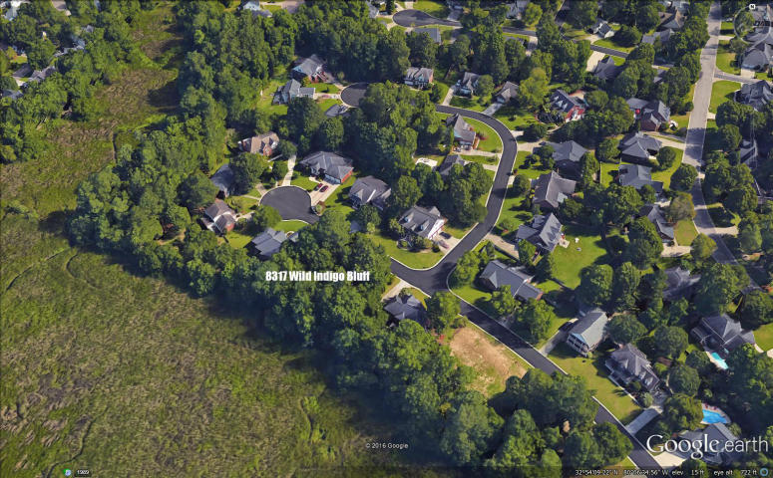
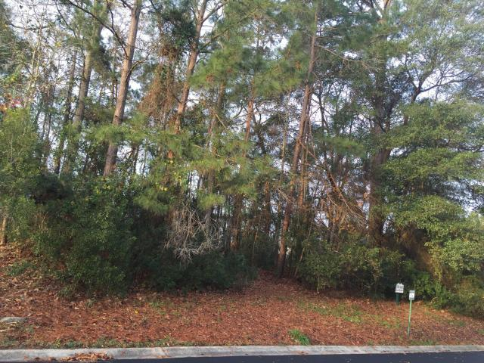
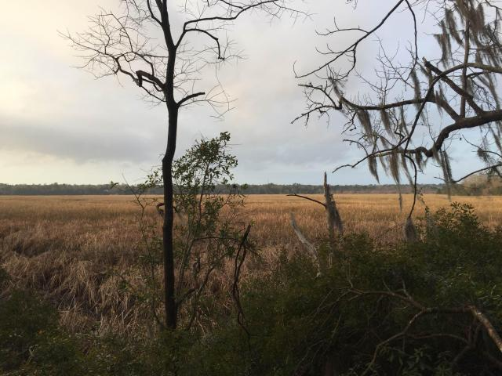
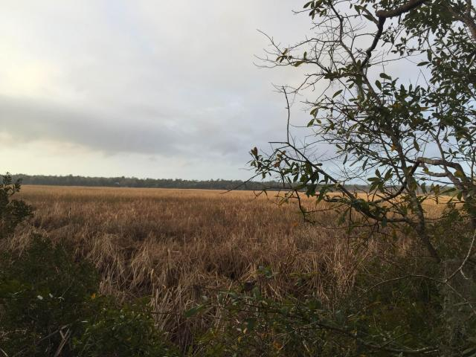

8317 Wild Indigo Indigo Fields - North Charleston MLS# 16002793 - $96,600
Open House Lunch ~ Friday, Oct 3 from 11 - 1
Handyman Special… Bring your hard hats!
Marshfront! Price Reduced!
Looking for a sweet marsh front lot close to everything? This is it!
A nature lovers paradise. Beautiful views of the marsh...you can smell the salt air and enjoy a private retreat and your own paradise. This is a high and dry lot in an upscale section of Indigo Fields. Close to Bosch, Boeing, shopping and in award winning Dorchester 2 school district.
Hillary Jones
843-709-4666 hillaryjones67@gmail.com www.agentownedrealty.com
AgentOwned Realty | 1800 Old Trolley Rd | Summerville, SC 29485

