Slide 1
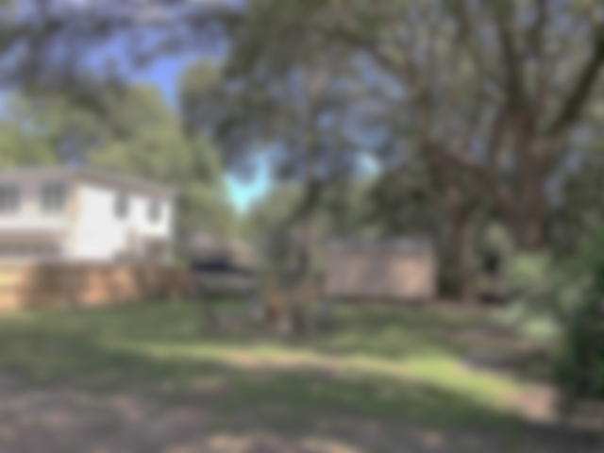
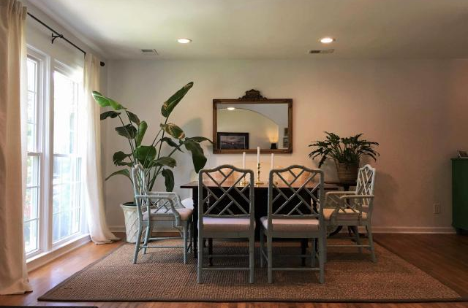
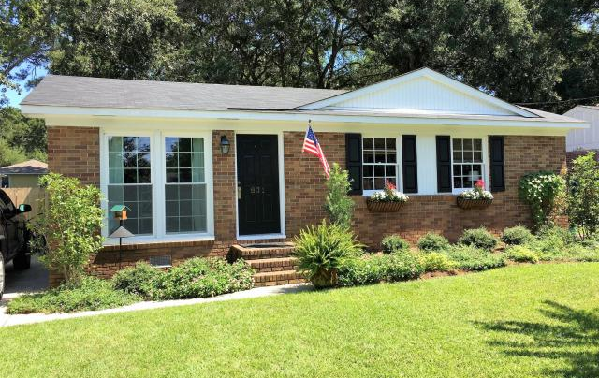
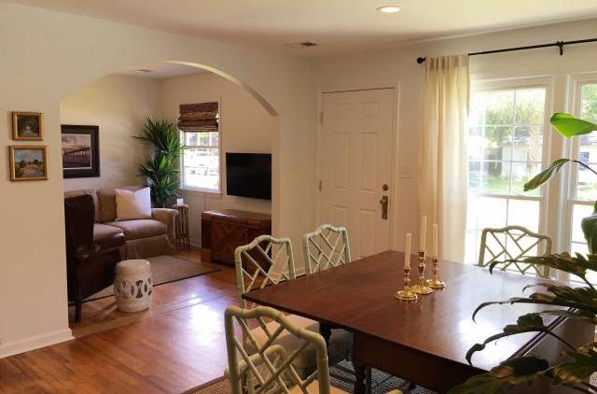

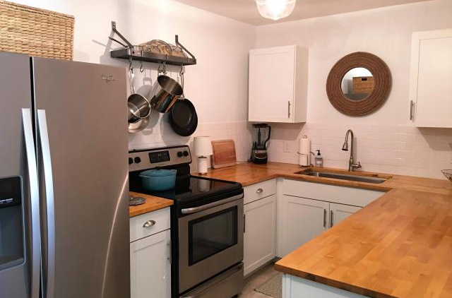
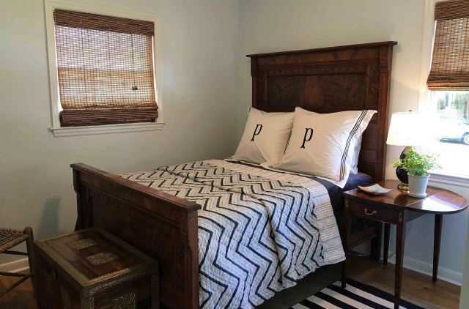
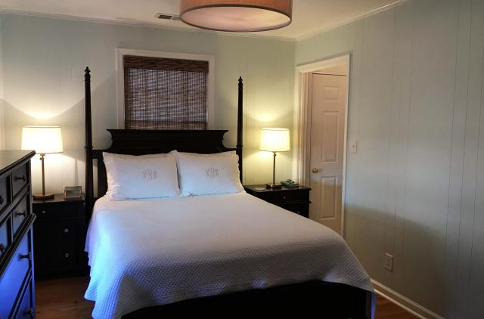
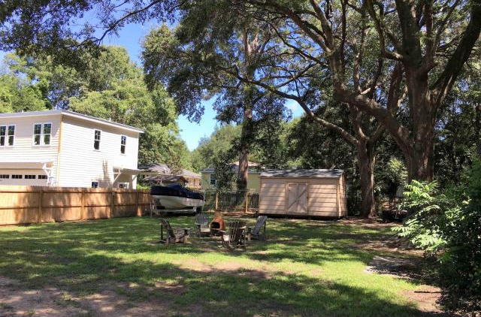

Price Reduced!
831 Armsway Street
Mount Pleasant, SC 29464
MLS# 17022048 ~ $439,000
3 Bedrooms ~ 2 Bathrooms
Charming three bedroom, two bath home located off desirable Coleman Boulevard. This home offers hardwood floors, smooth ceilings, new HVAC and duct work, great natural light with updated lighting and bamboo shades, and fresh neutral paint throughout. The kitchen features: brand new stainless steel appliances, white shaker cabinets, butcher block counter tops, and a farm sink. The yard has been landscaped and has mature oak trees with plenty of room to expand if needed. There is a new 16'x10' tool shed. The backyard is large and perfect for entertaining and cookouts. The location is a short bike ride to Sullivan's and Shem Creek, walk to the farmers market, and a few minutes to downtown!
Caroline Long Parnell
843-478-8188
caroline.parnell@agentownedrealty.com
AgentOwned Charleston Group • 902 Savannah Hwy • Charleston, SC 29407

