Slide 1
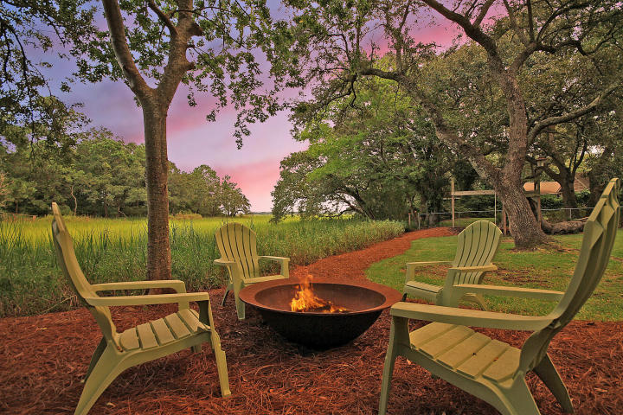
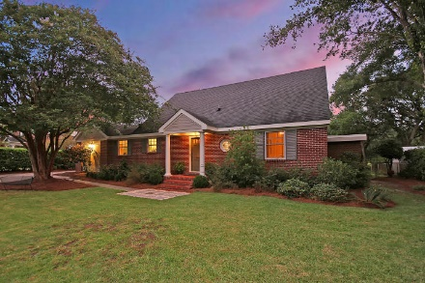
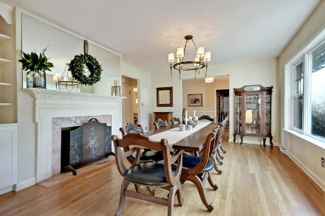
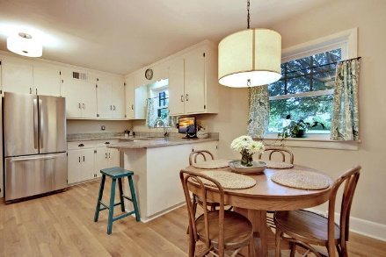
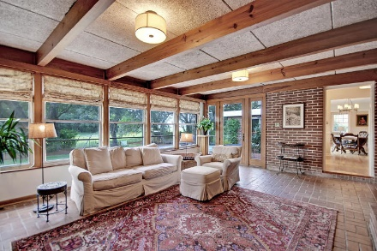
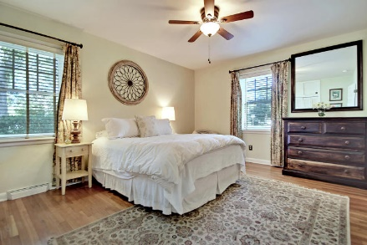
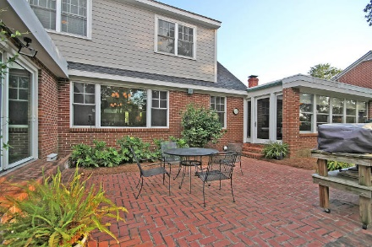
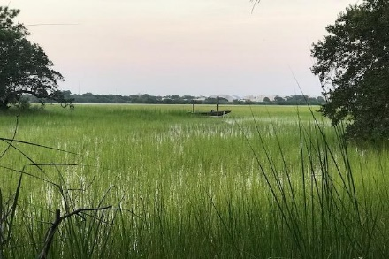
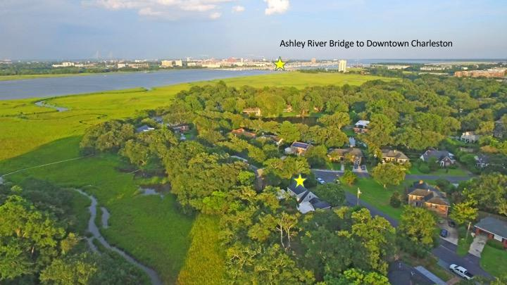
Marshfront Oasis Across The River From Downtown
Price Reduced!
831 Saint Dennis Drive
Moreland ~ Charleston, SC 29407 ~ MLS# 17027660 ~ $674,999
This lovely brick home near historic downtown Charleston is located on marsh/tidal creek and has loads of character that will charm you the minute you walk in the door. Views command your attention from a wall of windows in the spacious living and dining areas. Step outside to a huge patio perfect for entertaining or relax by the fire pit with views of The Citadel across the Ashley River. Launch your kayak at high tide from the back yard and paddle through the creek to the river. You will appreciate the care that has been given to upgrading this home while keeping its original charm. The spacious family room features custom built ins, wood beamed ceilings and expansive windows to enjoy the view. The dining room features a stately mantle, and dining with a view.
Master suite, a flex room, and additional bedroom/office are on the first floor. Eat in kitchen is updated and spacious. Be downtown in minutes or walk to popular Avondale. Near St. Andrews Math and Science Elementary, Porter Gaud School, Blessed Sacrament School, and The Cooper School.
Additional features include:
Hardwood oak floors
Stainless steel appliances
Granite countertops
Energy efficient windows and patio doors
New duct work
Encapsulated crawlspace
Rinnai tank-less gas hot water heater
New coating on flat roofs and new low maintenance cement siding and trim
Enlarged electrical panel
Book your showing today!
Lisa Quick lisa@mattoneillteam.com 843-452-6688

