Slide 1
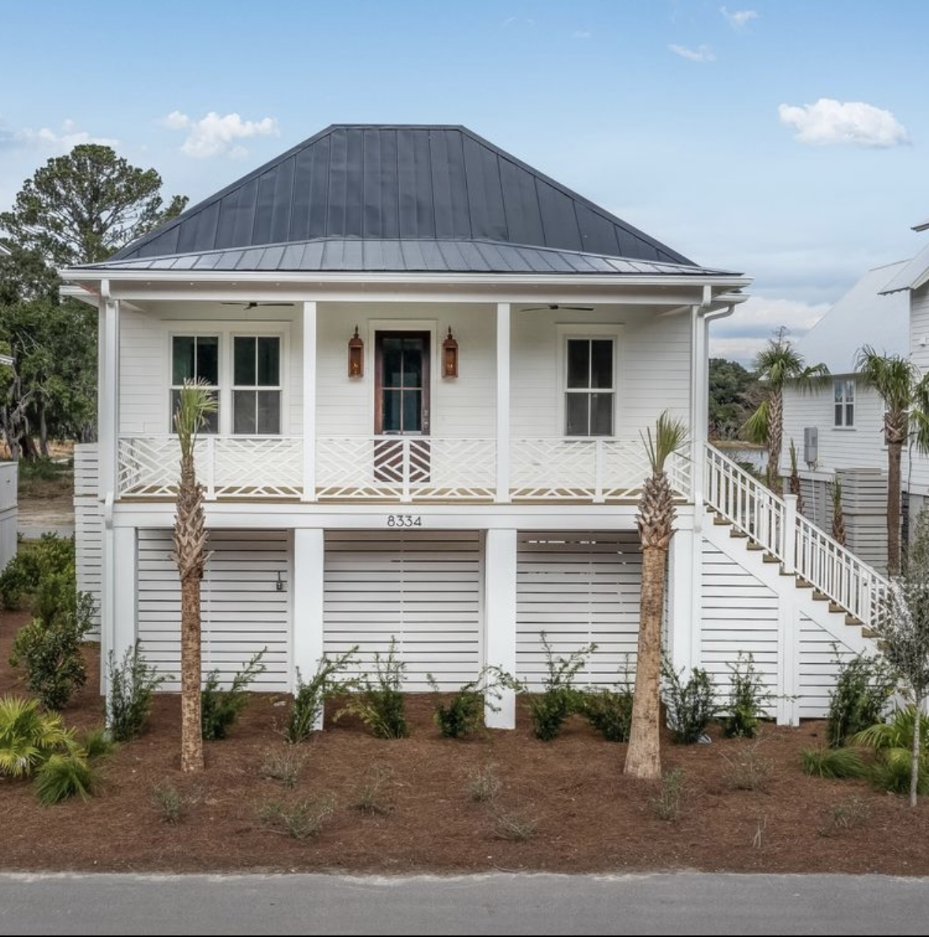
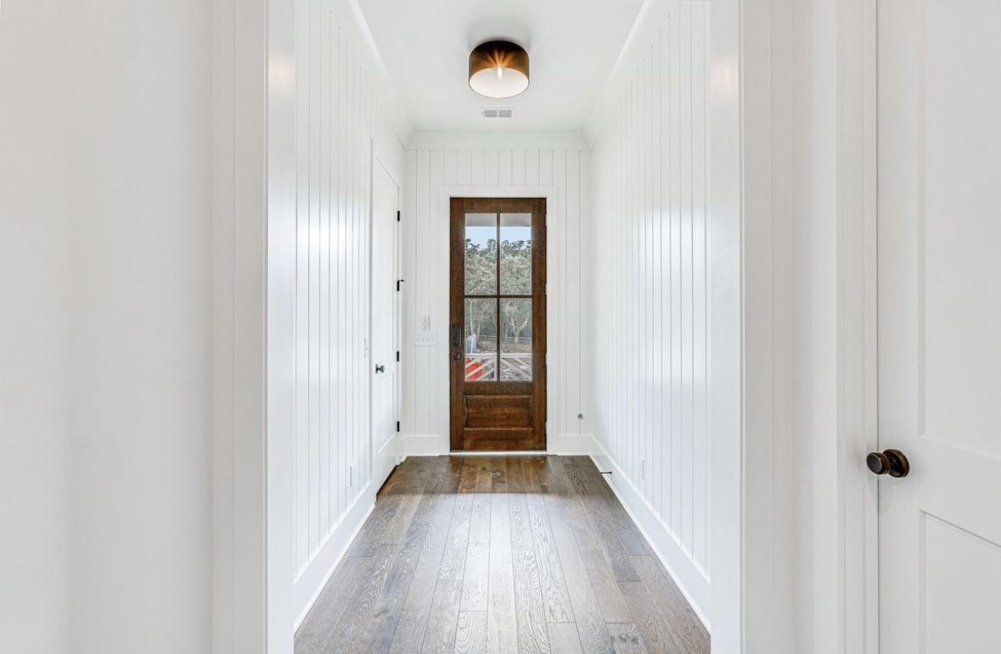
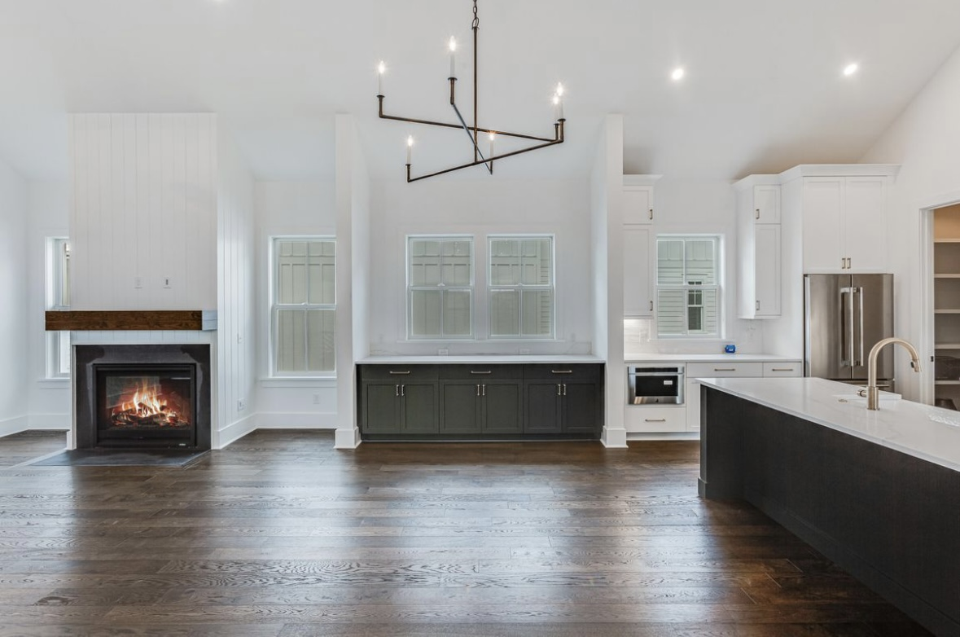
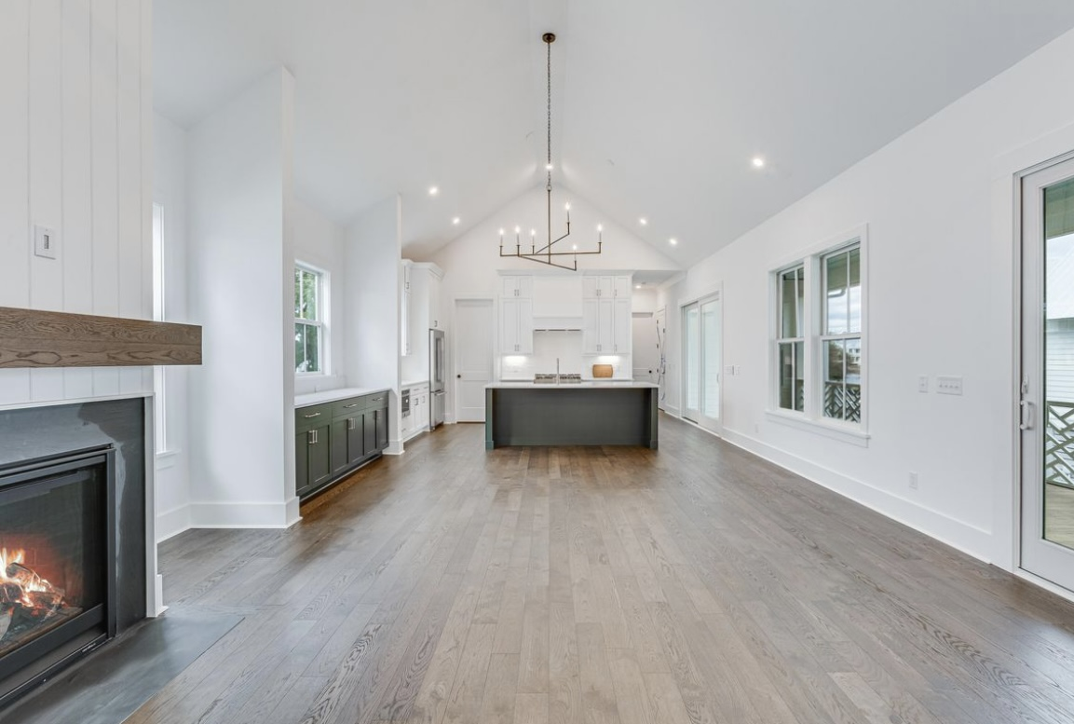
TALK ABOUT A RARE OPPORTUNITY!
Brand New Kiawah River Home w/ an Elevator
8334 Jack Island Drive
Kiawah River | Johns Island, SC 29455
MLS# 24000255 | $1,430,000
Here is a new construction home with all of the bells and whistles plus an elevator that was specifically built for the owner but an unfortunate family situation will prevent her from occupying the home * so, here it is * 3 bedroom, 3 1/2 bath, 2264 asqft home with the Navigator floor plan where the master suite is on one side of the home and the bedrooms 2 & 3 are on the other side with open space in between plus 694 sqft of decks and porches * you can choose to enter the home via the front stairs or pull into the 2 car garage and access the elevator which will probably be your choice especially when returning from those shopping trips * as you enter the home you will walk down a hallway that has plank siding and opens onto the large living space that offers a gas burning fireplace, lots of windows and doors for natural light * you will not be "lost in the kitchen" and away from guests with this floor plan * spacious kitchen with center island/ breakfast bar and a farmhouse sink * all of the appliances are stainless steel and upgraded * Jenn-Aire 36 inch, dual fuel range, dishwasher, built in microwave * lots of storage in the upgraded cabinets and granite countertops * the master bedroom is at one entire end of the home with walk-in closet, large bath with free standing tub and shower * the secondary bedrooms are on the other side of the home and are generous in size with their own ensuite bath * the powder room with pedestal is off the great room * floor coverings are hardwood and tile * 12 foot ceilings * upgraded fixtures and cabinet pulls throughout * the home has porches on the front and the rear of the home * there is a 2 car garage with door openers and lots of additional storage * one of few one-story floor plans, and the added convenience of an elevator this home is truly meant for easy living * Built with outdoor living in mind, the Navigator is coastal elegance at its finest * The wide-open living space is perfect for entertaining and provides the perfect seamless home for indoor/outdoor living * Kiawah River prides itself on open-space preservation, green building principles and responsible management practices to create a community that is truly respectful of this magnificent natural setting, the natural systems that shape its landscape, and to preserving it for future generations * PLEASE be sure to look under the documents tab for a detailed list of all of the features and upgrades in this wonderful home
Kara Delpino
(843) 860-4166
kara@hbrtwn.com
www.karadelpino.com
Harbourtowne Real Estate
672 Marina Drive, Ste 110
Daniel Island, SC 29492

