Slide 1
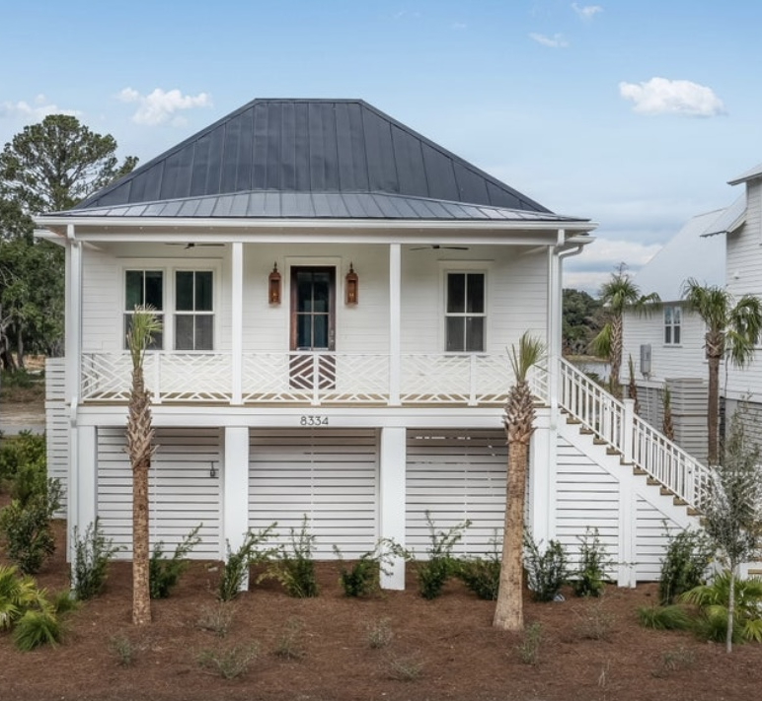
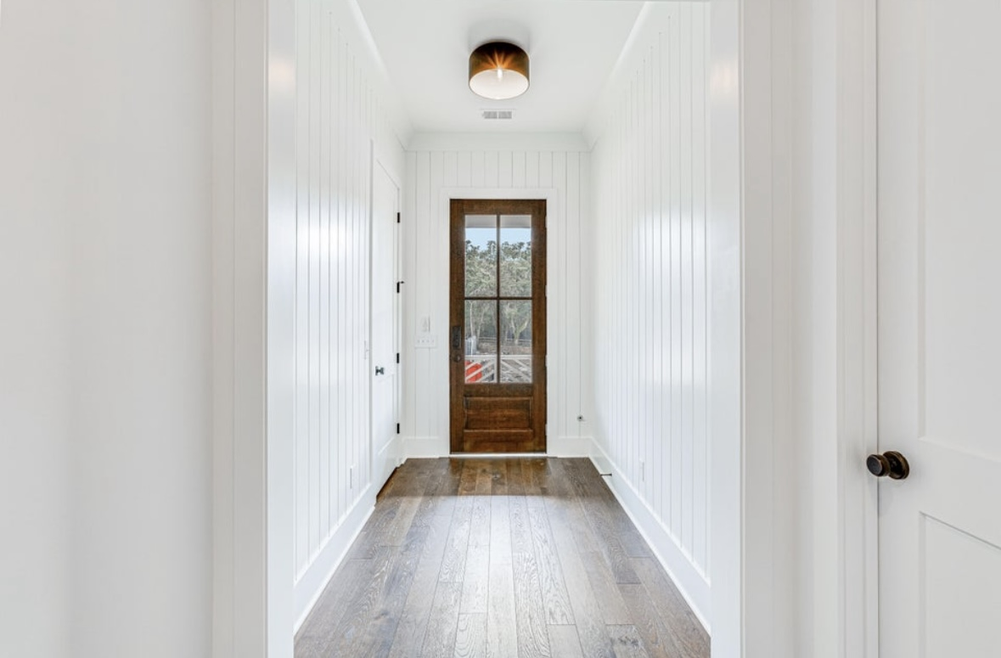
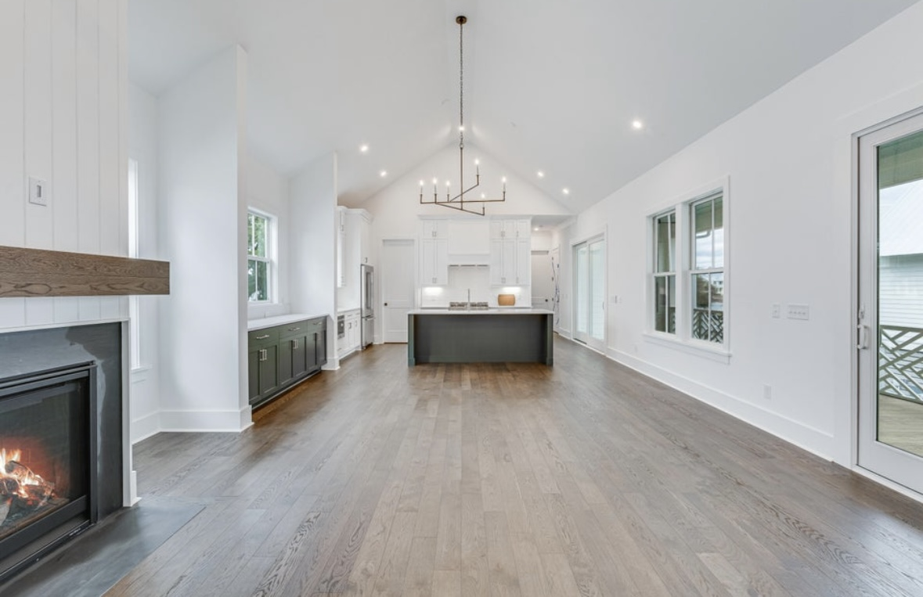
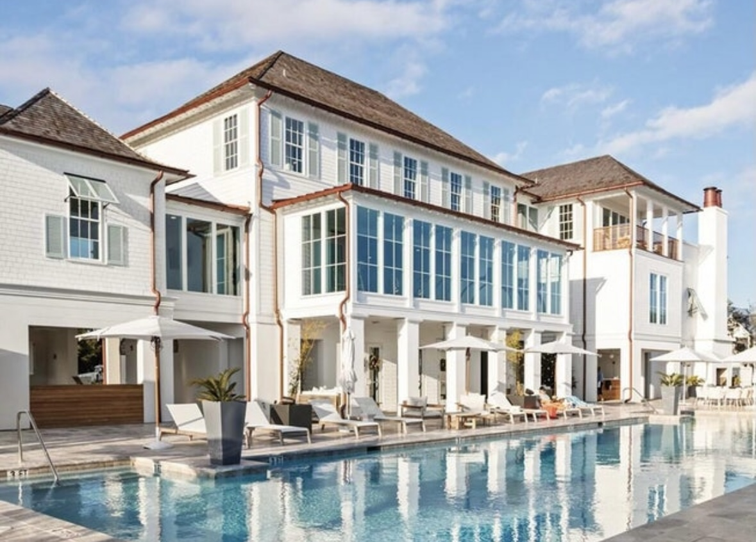
BOM DUE TO NO-FAULT OF THE SELLER
HUGE PRICE REDUCTION IN STUNNING KIAWAH RIVER
ONE FLOOR WITH ELEVATOR, AND ALL DESIGNER DETAILS!
8334 Jack Island Drive
Kiawah River | Johns Island, SC 29455
MLS# 24000255 | $1,399,000
BOM buyer decided home too small * here is a new construction home with all of the bells and whistles plus an elevator that was specifically built for the owner *lowest priced home in KR *Gorgeous details and finishes * 3 bedroom, 3 1/2 bath, 2264sqft home with the Navigator floor plan where the master suite is on one side of the home and the bedrooms 2 & 3 are on the other side with open space in between plus 694 sqft of decks and porches * you can choose to enter the home via the front stairs or pull into the 2 car garage and access the elevator which will probably be your choice especially when returning from those shopping trips * as you enter the home you will walk down a hallway that has plank siding and opens onto the large living space that offers a gas burning fireplace, lots of windows and doors for natural light * you will not be "lost in the kitchen" and away from guests with this floor plan * spacious kitchen with center island/ breakfast bar and a farmhouse sink * all of the appliances are stainless steel and upgraded * Jenn-Aire 36 inch, dual fuel range, dishwasher, built in microwave * lots of storage in the upgraded cabinets and granite countertops * the master bedroom is at one entire end of the home with walk-in closet, large bath with free standing tub and shower * the secondary bedrooms are on the other side of the home and are generous in size with their own ensuite bath * the powder room with pedestal is off the great room * floor coverings are hardwood and tile * 12 foot ceilings * upgraded fixtures and cabinet pulls throughout * the home has porches on the front and the rear of the home * there is a 2 car garage with door openers and lots of additional storage * one of few one-story floor plans, and the added convenience of an elevator this home is truly meant for easy living * Built with outdoor living in mind, the Navigator is coastal elegance at its finest * The wide-open living space is perfect for entertaining and provides the perfect seamless home for indoor/outdoor living * Kiawah River prides itself on open-space preservation, green building principles and responsible management practices to create a community that is truly respectful of this magnificent natural setting, the natural systems that shape its landscape, and to preserving it for future generations * PLEASE be sure to look under the documents tab for a detailed list of all of the features and upgrades in this wonderful home
Kara Delpino
(843) 860-4166
kara@hbrtwn.com
www.karadelpino.com
Harbourtowne Real Estate
672 Marina Drive, Ste 110
Daniel Island, SC 29492

