Slide 1
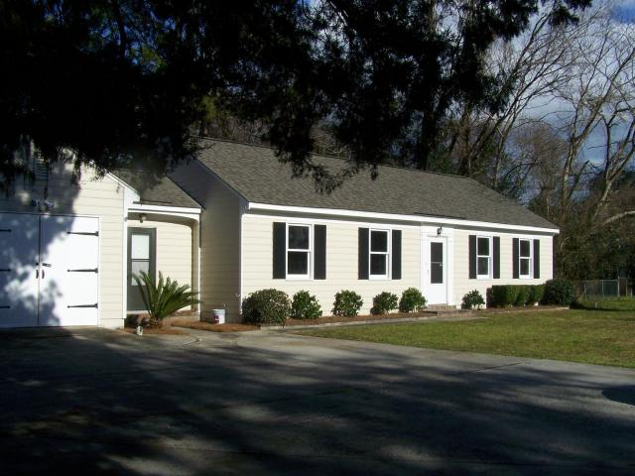
Price Reduced $6,000
+
New Landscaping
834 Dills Bluff Road
Lawton Bluff
Charleston, SC 29412
MLS# 15030332
Now $223,900
Freshly painted inside and out.
New floor in kitchen, large screened patio at rear of house.
Ceiling fans in master bedroom and other bedroom.
Fenced rear yard with nice trees.
Good starter home for single or young family.
Easy access to James Island Connector.
Thomas F Hartnett
Hartnett Realty Co., Inc. | 134 Meeting St, Chas, SC 29401
tfh@hartnettrealty.com | (843) 723-7222 Office | (843) 729-7222 Mobile

