Slide 1
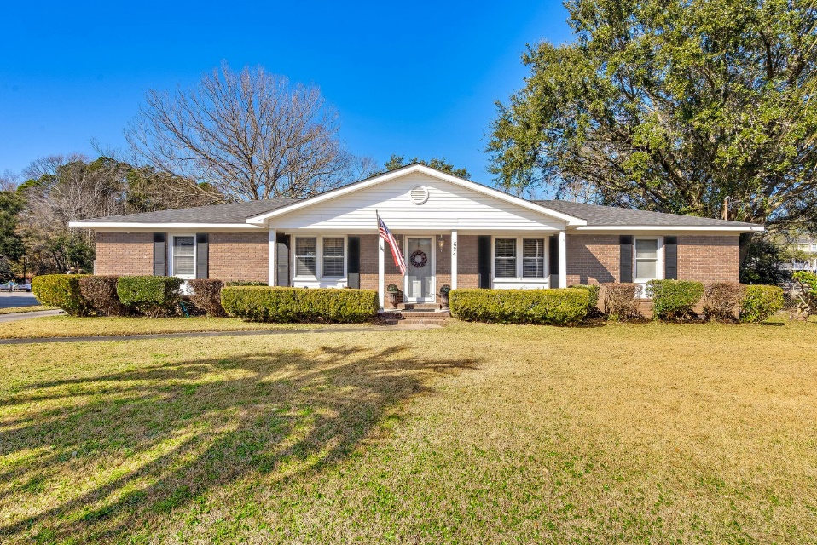
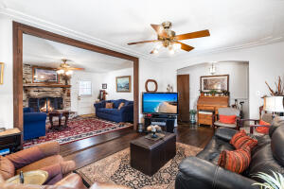
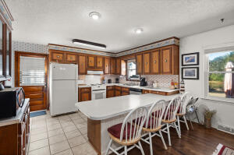
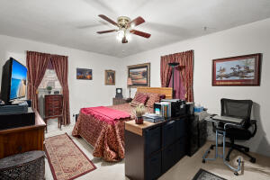
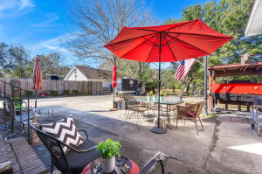
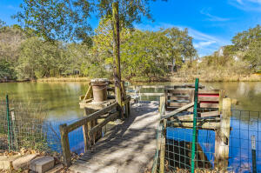



Brick Ranch in Stiles Point with Water Access
834 Waterloo Street
Stiles Point
Charleston, SC 29412
MLS# 23001288
$650,000
4 Bed | 2½ Bath | 1,956sf
Welcome home to 834 Waterloo Street! This wonderful 4 bedroom and 2.5 bathroom brick ranch is a MUST HAVE! Situated in a quiet, well-kept neighborhood with NO HOA FEE, this home sits on 0.43 acres with water access, a fantastic patio area, and awnings/shed - this home is TRULY ''Lowcountry Living''. Upon entering, you'll see that the homeowners of 40+ years have meticulously taken care of this wonderful home. You'll notice the well-kept wood flooring in the foyer which leads into the living area and kitchen. The kitchen boasts plenty of cabinet space and countertop room with an island that functions as a breakfast/eating area. If you love to cook and be in the kitchen, it's truly a fantastic layout. The bedrooms are located on the opposite side of the living area where you have 3 great size guest bedrooms along with the owner's suite. The sellers did upgrade the bathrooms to a modern look, which creates a wonderful balance in the home. What truly makes this property is the backyard! You'll notice the calm, peaceful water views with your very own access, HUGE yard, patio, shed, workshop WITH half bathroom, awnings for outdoor cooking or entertaining, the list GOES ON. Imagine fishing on a summer day in your own backyard or entertaining with THOSE views? Just 10 minutes to downtown Charleston, 20 minutes to Folly Beach and only 15 minutes to I-26 PLUS plenty of restaurants, grocery stores, gas stations, etc all within 5 - 10 minutes! Don't miss the opportunity to get a one-of-a-kind home like this. PROPERTY SOLD ''AS-IS'', Sellers WILL NOT make any repairs.
Nick Mazzilli
(843) 640-5575
nick@nickmcharleston.com
nickmavencharleston.com
Maven Realty
2180 McMillan Ave
#71672
Charleston, SC 29405

