Slide 1
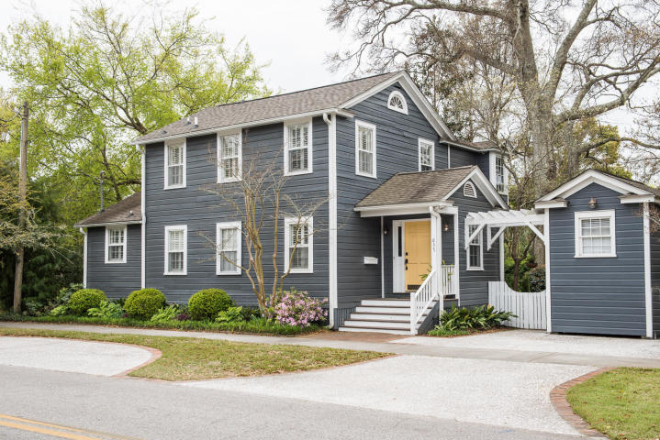
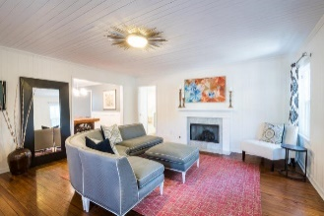
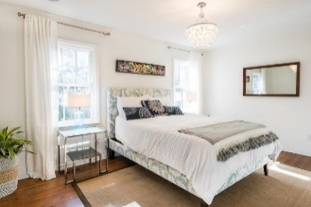
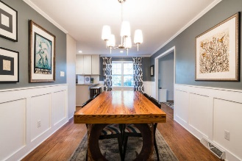
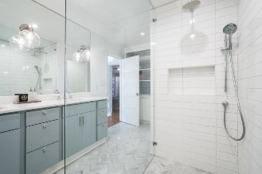
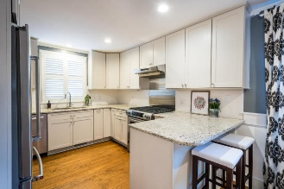
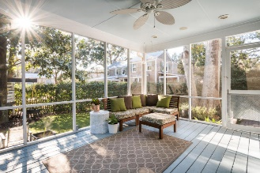
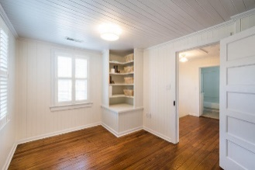
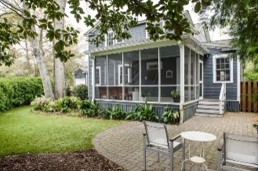


835 Pitt Street Old Village ~ Mount Pleasant, SC 29464 ~ MLS# 18003410 ~ $999,000
Price Reduced
in the Old Village!
Price Reduced
Well Below Appraisal
Open House Sunday 1-3
This historic home, located in the heart of the idyllic Old Village, has undergone spacious additions and impeccable renovations! Nothing has been spared and it is in move-in condition at a compelling price!!
The open floor-plan, gleaming heart pine floors, white V groove wooden walls, downstairs master bedroom and bath with a huge zero entry marble and glass shower, large screened porch overlooking a large patio and a very private and low maintenance back yard, three separate gathering areas, all adding up to be the perfect blend of unique charm and cutting-edge design.
Of note, the location of this home is in close proximity for walking kids to school, walking to the gym, tennis courts, the trendy shops and restaurants, and the iconic Old Bridge!
Mac Jenkinson
M (843) 224-0210
mac@carolinaone.com
Beth Moore
M (843) 532-4892
bmoore@carolinaone.com
Jenkinson & Moore, LLC | Carolina One Real Estate | 1503 Palm Blvd | Isle of Palms, SC 29451-2280

