Slide 1
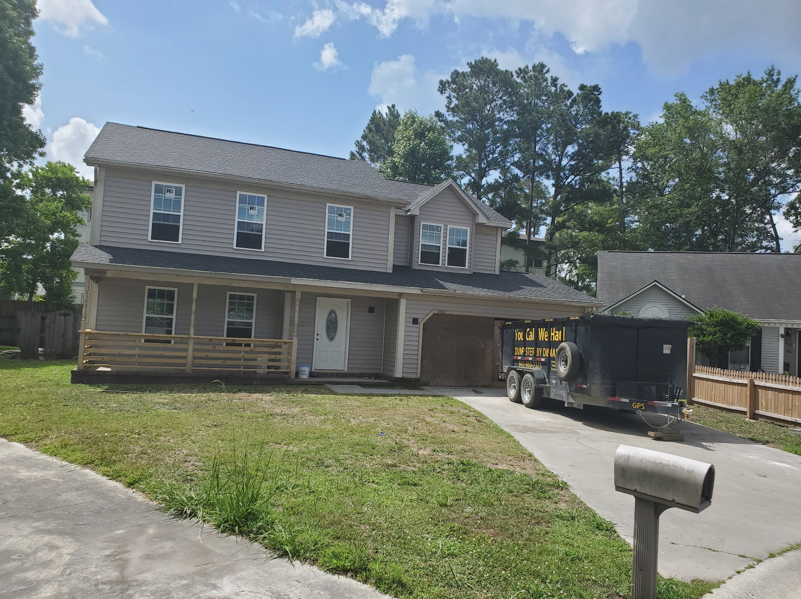
Coming Soon!!
8363 Coventry Court
Windsor Hill :: North Charleston
For Sale By Owner $350,000
Buyer’s Agent Protected
4 Bedroom | 2½ Bath
Over 1,800 Square Feet
For more information or to schedule a showing, contact
Rodney :: 843-860-7325 :: info@lockwoodoutdoor.com

