Slide 1
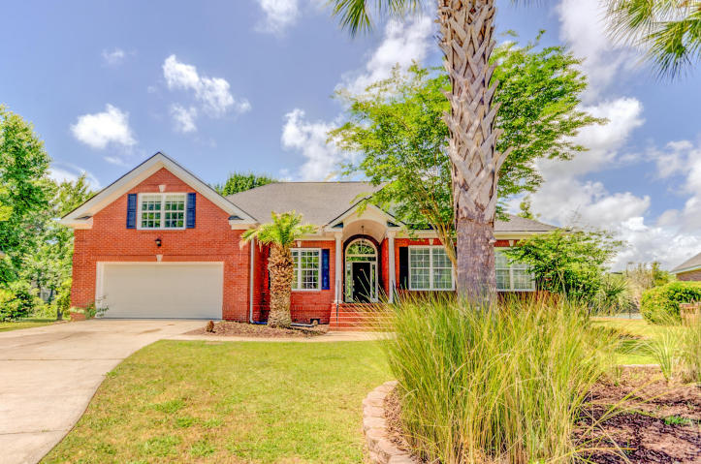
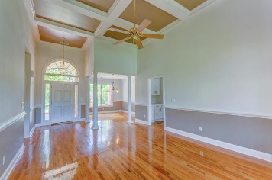
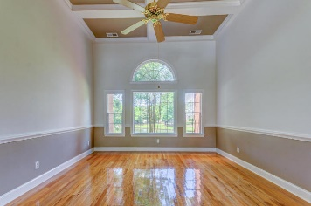
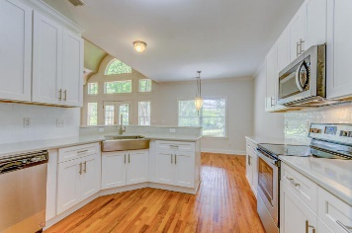
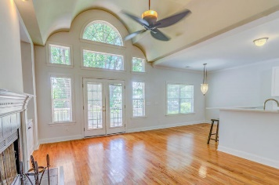
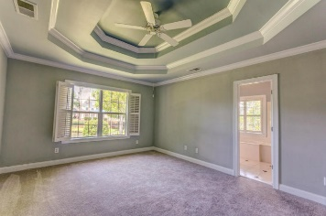
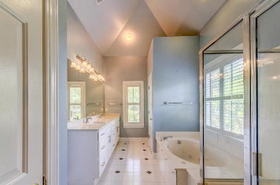
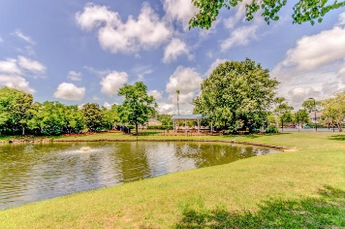
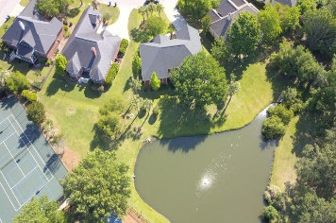
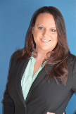

836 High Battery Circle
Belle Hall ~ Mt Pleasant
MLS# 18013085 ~ $535,000
Open House Lunch ~ Friday, Oct 3 from 11 - 1
Handyman Special… Bring your hard hats!
REDUCED $15,000
SELLER IS MOTIVATED!
This stunning brick home has the best lot in the neighborhood and lots of brand new upgrades and extras! Your private deck is the perfect place to enjoy a morning cup of coffee and listen to the serenity of the water from the pond. Just beyond the pond is the neighborhood pool, clubhouse and tennis courts. Complete with a formal sitting, dining AND family room, this home has 3 bedrooms and a FROG that acts as a 4th bedroom. You have plenty of room in this house! The master bath has double sinks, garden tub and walk-in closet. The kitchen has ALL NEW cabinets with the easy glide drawers and doors, appliances and counter tops! New roof, new carpet in all bedrooms, hardwood floors throughout home, and lots of natural light make this home move-in ready!
Brooke Madsen
(843) 834-1241
brookemadsen.realtor@gmail.com | www.brookemadsen.realtor
HomeGate Real Estate | 4000 S Faber Place Dr Ste 300 | Charleston, SC 29405

