Slide 1
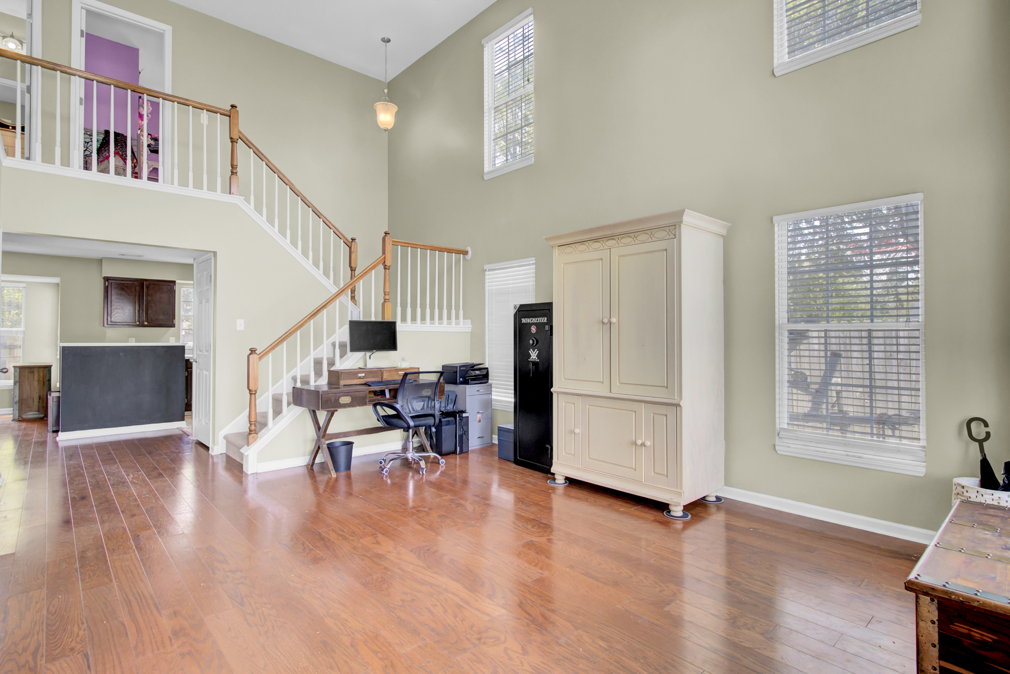
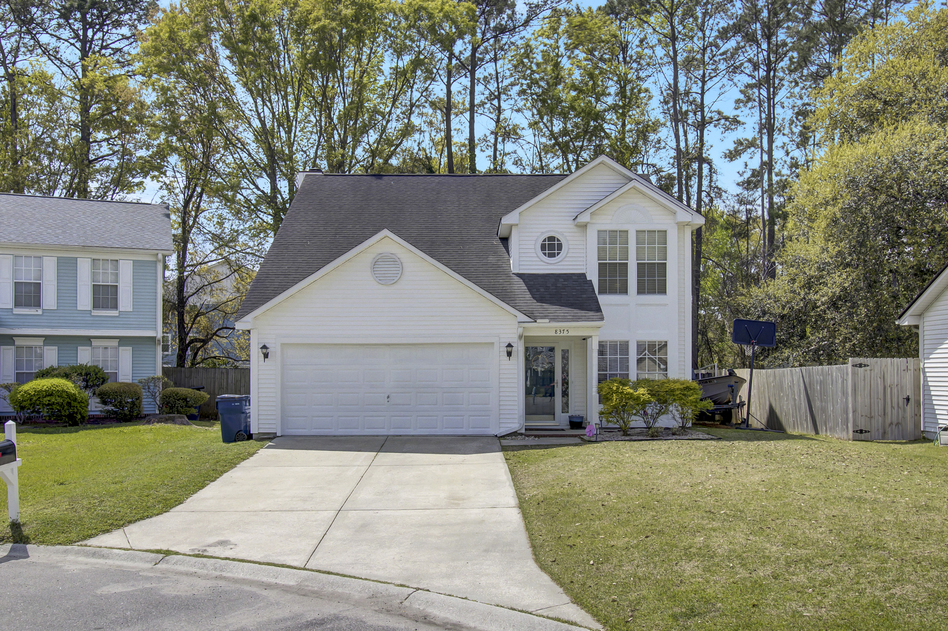
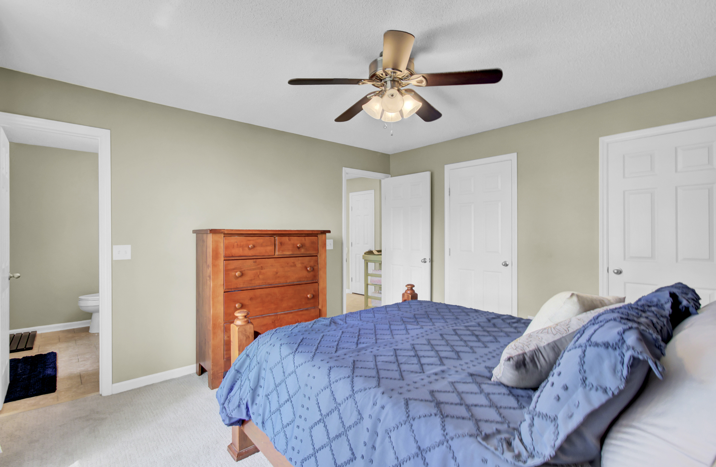
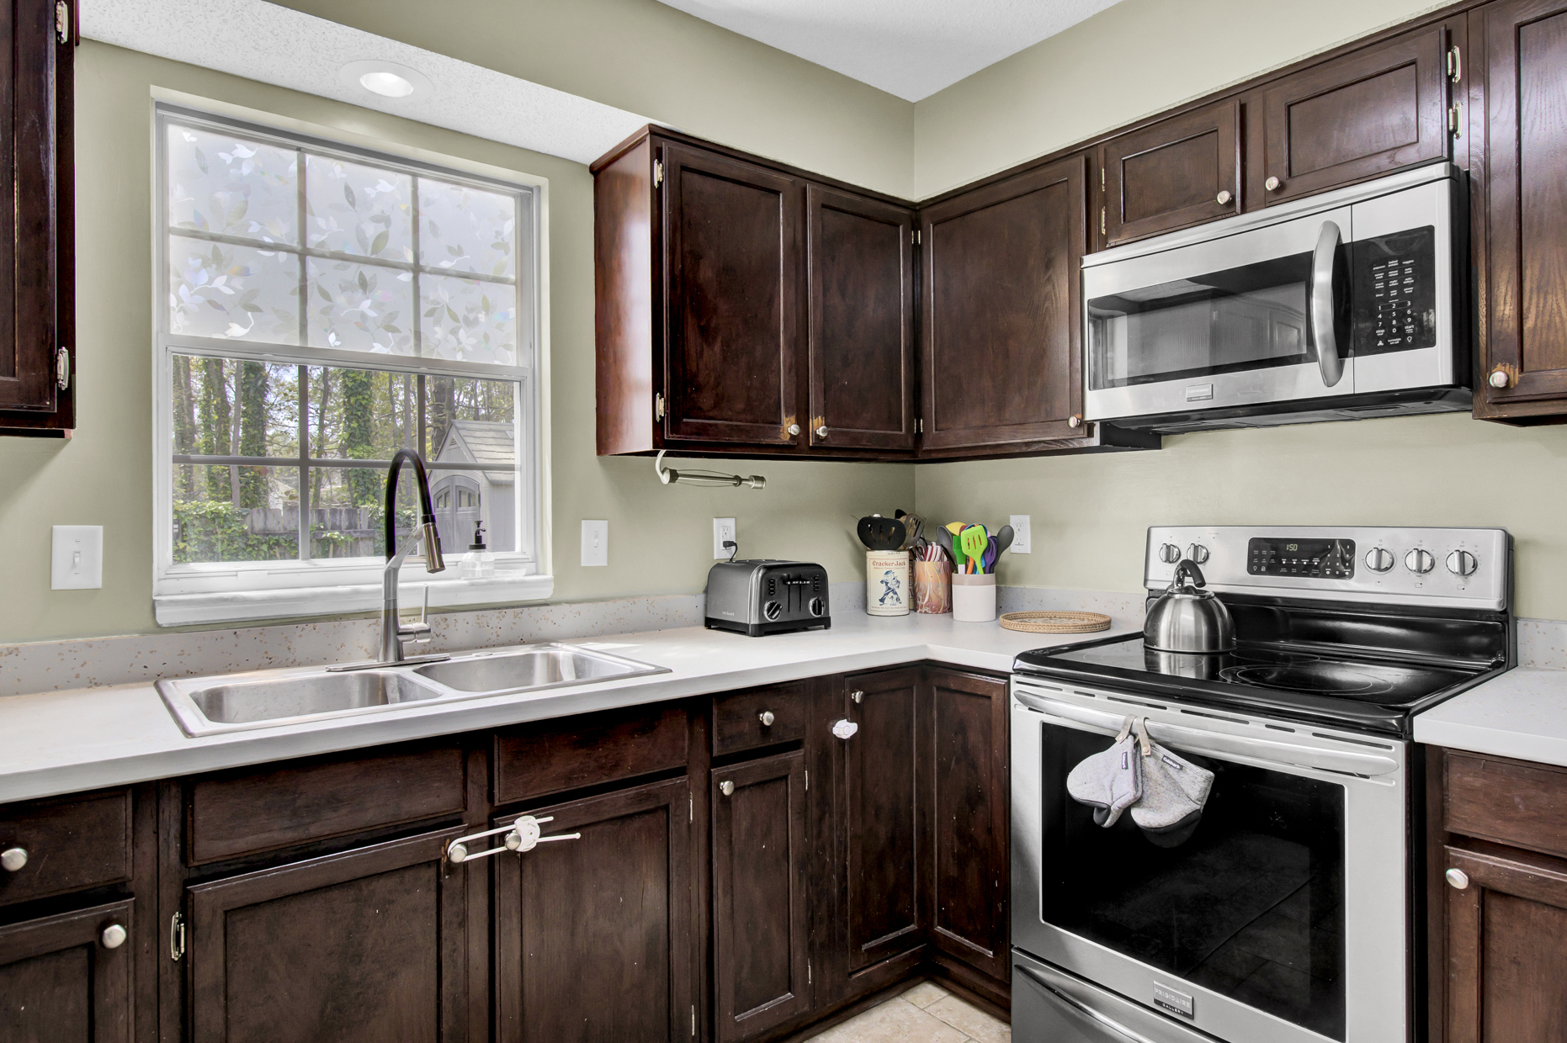
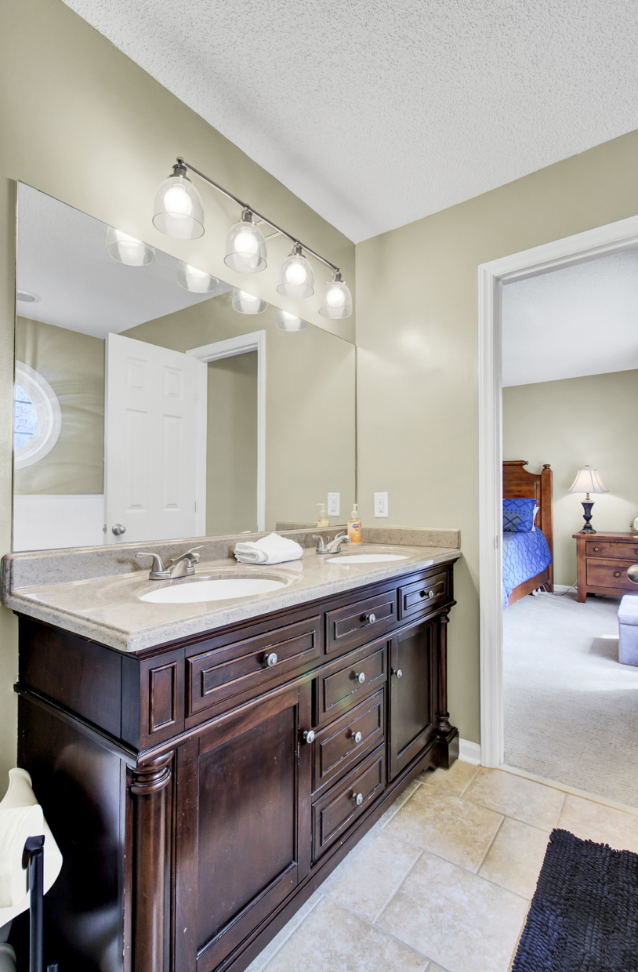
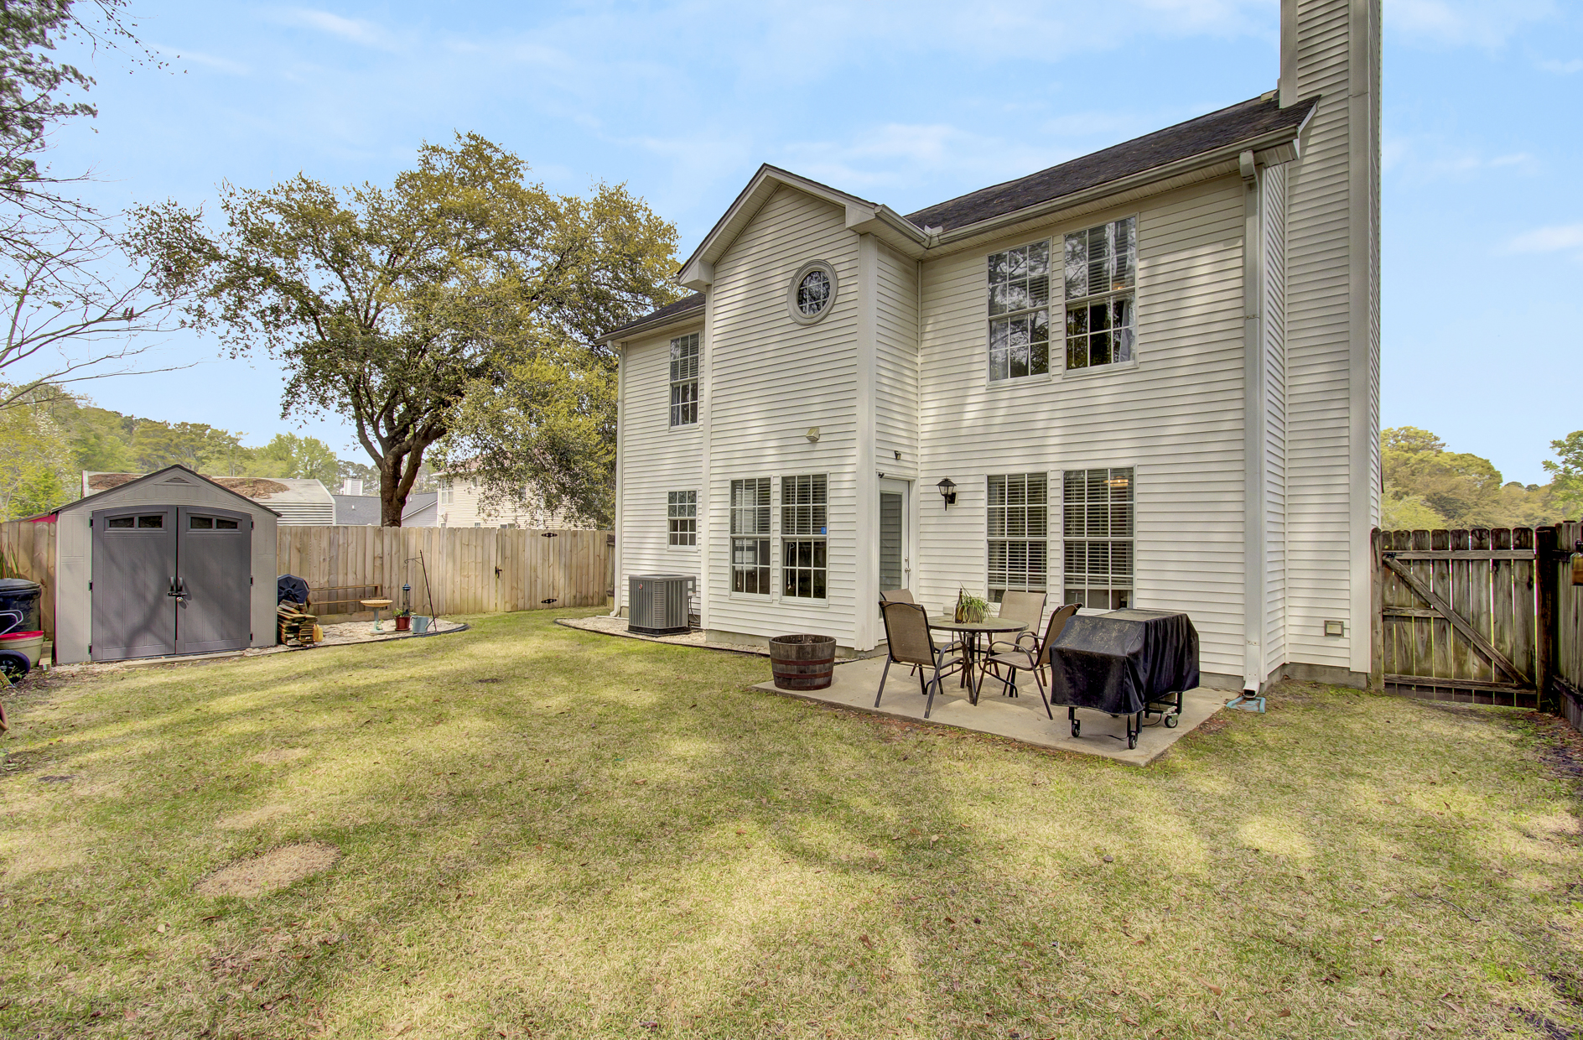
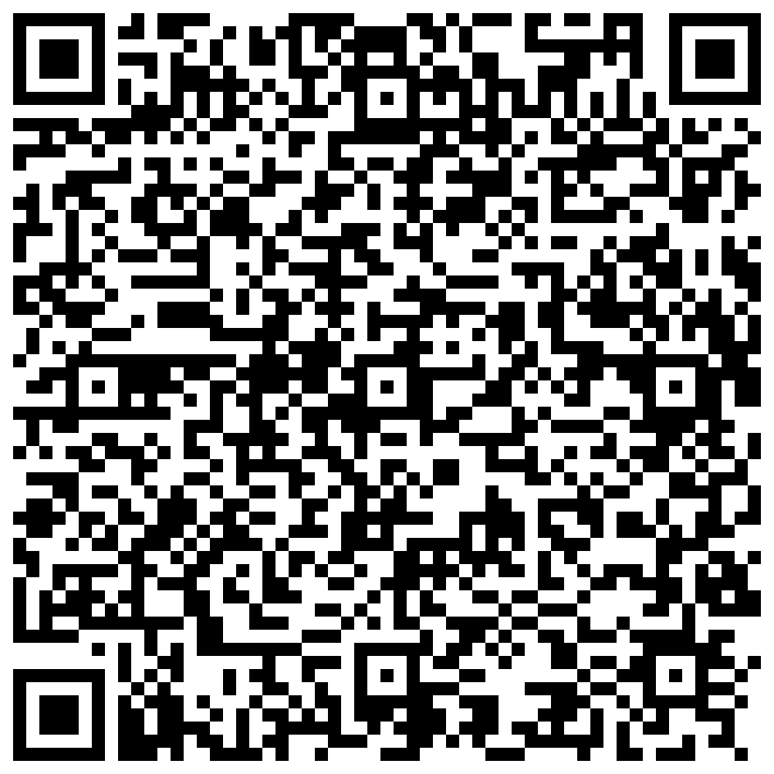


Hot Listing & Open House! Stop By Saturday April 6th from 11-2
8375 Coventry Court
Indigo Ridge
North Charleston, SC 29420
MLS# 24007638 | $346,000
Video Tour
Discover this hot listing in Indigo Ridge at Windsor Hill, a stunning, move-in-ready two-story nestled in a tranquil cul-de-sac. Experience the perfect blend of elegance and comfort with a bright, open floor plan, cathedral ceilings, and main-level hardwood floors. The home features three cozy bedrooms upstairs, fresh carpets, and updated bathrooms.
Outside, enjoy a private, fenced backyard, ideal for leisure and play, plus a convenient gardener's corner. Located in the desirable Dorchester 2 School Zone, this home offers easy access to amenities, local schools, shopping, and the interstate for commuters.
Don't miss out on this rare find. Schedule your open house tour today and make this private haven yours!
Video Tour
Ellen O'Neil
Broker/Owner, ABR, e-PRO, CNE
Charleston Realtor of Distinction
(843) 300-8530
www.EllenONeilProperties.com

