Slide 1

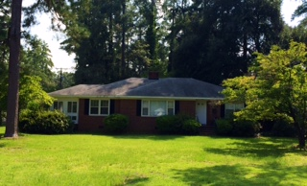

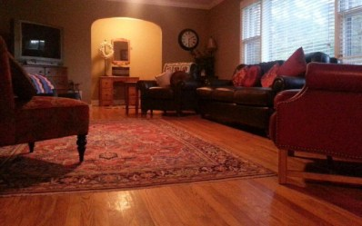
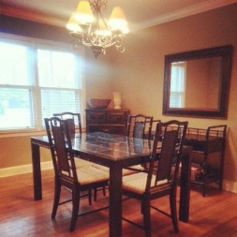
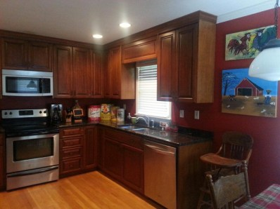
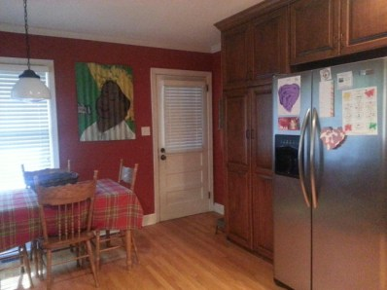
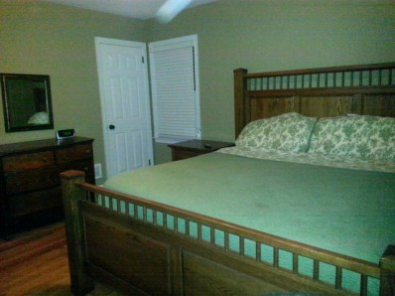
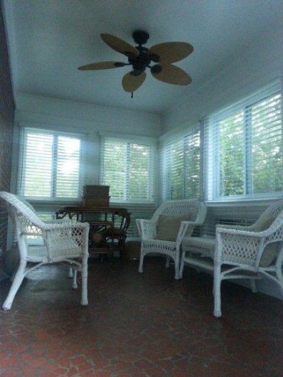


837 Brandy
Aiken, SC 29801
MLS# 87182 / $209,000
Beautifully renovated brick home with 2 car garage on corner lot in great location convenient to Polo and horse events, close to Fresh Market and southside shopping and downtown Aiken. Home features hardwood floors throughout, updated kitchen, granite countertops, SS appliances and beautiful wood cabinetry. This home is a must see!
Valli Catchpole
803.617.8540 / valli1@me.com
Property Consultants of the South, 1429 Lyon Dr SE, Aiken, SC 29801 / www.FineSouthernLiving.com

