Slide 1

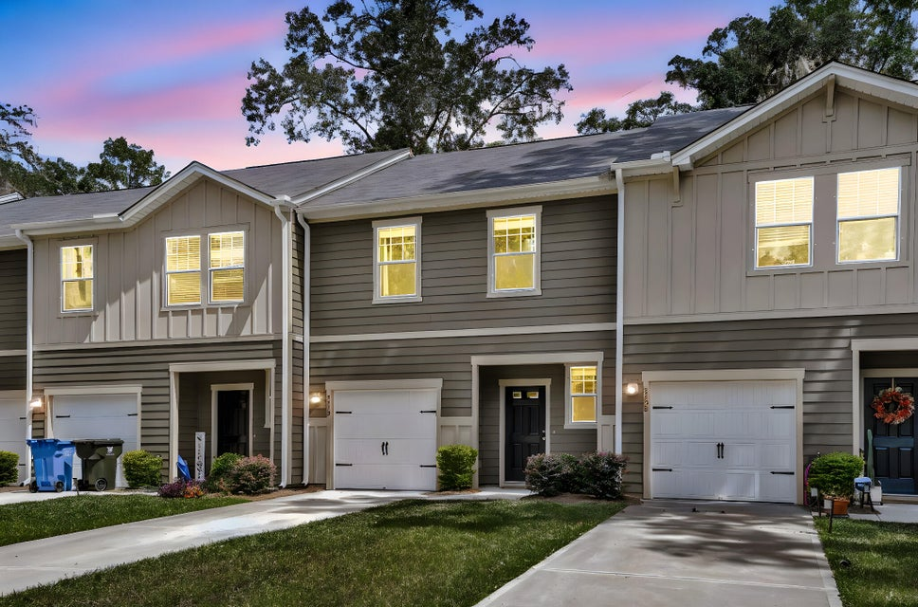
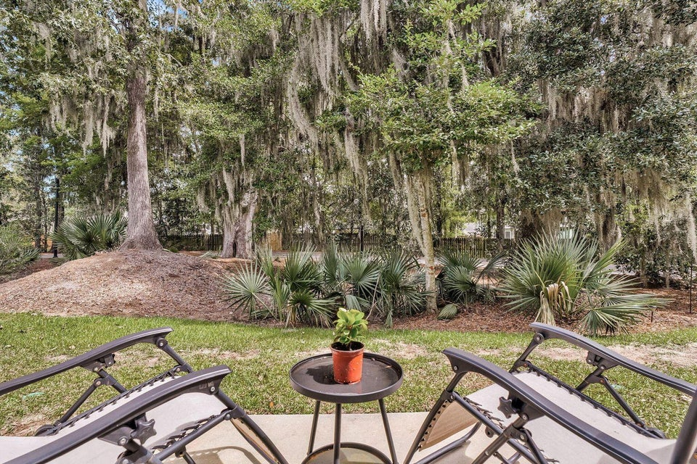
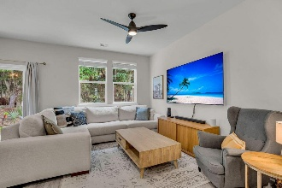
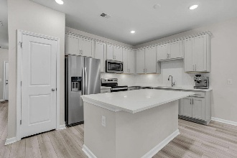
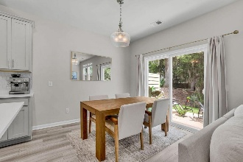
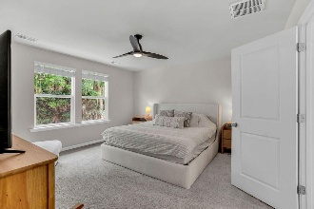
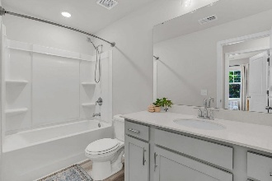

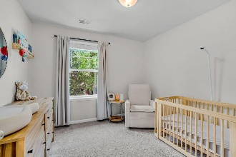
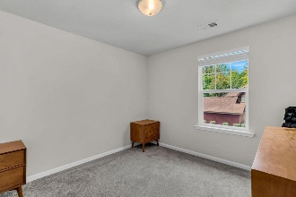
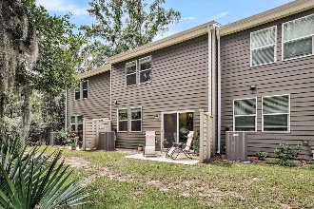
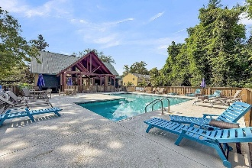
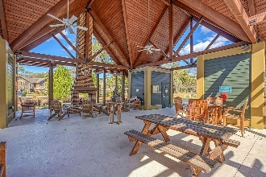
The Townhome Everyone Wants
in Summers Bend
Debbie Cromer
ABR, RSPS, REALTOR, CRS
(843) 437-6342
debbie@debbiecromer.com
www.debbiecromer.com
8410 Hidden Bakers Trace
Summers Bend on the Ashley | North Charleston| MLS# 25032830 | $329,900
Step into low-maintenance luxury in this 2024 townhome located in the sought-after Summers Bend on the Ashley, a popular North Charleston community known for its riverfront feel, strong sense of community, & modern Lowcountry lifestyle. Beautifully set along the Ashley River, the HOA covers amenities including a clubhouse, resort-style pool, scenic walking trails, & community dock access for kayaking & fishing, w/ landscaping included—making everyday living easy & carefree. This home features 9-foot ceilings, wide-plank LVP flooring, & an open floor plan that lives larger than expected. The stylish kitchen offers quartz countertops, designer lighting, stainless steel appliances (refrigerator conveys), 42'' upper cabinets, & a spacious island that opens seamlessly to the living & dining areas, perfect for entertaining. The main living space flows to a private back patio overlooking a peaceful wooded green area, ideal for grilling or relaxing, w/ custom blinds throughout. Upstairs, the spacious primary suite includes a spa-style bath w/ dual sinks, quartz vanity, & oversized walk-in closet, while two additional bedrooms provide flexible living space, one w/ its own full bath. Laundry is conveniently located upstairs, w/ a powder room on the main level. Additional features include a single-car attached garage (sheetrocked & primed) & durable Hardiplank exterior. Tucked away on a dead-end street yet minutes to I-26, shopping, dining, major employers, & Charleston International Airport, this home offers the perfect blend of modern convenience & tranquil waterfront community living in North Charleston. Special financing incentive available: 1% lender credit toward eligible closing costs when using seller's preferred lender.
TAKE A VIRTUAL TOUR | PROPERTY WEBSITE
Century 21 Properties Plus | 1090 Park West Blvd; Ste 103 | Mount Pleasant, SC 29466

