Slide 1
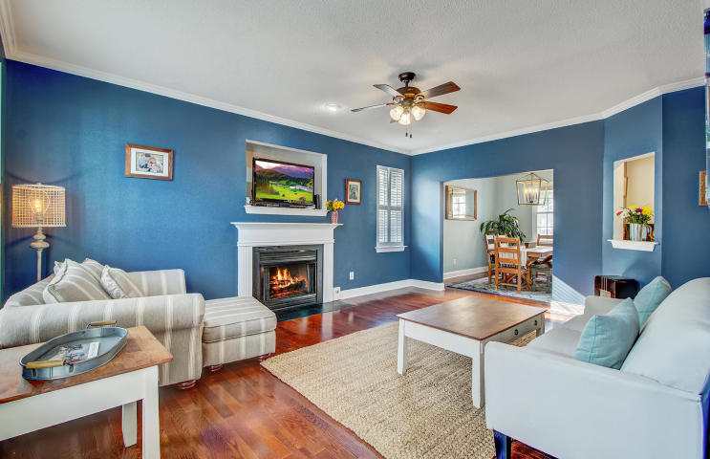
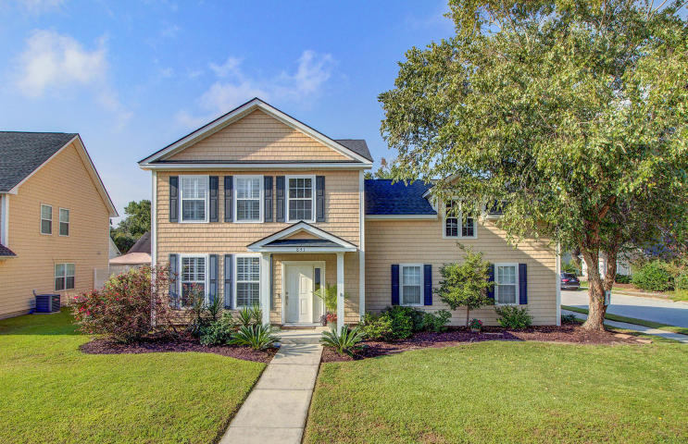
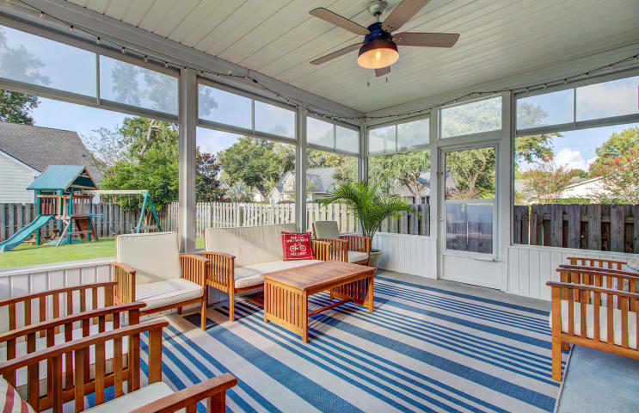
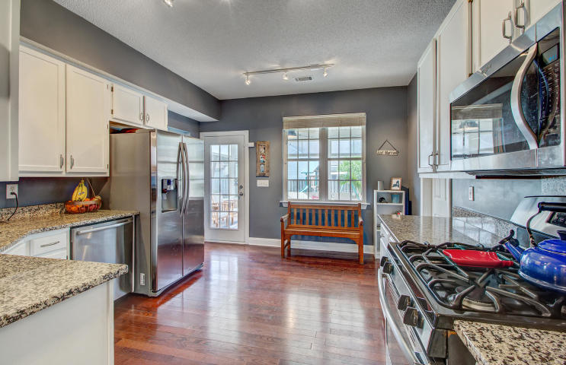
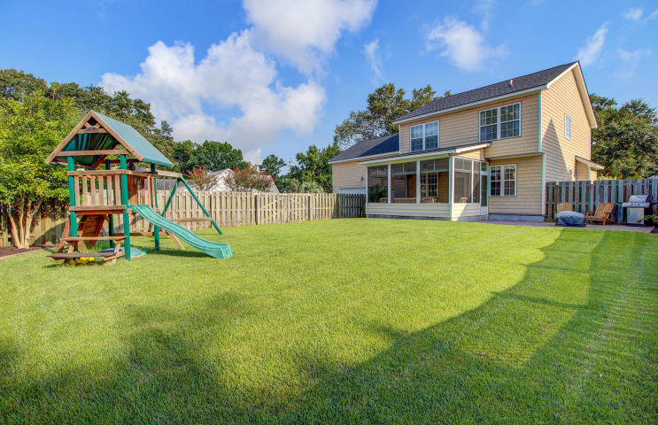
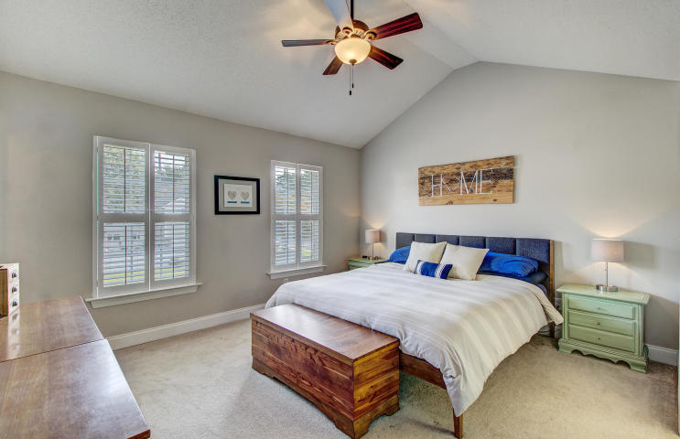
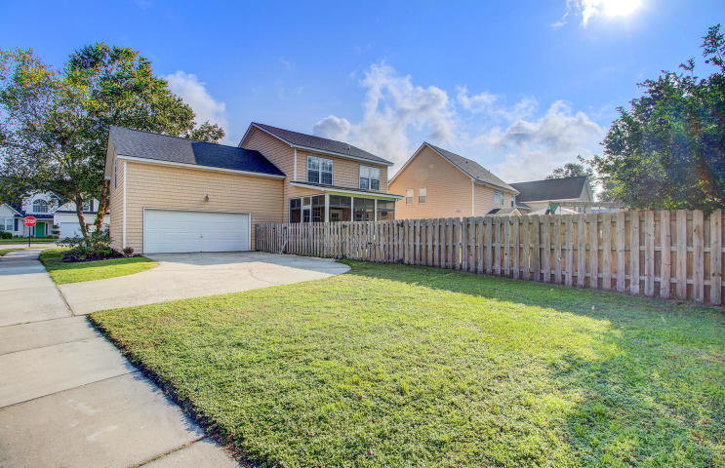


JUST LISTED: Charming James Island Home
841 Affirmation Boulevard
Lawton Harbor
Charleston, SC 29412
MLS# 20024314 | $420,000
If you have been looking for a move in ready, charming James Island home then your search is over! Welcome to 841 Affirmation Boulevard in the popular Lawton Harbor community conveniently located off scenic Harborview Road. This two story home is on a corner lot and has a very large, private, fenced yard perfect for playing with children and pets. The roof is BRAND NEW with 50 year architectural shingles installed in May, 2020. Additionally, the HVAC is newer (replaced in July, 2018) so the new owners can take comfort knowing these big ticket items have already been addressed! Upon entry you will be impressed with the attractive hardwood floors throughout the main level. The family room has a gas fireplace which is perfect for the occasional chilly nights in Charleston or simply to add ambience while relaxing in the evening. Granite counters and stainless steel appliances enhance the beauty of the kitchen which has bright white cabinets. A gas range will be sure to please the cook in your household! Adjacent to the kitchen and open to the family room you will find a separate dining room that is the perfect place to gather and enjoy your meals while you look out over the large, private back yard. This home offers a spacious screened porch off the kitchen- a second living space most of the year! With a yard like this, perfect for entertaining, a gas stub makes grilling out on the generous sized patio very convenient! Being on a corner lot, the home offers a rear entry two car garage that could serve as a "man cave" if desired since the driveway is ample in size and will accommodate vehicle parking. Upstairs you will find all bedrooms, including the master suite. The owner's will appreciate a spacious walk in closet as well as an updated master bath which includes two separate vanities. Two additional guest bedrooms share a second full bath with new tile floors in the hallway. The fourth bedroom is HUGE as it is located over the garage. This versatile space makes excellent guest quarters, with a large closet and plenty of room for a bedroom set and sitting area. Don't need a fourth bedroom? Then use this spacious room for a combination of purposes such as a home office, play room, bonus living room and/or work out room. The possibilities are endless! Living at 841 Affirmation Boulevard comes with many benefits. Stiles Point Elementary School is within walking or biking distance. Many conveniences are simply a short ride including Harris Teeter, Coastal Crust and other local shops and restaurants. It is a mere 10 minute ride to Folly Beach and even quicker to get to Historic Downtown Charleston! This home is in the heart of it all and is the perfect example of why living on James Island is so desirable- schedule your tour today and don't miss this wonderful opportunity to make this treasure of a home yours!
Check out the virtual tour here: https://my.matterport.com/show/?m=wYuUMzyH5b9
Ellen O'Neil
Broker/Owner, ABR, e-PRO, CNE
Charleston Realtor of Distinction
(843) 300-8530
www.EllenONeilProperties.com

