Slide 1
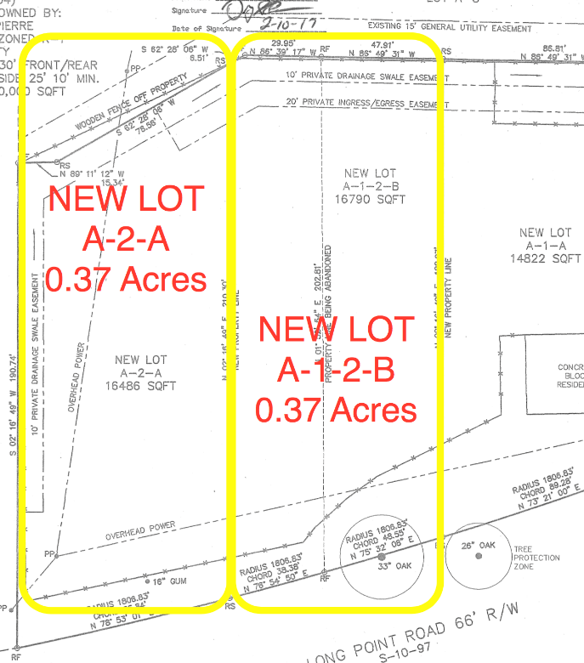
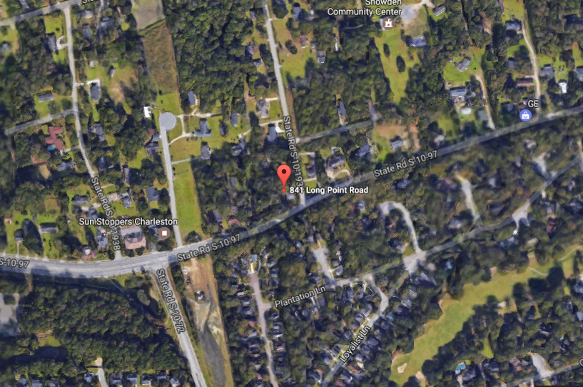


DEVELOPABLE SNOWDEN LOT
841 LONG POINT ROAD
Mount Pleasant, SC 29464
VACANT LAND FOR SALE
A convenient location for a new home whether you are building it for yourself to live in or for one of your clients if you are a homebuilder or developer. A 0.38 Acre Lot with a privacy fence and you are one turn away from heading towards Highway 17 or I-526. Enjoy easy access to shopping, dining or a walk, run or bike to Palmetto County Park or the Mt. Pleasant Recreational Center on Egypt Road. Located in the Historic Snowden Community on one of Mt. Pleasant's most scenic highways. This parcel also has the ability to be combined with a contiguous parcel owned by the same Seller that has another 0.38 Acres. Both of these lots could be combined for a 0.76 Acre Homesite.
MLS ID: | 17004481
Acrage: | 0.38
Sale Price: | $250,000
Legal Description: | LOT A-2-A District/Ward 2-1
List Price/Acre: | $657,894.74
Subdivision: | Snowden
Lot Size: | 16486
County: | Charleston
Tax ID/APN: | 556-00-00-161
David H Seay
CCIM, BIC, CCIM, REALTOR
(843) 364-6720
david@seaydevelopment.com
Seay Development, LLC
3404-202A Salterbeck Street
Mt. Pleasant, SC 29466 www.seaydevelopment.com

