Slide 1
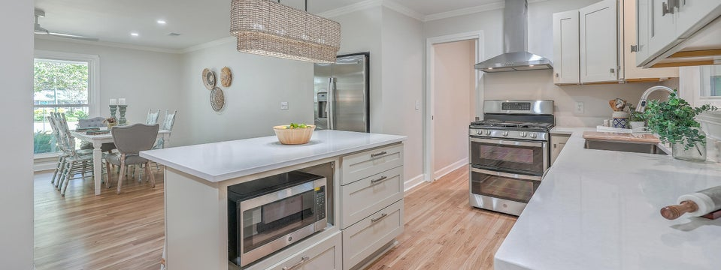
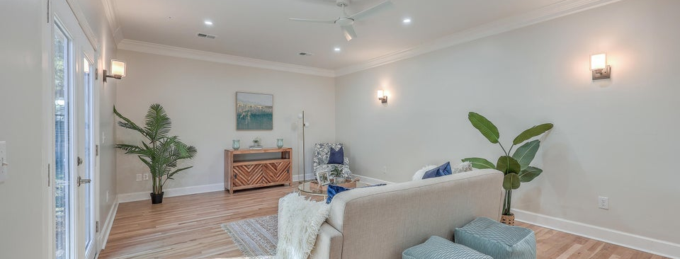
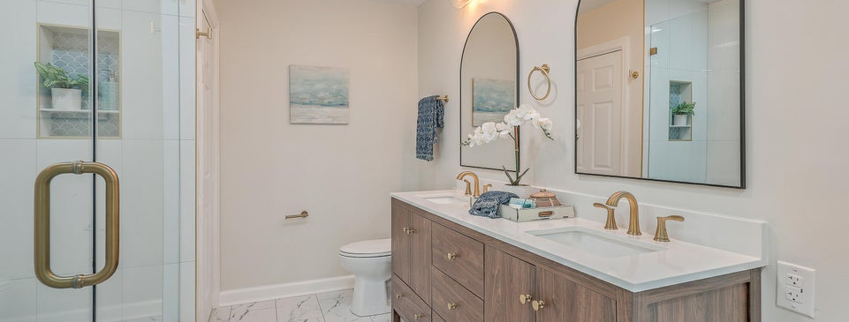

JUS
9714 ROSEBERRY STREE
MOTIVATED SELLER!
/
7
1/
ii
Recently Renovated
841 Weir Street | Lawton Bluff | MLS# 24026726
OFFERING BUYER AGENT COMPENSATION | GREAT LOCATION | NO HOA
�
$799,990
3 BED
2 BATH
1,878 SQ_FT
0.34 ACRES
Stunning, complete top to bottom renovation on this fully transformed brick ranch on a huge corner lot in the desirable Lawton Bluff neighborhood off Harbor View Rd., in the heart of James Island. Convenient to downtown Charleston, Folly Beach, and many great restaurants, shopping, grocery stores and more. This home has 3 bedrooms, 2 full bathrooms, and almost 1900 sf of space. New ROOF, New HVAC and ductwork, New Windows, New Electrical, New plumbing, New flooring, New kitchen cabinetry and quartz counters and stainless appliances, New bathrooms with LVP flooring, custom cabinetry, and more! This house is completely modernized and ready for its new owners. On a 0.34 acre corner lot with no HOA, bring on the boats and toys. There is a two-car garage with new garage door and opener. The fenced-in backyard has a patio and French doors leading into the large family room. Recessed can lighting throughout the main living spaces. Lots of natural light. Den features a wood-burning fireplace. Real oak wood floors throughout most of the home except bathrooms with LVP. Laundry room off the kitchen makes a great mudroom from the garage. The primary suite is sure to impress with large custom tile shower, dual sink vanity, and a huge walk-in closet (hard to find on brick ranches). Come check this out today.
Take a video tour
Scott Baskin
THE SCOTT BASKIN TEAM
843-324-4139
scott@explorecharlestonrealestate.com
SCOTT BASKIN TEAM

