Slide 1
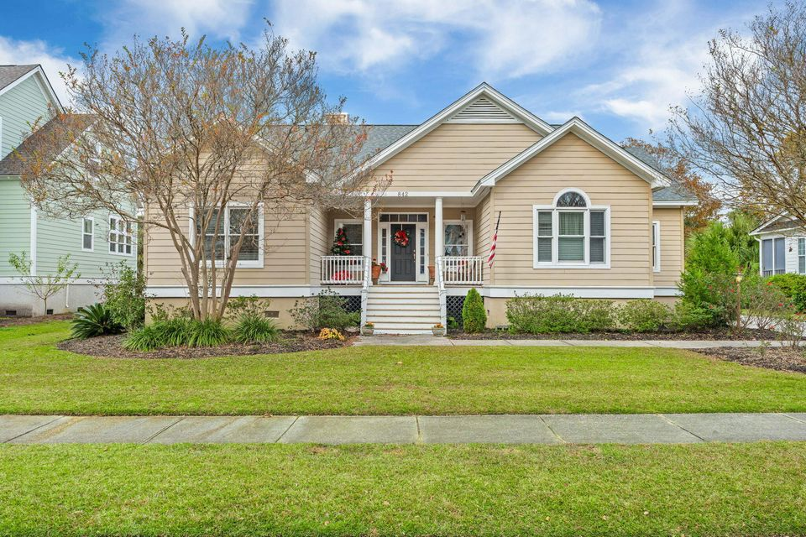
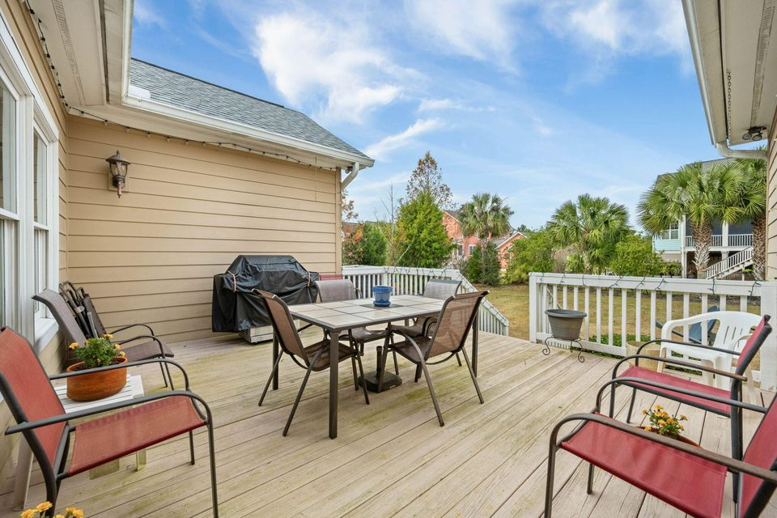
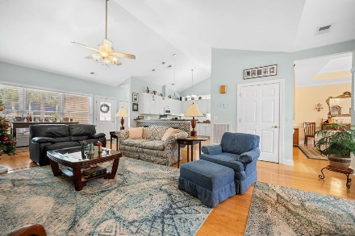
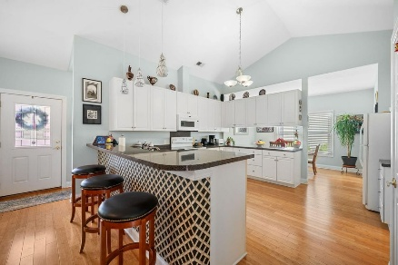
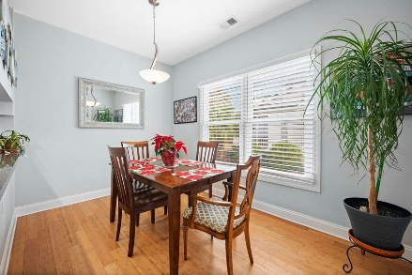
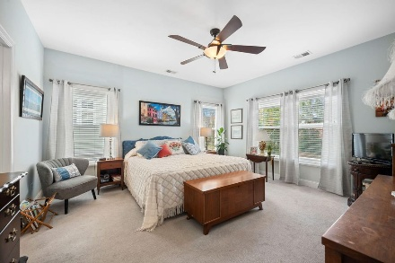
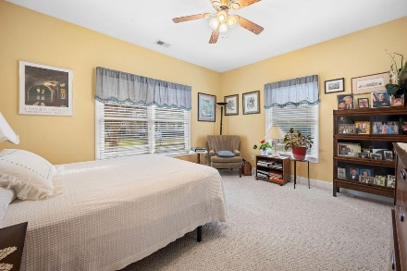
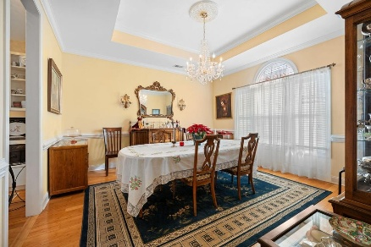
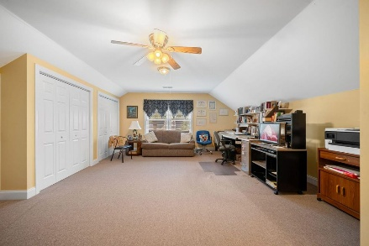
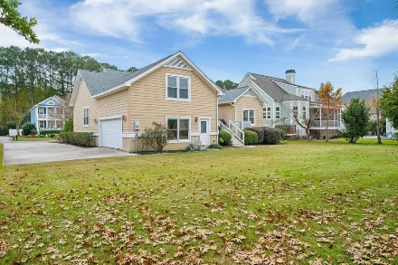


842 Captain Toms Crossing
Perfect Family Home in Grimball Gates
Johns Island, SC 29455
MLS# 25031987 | $847,500
Welcome to this wonderfully designed by the original-owner home! Well maintained and located in the gated community of Grimball Gates. This residence shows the love of a family home and no space was wasted building. The entry is beautiful with a covered front porch that leads you into a spacious living room with cathedral ceilings and a gas fireplace. Both the front porch and the large back deck create ideal spaces for entertaining and enjoying the morning and afternoon peace. On the first floor, you'll find the primary suite with walk-in closet, separate shower and tub. The secondary bedroom has its own wing and is conveniently located next to the full guest bathroom. Off from the living room is the kitchen that offers everything you need for cooking and entertaining. There is a breakfast nook and the dining room is connected to the kitchen by the butler's pantry. If you need more seating there is room at the kitchen counter that will accommodate bar stools. There is also a spacious laundry room off the kitchen.
The second floor features a large third bedroom with its own private full bathroom perfect for guests or your teenagers. The two plus-car garage offers extra space for the lawn equipment or whatever else you may desire. The driveway also provides room for multiple vehicles. Both the front and backyards are beautifully manicured. The backyard offers plenty of room to add a pool if desired.
Grimball Gates community is nearly a 100 acres which offers deep-water access to the Stono River, walking/jogging trails, and picnic pavilion. There is also boat and rv storage available for an additional fee. Please visit this home in person to appreciate all the things it has to offer.
Kelly Rozier
(843) 209-3129
kellywrozier@gmail.com
Brand Name Real Estate
4 Carriage Lane Suite 106
Charleston, SC 29407

