Slide 1
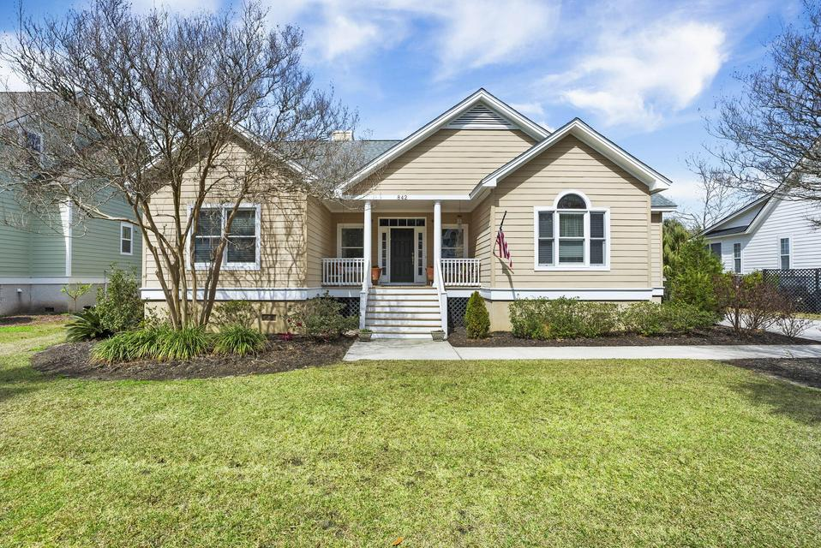
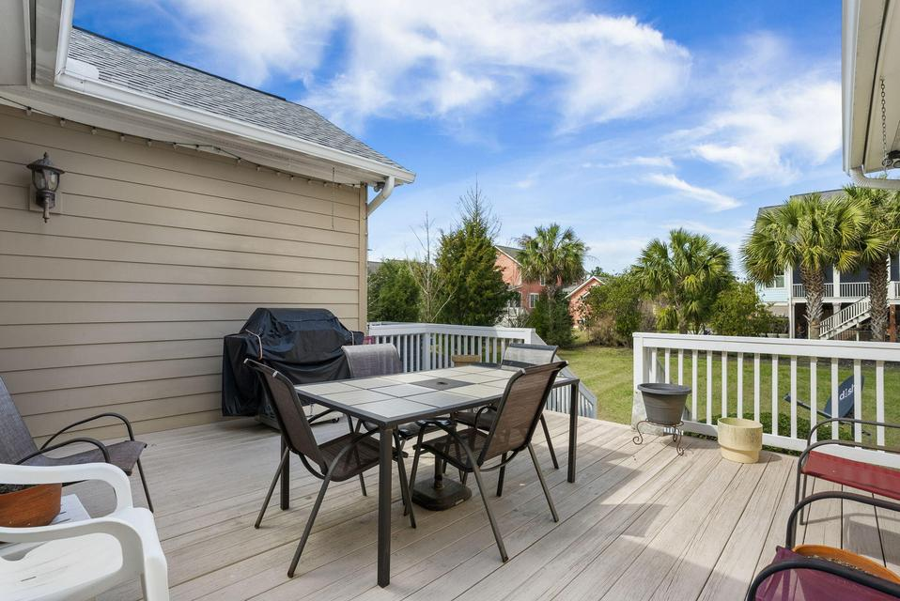
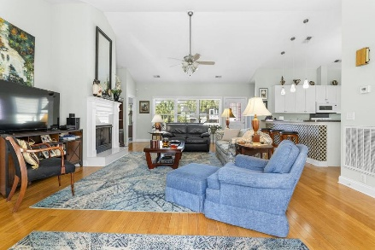
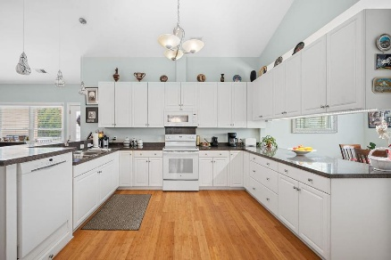
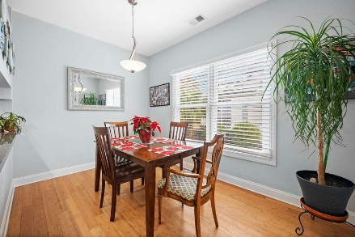
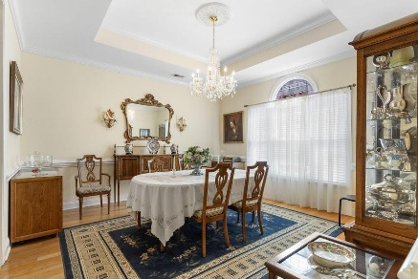
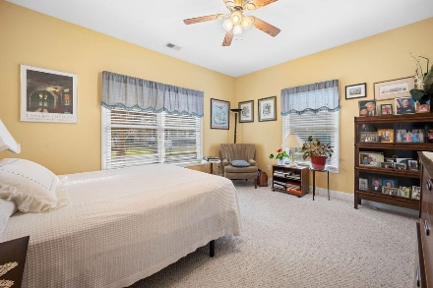
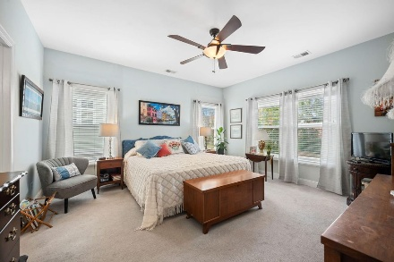
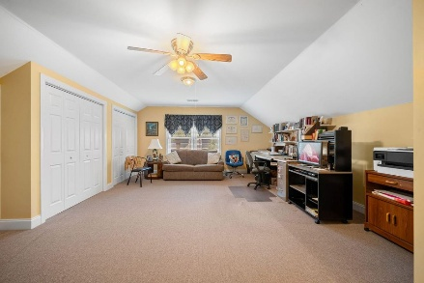
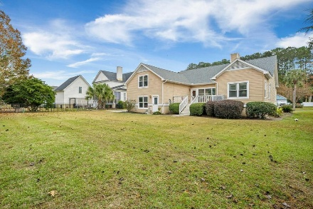


842 Captain Toms Crossing
New Price & Motivated Seller
Johns Island, SC 29455
MLS# 25031987 | $834,900
Tucked inside the gated community of Grimball Gates, this beautifully maintained original-owner home offers the perfect blend of comfort, thoughtful design, and Lowcountry charm. A welcoming covered front porch sets the tone as you step inside to a bright and airy living room featuring soaring cathedral ceilings, abundant natural light, and a cozy gas fireplace. Designed for both everyday living and effortless entertaining, the home flows beautifully from space to space. The kitchen sits at the heart of the home, offering generous workspace, counter seating for bar stools, and easy access to a sunny breakfast nook and formal dining room connected by a convenient butler's pantry. Just off the kitchen is a spacious laundry room for added functionality.
The primary suite is located on the main level and provides a peaceful retreat complete with a walk-in closet and a private bath featuring a soaking tub and separate shower. A secondary bedroom is privately situated in its own wing near a full guest bath.
Upstairs, a large third bedroom with its own full bathroom creates the ideal space for guests, teens, or a private retreat.
Outdoor living is just as inviting, with both a covered front porch and a spacious back deck perfect for relaxing or entertaining. The beautifully manicured yard offers plenty of space to add a future pool if desired. A new roof installed in 2025 provides added value and peace of mind.
The oversized two-plus-car garage allows for additional storage or equipment, while the extended driveway provides ample parking.
Residents of Grimball Gates enjoy nearly 100 acres of natural beauty, including deep-water access to the scenic Stono River, walking and jogging trails, and a picnic pavilion. Boat and RV storage are also available for an additional fee.
This is a wonderful opportunity to enjoy peaceful Lowcountry living while remaining just minutes from everything Charleston has to offer.
Kelly Rozier
(843) 209-3129
kellywrozier@gmail.com
Brand Name Real Estate
4 Carriage Lane Suite 106
Charleston, SC 29407

