Slide 1
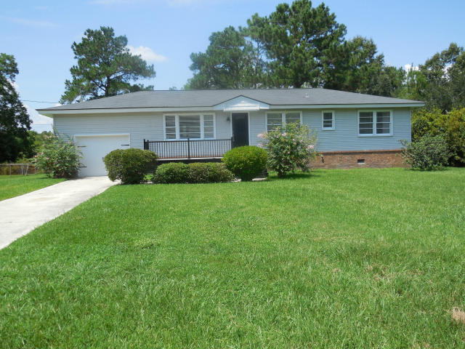
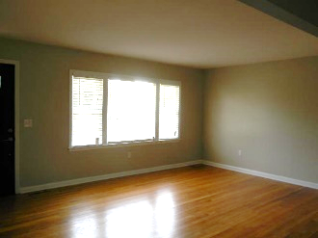
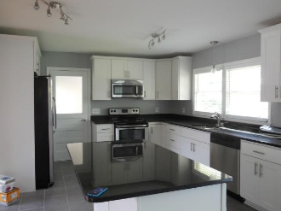
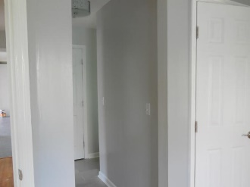
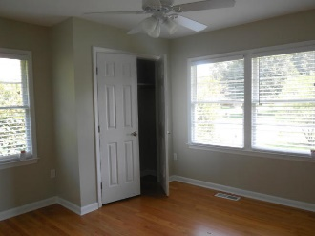
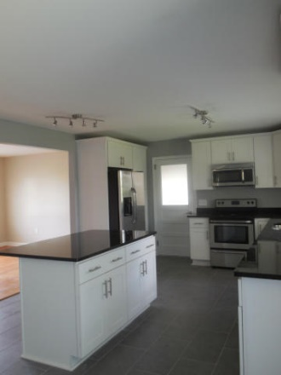
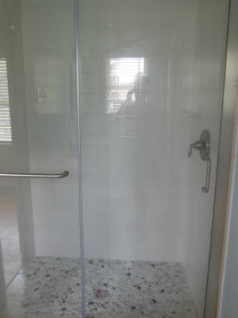
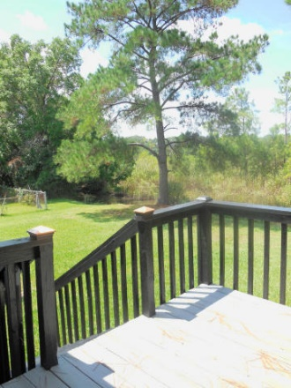
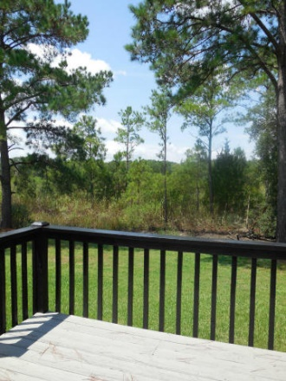


Less then 5 minutes to I-526 & less then 7 miles to MUSC
$4,000 Buyer Agent Bonus with ratified contract by September 30th
843 Longbranch
Shaftesbury ~ Charleston ~ MLS# 15022360
$2,000/mo
House is on the water in West Ashley. Kayak from your backyard. House has been totally renovated! All new appliances, new kitchen, granite countertops, hardwood floors. Jack and jill bathroom with stone shower, master bath, tiled floors in kitchen and bathrooms, new paint and front porch. Compensation is 10% of one months rent.
AgentOwned Charleston Group
902 Savannah Hwy
Charleston, SC 29407-7802
Lisa Deaton 843-224-7878
lisamdeaton@comcast.net
www.agentownedrealty.com

