Slide 1
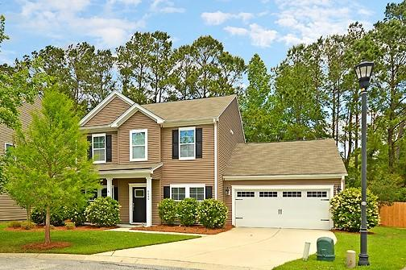
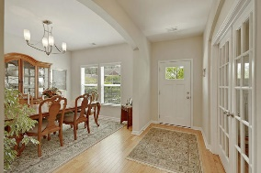
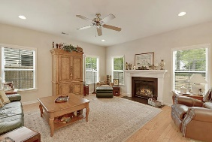
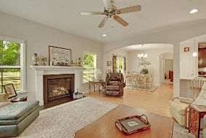
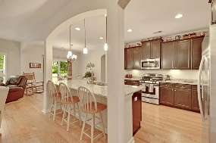
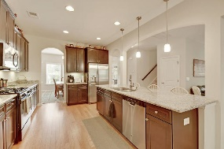
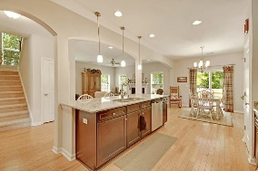
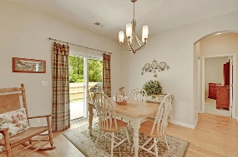
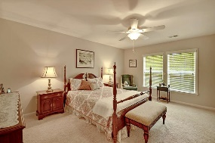
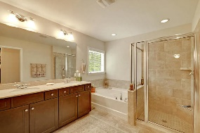
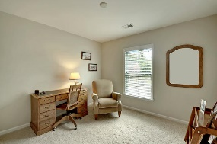
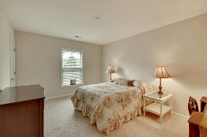
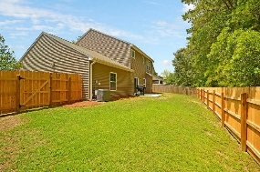


Immaculate Condition in Taylor Plantation
8444 Rice Basket Lane
Taylor Plantation
North Charleston, SC 29420
MLS# 19012353
$299,000
4 Bedrooms | 3 Baths | 2,500 sf
This 2,500 Sq. Ft., 4BR, 3BA home is in IMMACULATE, move-in condition and has been maintained extremely well! This home was a model home and is loaded with upgrades. Please view other homes for sale nearby and you will find this home to be the best of them all! On the first floor, buyers will find a guest bedroom and full bathroom, office, separate dining room, spacious family room with gas fireplace, eat-in kitchen area and a WONDERFUL, gourmet kitchen! The gourmet kitchen features granite counters, huge island with sitting bar, gas cooktop and range and upgraded custom cabinetry with lighting underneath. Buyers will also find beautiful hardwood floors downstairs and a back door leading to the rear patio and fenced-in and private backyard. Upstairs offers the master bedroom and bathroom as well as two additional bedrooms and a second full bathroom. The large master bedroom has a master bathroom featuring dual vanity, tub, custom tile shower, tile floor and a large walk in closet. All upstairs bedrooms have walk-in closets. The home also offers ample floored attic storage. Dorchester Dist. II schools and proximity to shopping and the airport make this a great location for your new home!
Larry & Kathy Mazalatis
Larry Cell 843-693-0529
Kathy Cell 843-693-0159
Office 843-871-9133
AGENTOWNED PREMIERE GROUP | 1800 TROLLEY RD | SUMMERVILLE, SC 29485

