Slide 1
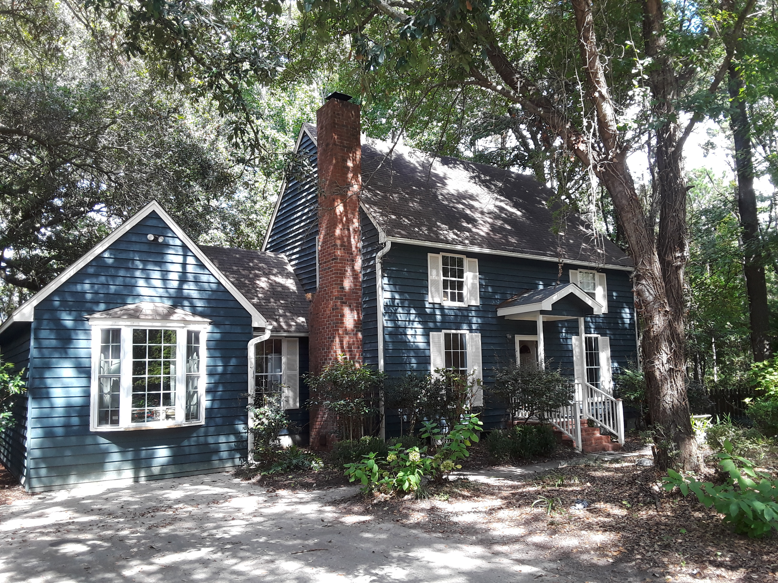
New On The Market
Open House This Weekend
12-4 Saturday & Sunday
Spacious 4 bedroom 3 bath home on deep water creek that leads to the Intracoastal Waterway. Enjoy amazing marsh and water views while shrimping, crabbing, or fishing from your own private dock. Less than 15 minutes from Wando High. Home has 3 beds/2baths upstairs and 1 bed/1bath down (good for MIL suite, teen or Nanny).
Awendaw offers so much for the outdoor enthusiast. Whether you visit the Birds of Prey center, hike the Palmetto trail, take the ferry to Cape Romaine Wildlife Refuge, or enjoy an evening of food and music at Awendaw Green. Flood insurance required $1,016 annually.
844 Springwood Circle
Wando Lakes ~ Mount Pleasant, SC 29464
$325,000
Linda Kammel (843) 884-3901 O ~ (843) 670-0180 M
lindakammel@gmail.com
Old Dominion, REALTORS · 890 Johnnie Dodds Blvd · Mt Pleasant, SC 29464

