Slide 1
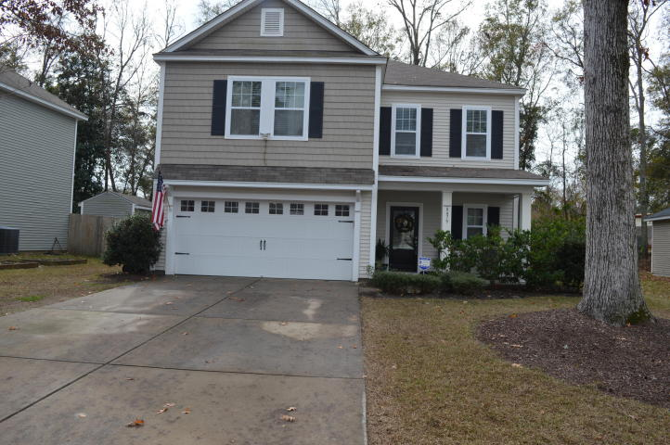
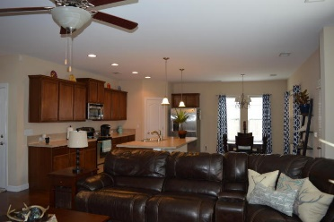
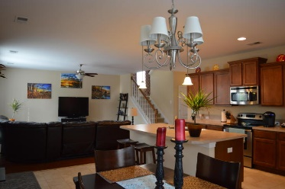
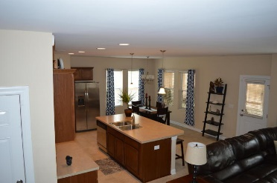
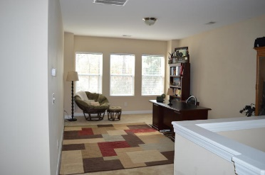
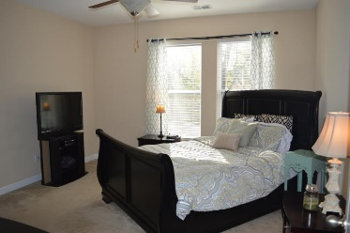
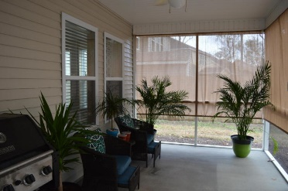
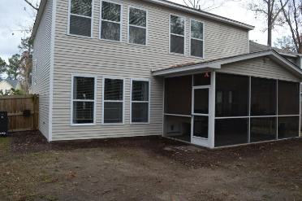
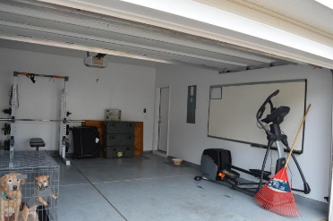


Beautiful Move in Ready Home. Easy to see!
8479 Athens Way
Appian Place ~ North Charleston
MLS# 17000174 ~ $235,000
This beautiful home offers an open floor that will serve as a great place for family and friends to gather. With staggered maple cabinets, stainless steel appliances, plenty of counter space and a large island and pantry make this kitchen perfect. Off the kitchen is a nice sized screened in porch to enjoy the Charleston breezes while relaxing in privacy. Located upstairs you will find 3 bedrooms with walk in closets, along with a large loft, which can serve as a media room or study and a large laundry room. The master bedroom features dual sinks in the bathroom and a spacious 5-foot shower. The garage has finished painted walls with an epoxy floor coating. This David Weekly home is Platinum level Green Certified making it 35% more energy efficient than Energy Star rated home. It is conveniently located near the I-26 and I-526, airport, Air Force Base, Bosch, Boeing, Shopping and Dinning.
Patty Stover
(843) 819-7924
pstover60@gmail.com
www.pattystoverrealty.com
ERA Wilder Realty | 125 Wappoo Creek Ste F | Charleston, SC 29412

