Slide 1
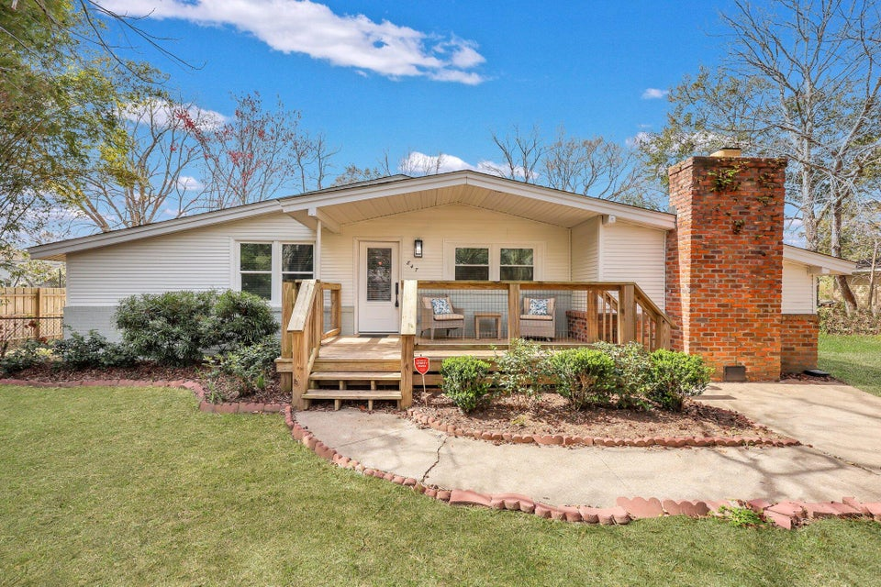
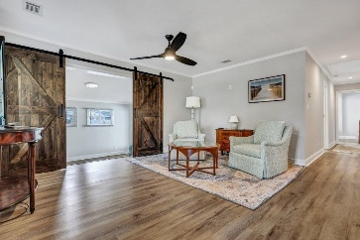
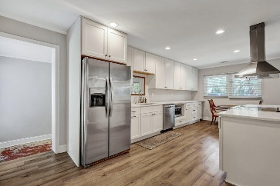
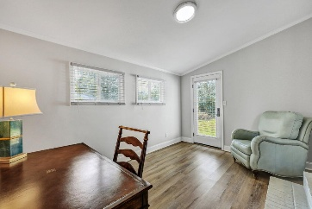
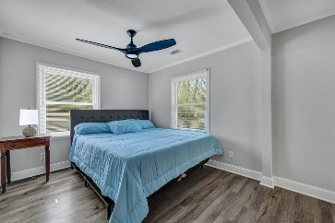
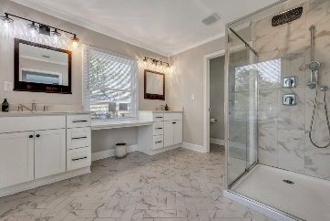
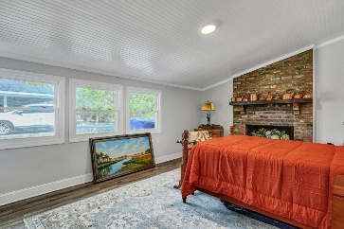
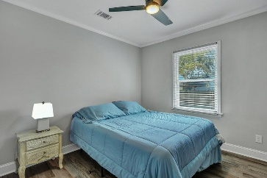
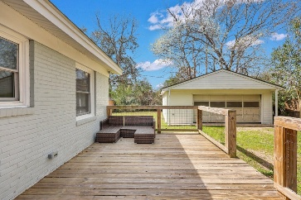
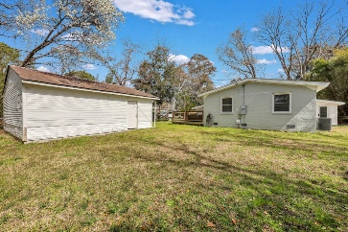
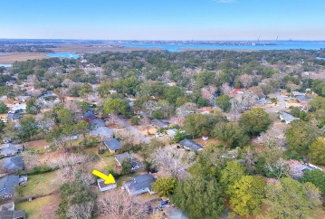



Renovated Ranch in Lawton Bluff
847 Quail Drive
Lawton Bluff
Charleston, SC 29412
MLS# 25006260
$599,000
3 Beds | 2 Baths | 1,910 SF
This beautifully renovated home offers the perfect blend of modern amenities and spacious living. With a 2020 roof, HVAC, and duct work, plus updated electrical and plumbing, this property is move-in ready with peace of mind. Step inside to discover a large, bright kitchen that flows seamlessly into the inviting living room, making it ideal for entertaining. The kitchen is equipped with stainless steel appliances and stylish cabinetry, offering both functionality and flair. Gleaming wood floors extend throughout the home, enhancing its warmth and charm. A small study or office off the living room provides a quiet space to work or relax. The master suite is generously sized, featuring a walk-in closet and an updated en-suite bathroom, ensuring a comfortable retreat.
Two additional bedrooms provide plenty of space, and one of them boasts its own private entry perfect for a mother-in-law suite or an AirBnB rental. The massive 2-car garage is a standout feature, offering enough space for up to 4 cars or a spacious workshop. Whether you're a car enthusiast, need room for extra storage, or love working on projects. Don't miss out on this exceptional home in the desirable James Island area, schedule a tour today! Transferable termite bond included. Garage, shed, and refrigerator to convey in "as-is" condition.
VIRTUAL TOUR
Nick Mazzilli
843-640-5575
nick@themazzilliteam.com
sellmyhousecharlestonsc.com
The Mazzilli Team
3427 W Montague Ave
Suite 6
North Charleston, SC 29418

