Slide 1
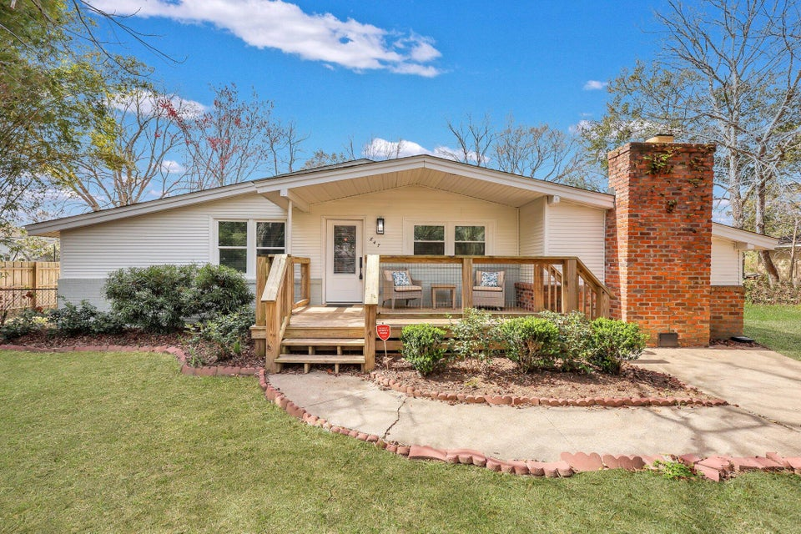
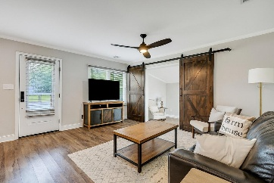
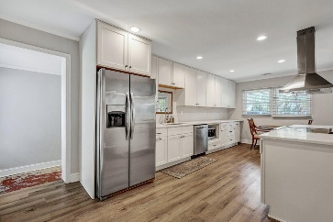
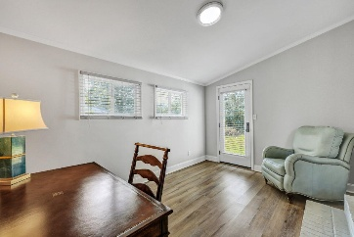
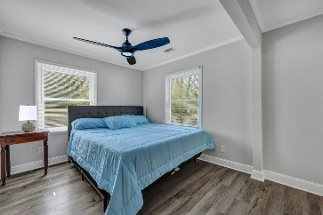
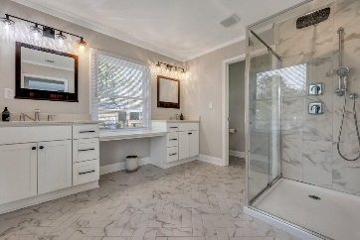
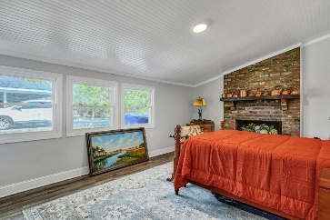
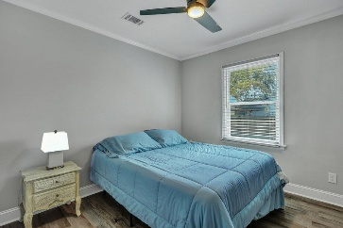
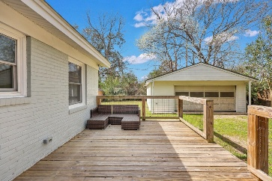
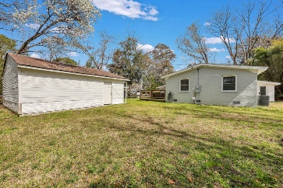
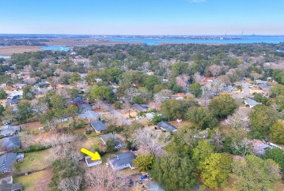



Renovated Mid-Century Ranch on James Island
847 Quail Drive
Lawton Bluff
Charleston, SC 29412
MLS# 25006260
$575,000
3 Beds | 2 Baths | 1,910 SF
This stunningly renovated home offers the perfect blend of modern updates, flexible living space, and unbeatable charm. Featuring a new roof, HVAC, and ductwork (2020), plus upgraded electrical and plumbing, this property gives you total peace of mind from the moment you move in. Step inside to a bright, open-concept layout where a spacious kitchen flows effortlessly into the living area—ideal for entertaining guests or enjoying cozy nights in. The kitchen features sleek stainless steel appliances, contemporary cabinetry, and plenty of counter space for meal prep or casual dining. LVP floors run throughout, creating warmth and elegance in every room. Just off the living room, you'll find a versatile bonus space perfect for a home office or study.
The generously sized primary suite includes a walk-in closet and a beautifully updated en-suite bath for your private retreat. Two additional bedrooms offer excellent flexibility, and one includes its own private entrance - perfect for a mother-in-law suite, short-term rental, or creative studio. Outside, the oversized 2-car garage is a rare find, accommodating up to 2 large vehicles or your dream workshop. Whether you're a car enthusiast, need extra storage, or love weekend projects, this space delivers. Located in the sought-after James Island area, you'll enjoy easy access to Folly Beach, downtown Charleston, and top-rated schools. A transferable termite bond is included, and the garage, shed, and refrigerator all convey in as-is condition. Don't miss this opportunity - schedule your private showing today and see why this home stands out from the rest!
VIRTUAL TOUR
Nick Mazzilli
843-640-5575
nick@themazzilliteam.com
sellmyhousecharlestonsc.com
The Mazzilli Team
3427 W Montague Ave
Suite 6
North Charleston, SC 29418

