Slide 1
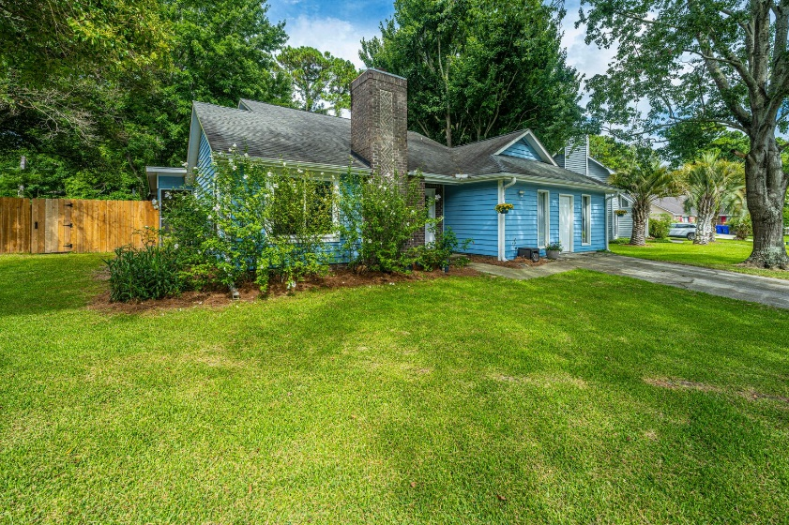
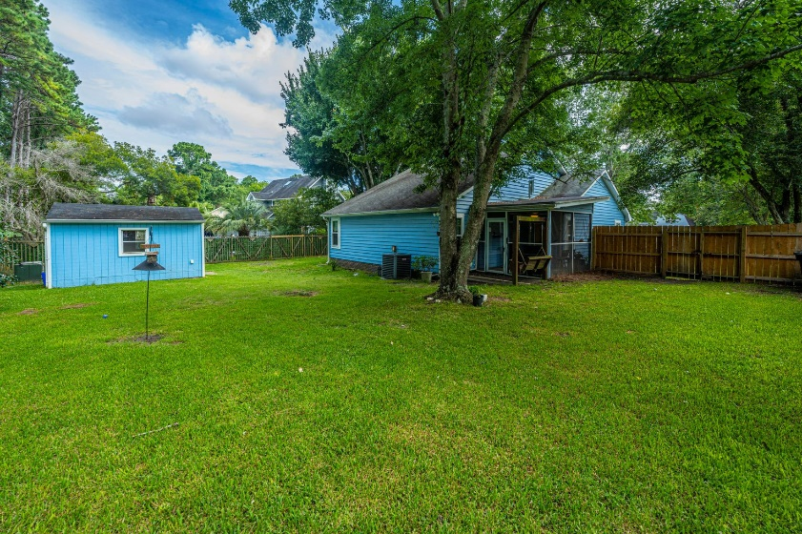
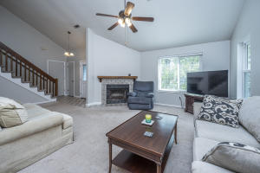
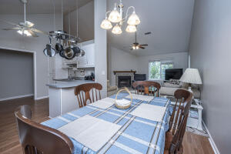
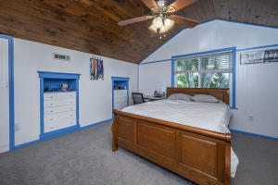
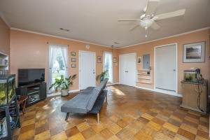
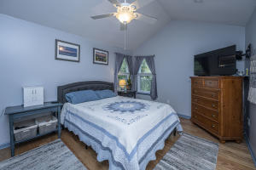
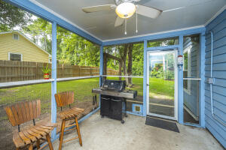



Why wait for new construction?
This Park Circle area home is LESS THAN 2 YEARS!
$400,000 Mt. Pleasant House
847 Ramblewood Circle
Wando Lakes · Mount Pleasant, SC 29464 · MLS# 21018612
Welcome to 847 Ramblewood Circle in central Mount Pleasant! This 4 bedroom home has a converted garage that could be a 5th bedroom/office or mother-in-law or older kid suite. The property is on a cul-de-sac and has a large fenced in backyard. Master Bedroom is down. This location is perfect with close proximity retail/shopping at Town Centre, Indigo Square and close to the new Lucy Beckham High School (opened in 2020). HS 2021-22: Lucy Beckham HS (9-11)/Wando HS (12). SCHEDULE YOUR SHOWING TODAY!
Del Shaffer
843.408.6821
dshaffer@carolinaoneplus.com
2713 Highway 17 North
Mt. Pleasant, SC 29466

