Slide 1
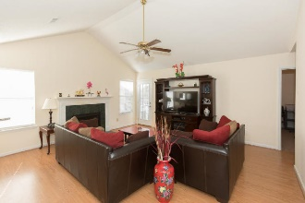
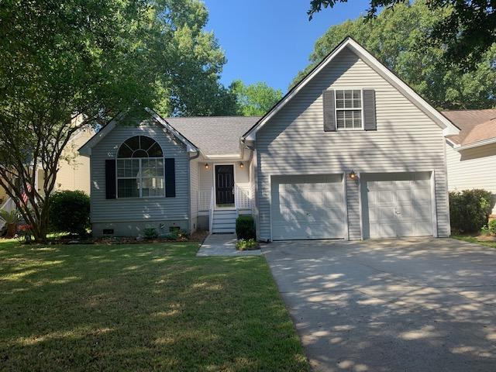
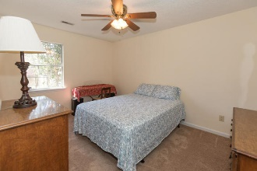
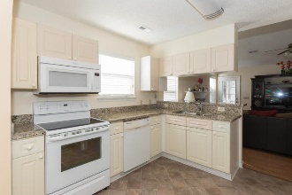
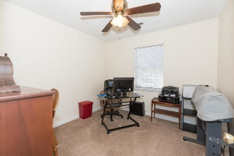
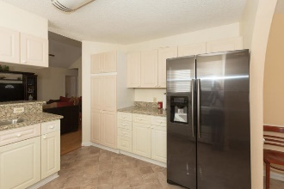
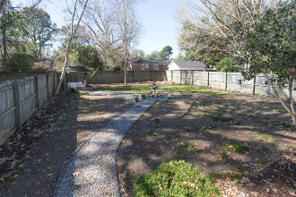
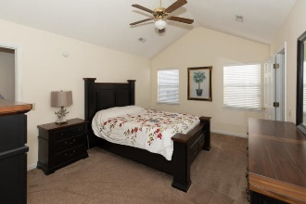
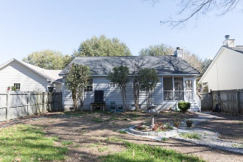


HUGE PRICE REDUCTION! BELOW APPRAISAL!
849 Harbor Place Drive
Harbor Place · Charleston, SC 29412 · MLS# 19004544 · $310,000
Beautiful 3 bedroom 2 bath home in Harbor Place. Conveniently located to down town and Folly beach. Bright kitchen with granite counter tops overlooking large family room with fire place. Downstairs master bedroom has walk in closet and en suite with dual sinks. Finished room above garage can be 4th bedroom or flex space. Relax on the screened in porch overlooking back yard with privacy fence. New roof installed 2016. Must See!
Michael Dew
O 843-769-5100
M 843-870-7000
michaeledew@gmail.com
www.michaeldewrealestate.com
AgentOwned Charleston Group
902 Savannah Hwy
Charleston, SC 29407
Real Estate ● Mortgage Insurance ● Business Brokerage

