Slide 1
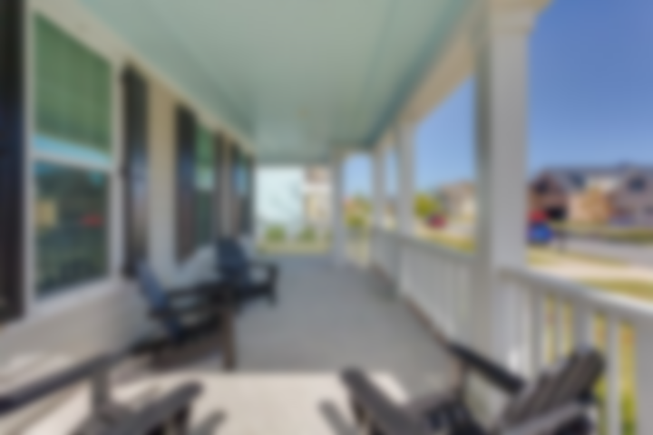
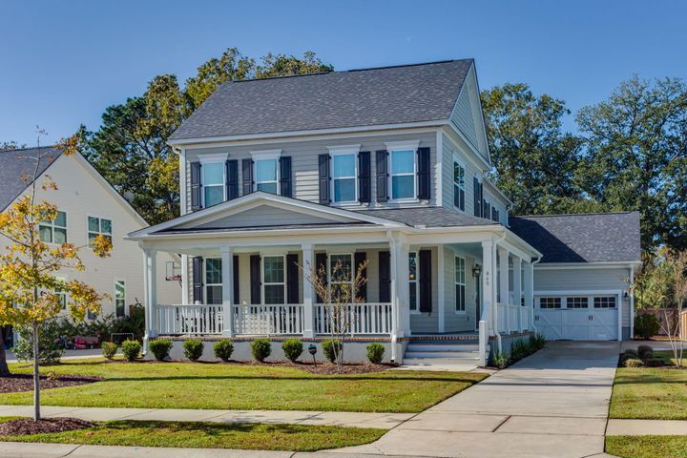
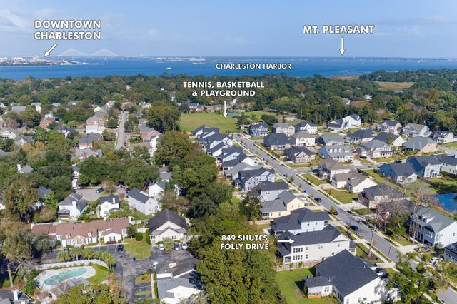
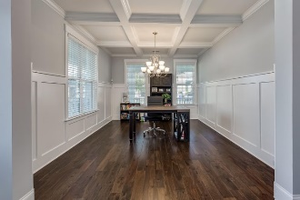
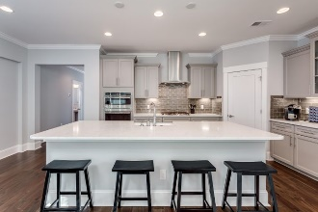
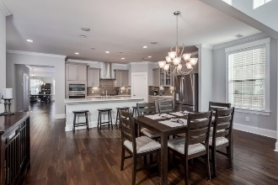
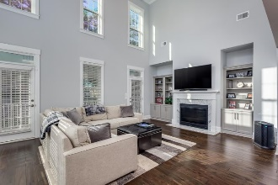
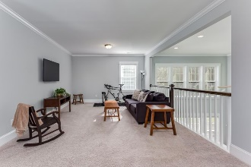
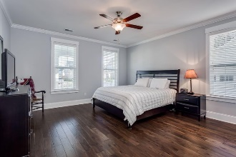
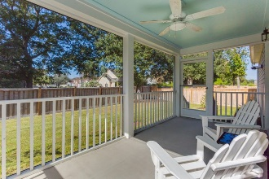
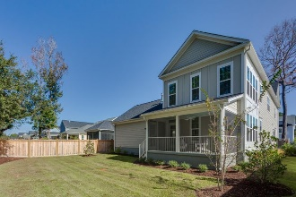
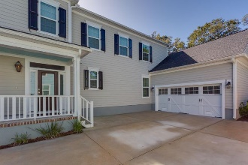
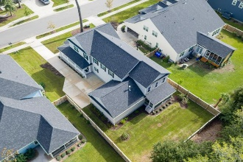


JUST LISTED! 5 Minutes To Downtown Charleston
849 Shutes Folly Drive
The Village at Stiles Point | Charleston | MLS# 20030696 | $737,000
This is a rare opportunity to own a practically new and meticulously cared for home in the highly desirable, The Village at Stiles Point neighborhood. This home is located only three miles to downtown Charleston, minutes to Folly Beach, and walking distance to grocery and restaurants. Upon entering this Lowcountry home, you will notice the inviting wrap-around front porch that is highlighted with decorative rails, tabby oyster shell concrete, and a natural gas lantern, perfect for enjoying those beautiful Charleston sunsets. As you enter the home, you will be greeted with gleaming hardwood floors, 9+ ft ceilings, an extensive trim package including 7 inch baseboards, crown molding, and tall windows which bring in ample natural light. Notice the separate dining room featuring coffered ceilings. The first floor master is very spacious and includes an ensuite bath with double sinks, garden tub, and large shower. Notice the spacious walk-in closet off of the master bath which includes a full shelving system for extra storage. The spacious chef's kitchen includes a oversized island, granite countertops, designer cabinetry, subway tile backplash, wall ovens, 5 burner natural gas cooktop, Kohler farmhouse sink, and GE stainless steel appliances. The main living space offers an open concept dining, which is perfect for entertaining. You will notice the cathedral ceilings, built-ins, natural gas fireplace, built-in bluetooth speakers with digital control, and additional light from the multiple windows. The laundry/mud room is downstairs and includes access to the 2 car garage. The second floor includes an open/flex space, perfect for an office, second family room, or children's play area. There are three large bedrooms upstairs and one full bathroom. All the bedrooms include walk-in closets. There is a large screened-in porch off of the main living area and a nice sized yard that is partially fenced. Award winning Stiles Point Elementary is a short walk away and in-community amenities include full access to Stiles Point park that has full-court baskeball, tennis, playground, baseball field, and more! Don't miss out on this move-in ready home in one of Charleston's A+ locations!
Virginia Landon 803-493-9202
virginialandon@kw.com
virginialandon.kwrealty.com
Keller Williams Realty 496 Bramson Ct Ste 200 Mt. Pleasant, SC 29464

