Slide 1
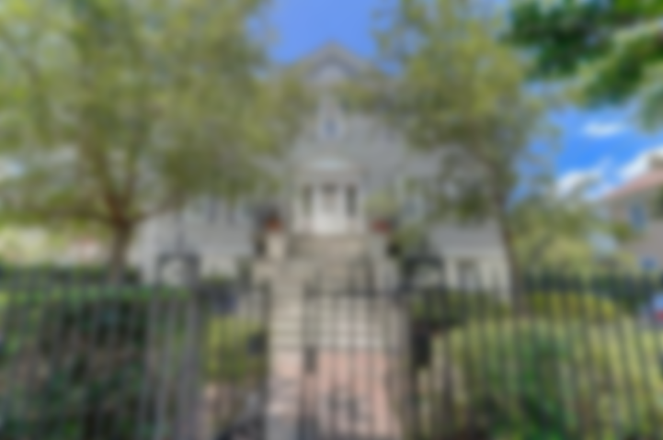

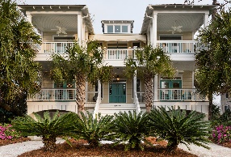
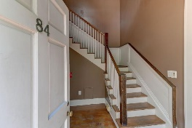
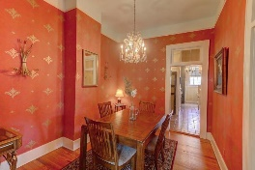
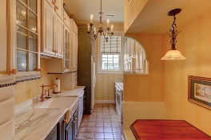
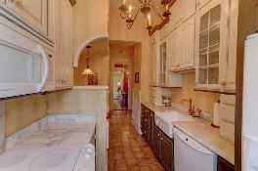
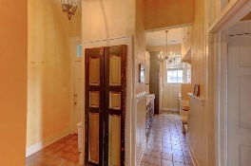
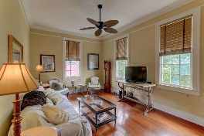
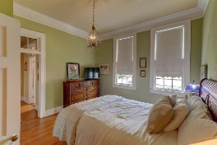
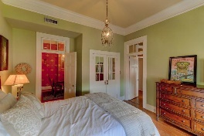
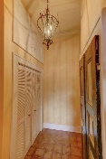
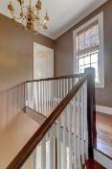
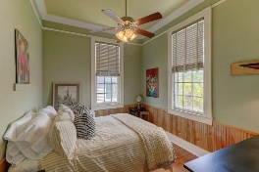
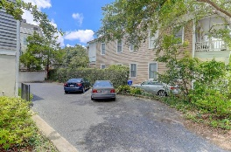


84 Bull Street D
Charleston, SC 29401 :: MLS# 18017714 :: $460,000
Harleston Village Broker Open House
Friday, November 16th from 1-3pm
Champagne, cheese, and chocolate!
Champagne, cheese, and chocolate!
Urban living at its finest! Surrounded by trees & historic homes & still close to neighborhood eateries, Colonial Lake & parks, shopping, and MUSC & College of Charleston. Whether you are a professional, looking for a second home in the #1 City in America (Travel&Leisure), or an investor, you must check out 84 Bull St Unit D. This 2 BR/1 Bath condo has all of the historic charm you are looking for in a Charleston home & most importantly 1 Deeded Parking Space. This is not a cookie cutter unit- it is modern but has all of the old school features you need- heart pine floors, marble countertops, farmhouse sink, 11 foot ceilings, plaster walls, & old glass windows. Set on the corner of Bull Street and Rutledge Avenue it is in a grand historic home built by an undocumented builder in the early 1840s.
A man by the name of Count Eugene Joseph Huchet, a cotton trader and French immigrant purportedly descended from European nobility, purchased the house in 1857 to be the home for his family. Today, the Hutchet House is now home to six private luxury units after it was divided into condos in the early 1980s when the house was renovated. Here is your chance to own a piece of history. The regime fee covers insurance, flood insurance, exterior maintenance, common utilities, & a termite bond. There are two entrances- the back entrance has handrails.
Andrea Ulmer
(843) 670-6341
aulmer@carolinaone.com
www.andreaulmer.com
Carolina One Real Estate :: 628 Long Point Rd :: Mt Pleasant, SC 29464-3032

