Slide 1
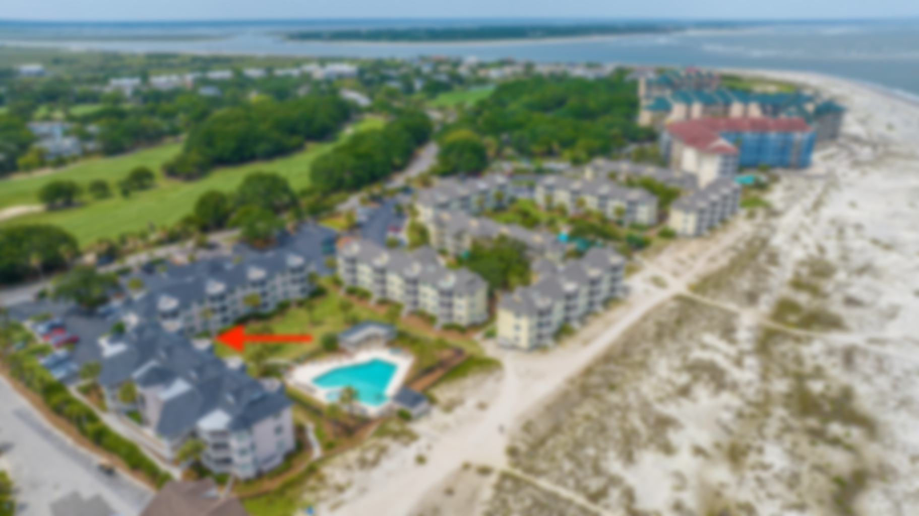
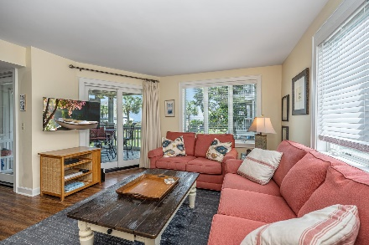
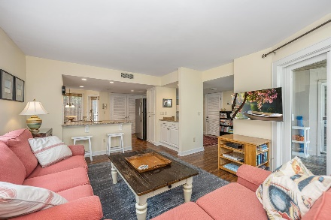
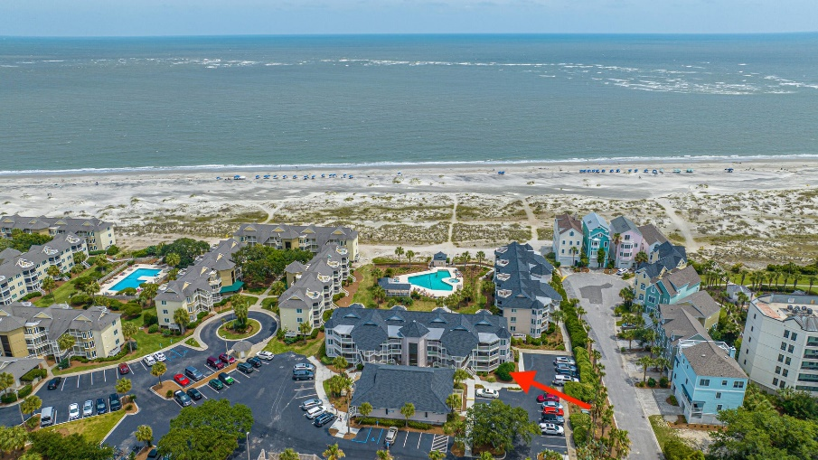
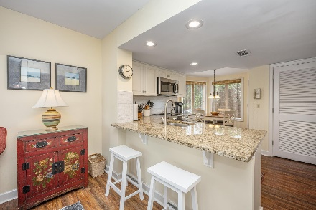
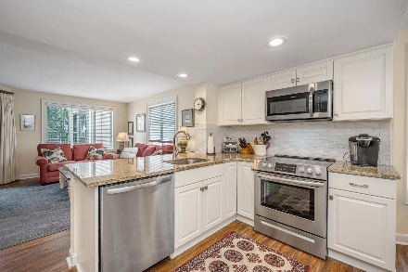
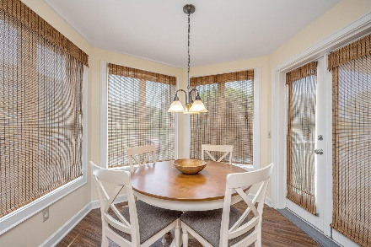
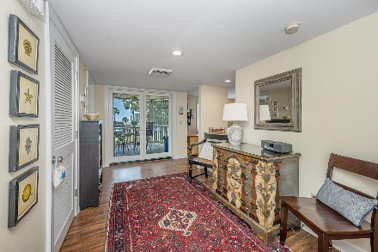
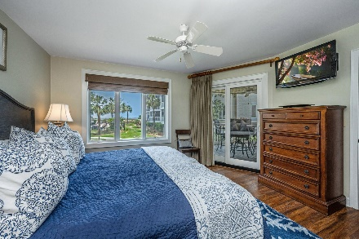
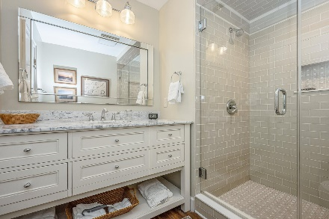
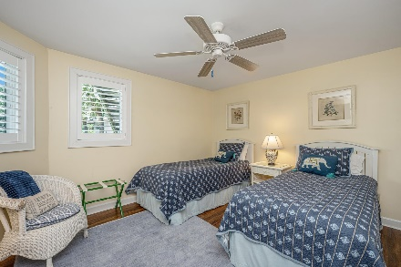
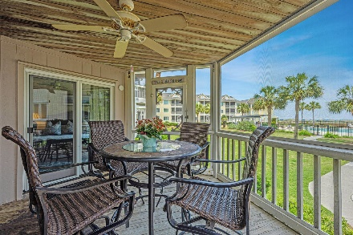

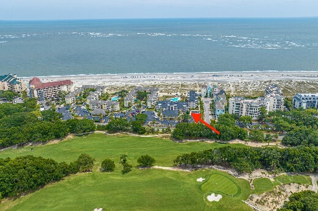
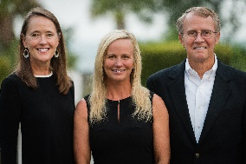

8500 Palmetto Drive H 101
Wild Dunes
Isle of Palms, SC 29451
MLS# 23013780 | $1,230,000
Motivated Seller
Ocean Front
Welcome to your little slice of paradise! Tidewater at Wild Dunes is located steps from the beach and provides turn key resort living. This bright & sunny condo offers a tastefully updated interior and open feel. A large foyer welcomes you and draws you into another world, one where tropical cocktails, beach walks, and poolside lounging are daily occurrences. A spacious, workable kitchen features granite countertops and stainless steel appliances, a breakfast bar open to the living area, and an eat-in dining nook. The living area is generously sized and offers glass doors to the screened-in porch, a place you'll love to sit and sip morning coffee or relax in the evening enjoying the sounds of ocean waves! Engineered, wood-look hard floors throughout make sandy feet clean up a breeze!
The primary bedroom offers access to the rear porch and an en-suite luxury bathroom. Updated and beautiful, the bathroom features a large custom glass tiled shower and furniture style vanity completed in soothing neutral tones and finishes. A second bedroom and a second bathroom offer plenty of space for guests and the bath is updated and well appointed. In unit washer and dryer are added conveniences. Owners & guests will be be sure to enjoy both the large pool and kiddie pool, cooking meals at the community gas grill, or lounging under a newly built pergola. This condo has direct beach access, with a short, approximately two minute walk from the screened porch to the sands and waves of the Atlantic Ocean. This property is ideal as a weekend getaway, full-time residence, or rental investment (with strong rental history). All of this and located in gated Wild Dunes on the Isle of Palms, one of Charleston's most coveted resort and residential developments. Ownership within this prestigious enclave provides access to championship golf, numerous on-site restaurants, miles of bike and walking paths, adjacent marina, and much more. Additionally, Wild Dunes is minutes from the world class dining and shopping of neighboring Sullivans Island, Mount Pleasant, and downtown historic Charleston.
Don Dawson
843-514-0452
ddawson@carolinaone.com
Carolina One Real Estate • 2713 Highway 17 North • Mount Pleasant, SC 29466
www.TeamDawsonSC.com

