Slide 1
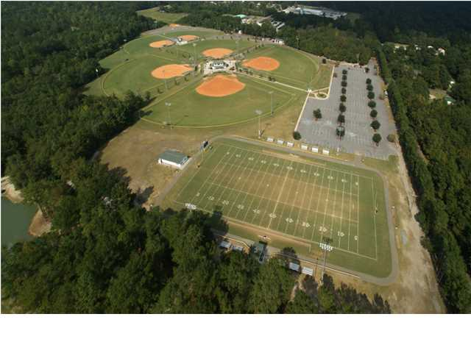
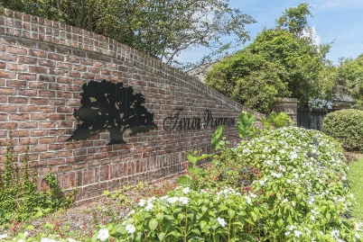
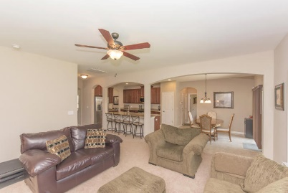
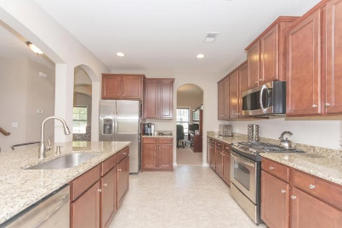
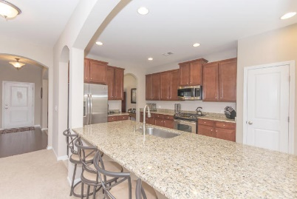
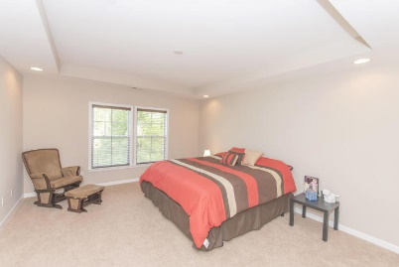
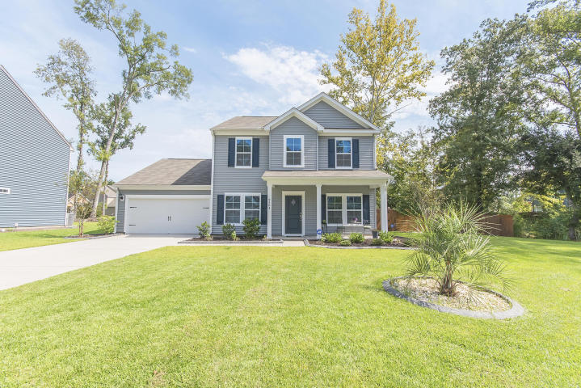
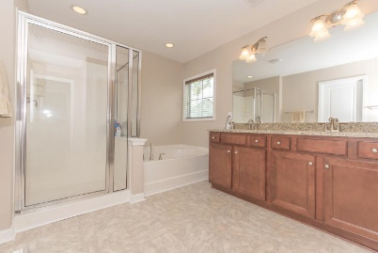
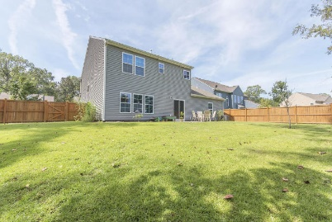


8504 Marsh Overlook
Taylor Plantation | North Charleston | MLS# 15022762 | $269,000
$10,000 Price Adjustment!
Seller Highly Motivated!
Priced to Sell! Gorgeous home on one of the best and largest cul-de-sac lots in the neighborhood. Beautifully appointed and in immaculate condition. Formals, Gourmet Kitchen w/ Tri-vection microwave oven, 42'' upgraded maple cabinets w/added moulding, single sink with upgraded fixture, granite counters in kitchen and all 3 bathrooms, Guest suite down, Master suite with boxed ceiling, plus 2 additional bedrooms and laundry room upstairs. Step outside to a patio and fully fenced yard. Pretty landscaping with decorative concrete borders in the front of the home along with an extra long driveway, great for additional parking. No neighbors on the right side of the home and easy access to the Riverside walking trail across the street. Additional upgrades include lighting, carpet, closet shelving, window casings, insulated interior walls, elongated commodes, attic storage and gutters.
View a virtual tour at www.8504marshoverlook.com
Beth Mandell
M 843-900-1296 | O 843-871-2121
bmandell@century21properties.com
www.bestcarolinahomedeals.com
Century 21 Properties Plus of Summerville | 118 W Richardson Ave | Summerville, SC 29483

