Slide 1
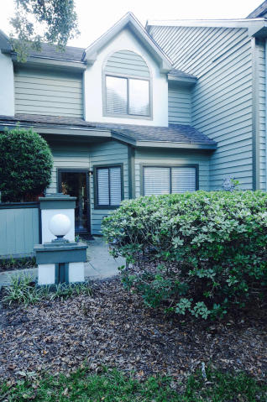
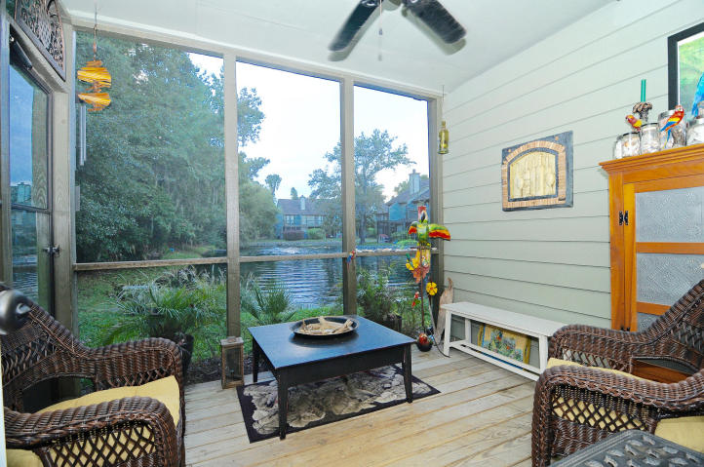
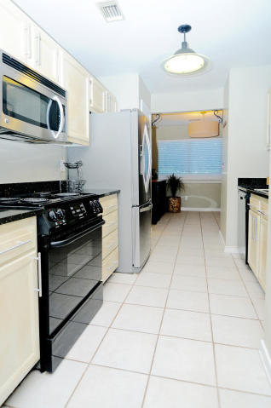
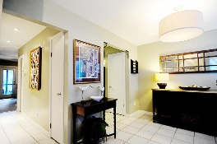
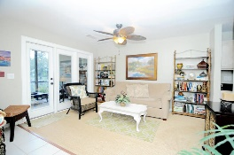
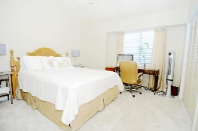
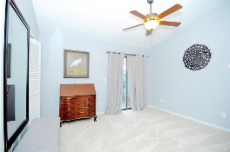
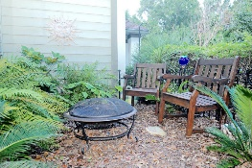
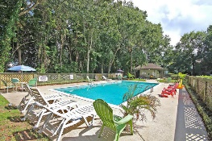
Great Amenities, Great Location, Great Price! 850 Ilex Court B ~ Waterford ~ Mt Pleasant MLS# 16025104 ~ $231,000
Charming townhouse centrally located in Mt Pleasant convenient to downtown, beaches and Towne Centre Shopping. Situated in a quiet neighborhood, this home features an updated kitchen with a stainless steel refrigerator, granite countertops, updated bathrooms, and a wood-burning fireplace.
Relax on the screened in porch overlooking the neighborhood pond, or on your own private deck off the master suite. This townhouse boasts ample storage space with double closets in the master, built-in cabinetry in the guest bedroom, and an additional storage closet off the screened in porch.
Trey Morrison
trey@landsouthofcharleston.com
Mobile 843-697-6849
Land South of Charleston, LLC | 409 King St | Charleston, SC 29403

