Slide 1
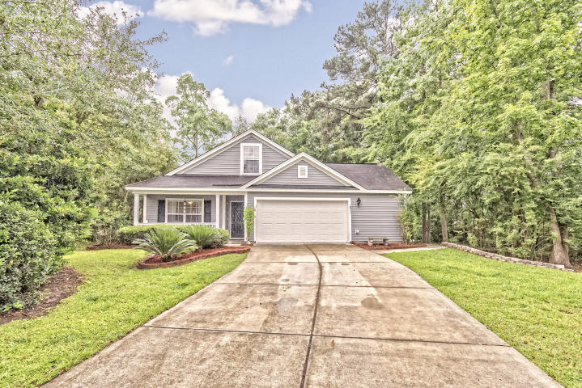
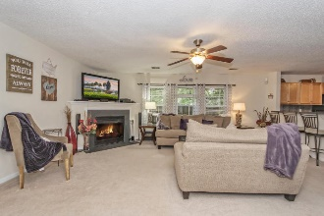
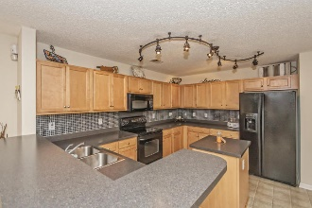
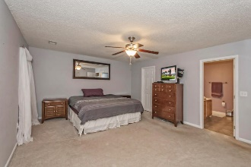
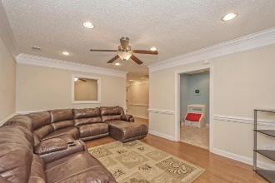
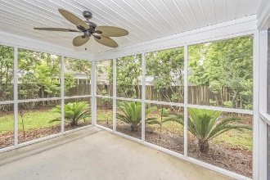
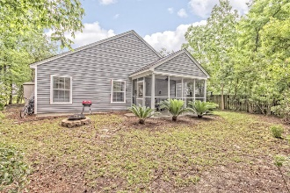

Agent Open House Luncheon October 14th From 12pm-2pm
Open House Saturday 12-3 Refreshments Provided
8511 Haley Court
Hollow Oaks :: North Charleston :: MLS# 16015031 :: $229,700
This was once the MODEL HOME. No other home like it on the market, This immaculate home has 4 bedrooms, 2 full baths and over 2800 square feet. The home has a finished heated and cooled garage. This room has a separate office as well as two other rooms that could be a mother-in-law suite or media room. The huge master suite is located in rear of home offering lots of privacy. The master bath has a separate shower and relaxing soaking tub as well as double vanity sinks. The kitchen is nice and open to the huge family room. The large 4th bedroom is located above the garage. This home is located on a huge private cul-da-sac lot with approximately 1/3 of an acre. Other great features include: upgraded appliance package featuring: Under Cabinet Lighting, microwave, dishwasher, kitchen island, maple cabinets and flat top stove; gas fireplace in family room; recessed lighting; upgraded carpets and flooring; screened in back porch; professionally landscaped yard.
Mike Hillman
Office 843-303-7455 | Cell 843-568-7475 info@coastlineps.com www.findhomesincharlestonsc.com
RE/MAX Advanced Realty
311 Johnnie Dodds Blvd Ste 181
Mt Pleasant, SC 29464

