Slide 1
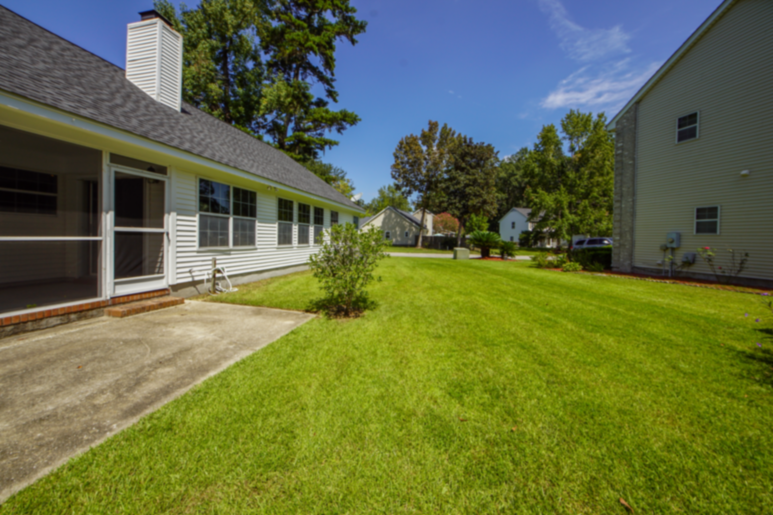
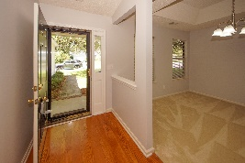
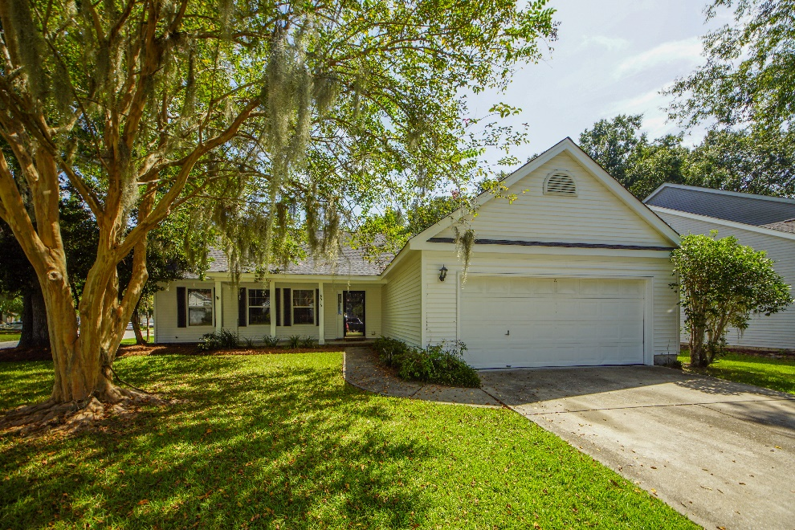
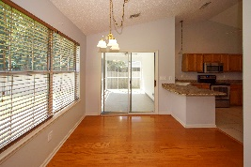
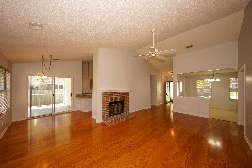
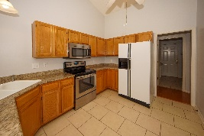
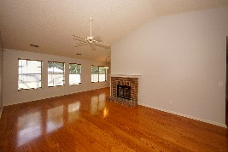
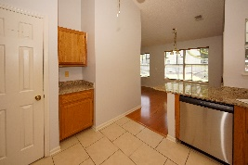
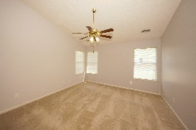
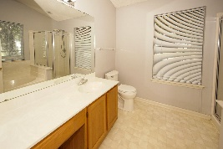
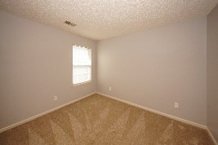
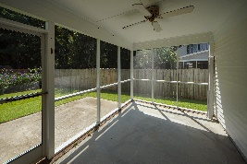
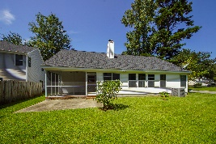


8515 Stonebridge Drive Whitehall | North Charleston, SC 29420 | MLS# 20026698 | $265,000
Custom home on beautiful lake!
Wonderful One-Story Home
In Conveniently Located Whitehall
Wonderful one-story home in the well established Whitehall subdivision. This lovely home welcomes you first with a front porch and then secondly with the beautiful wood floors. With an open floor plan and soaring vaulted ceilings, the home feels much bigger than you expect. There is a large kitchen with plenty of granite countertop space for meal preparation and attractive stainless appliances. The breakfast area is bright and sunny with lots of windows. The generous sized great room is a nice spot to entertain and has wood floors and a fireplace for those cool nights. The master retreat is large and offers plenty of furniture placement possibilities. The vaulted ceiling is another nice touch and gives the room a spacious feel! The master bath has a garden tub and separate stall shower. The two secondary bedrooms are good sized and have lots of natural light. The relaxing screened porch will be that favorite place to hang out with a cool beverage of choice and enjoy the outdoor views. There is an extra patio that is exactly what is needed for the grill-master in the family. Whitehall has lots of walking trails, community pool, tennis courts and is close to everything you need. Roof replaced in 2017, HVAC replaced 2016, water heater in 2018, and the kitchen appliances are approximately 1-2 yrs. old.
Gay Hartmann
M (843) 607-3400 | O (843) 871-9000 | F (843) 202-2958
ghartmann@carolinaone.com
Carolina One Real Estate | Summerville, Trolley Road Office | 1530 Old Trolley Rd | Summerville, SC 29485-8225

