Slide 1
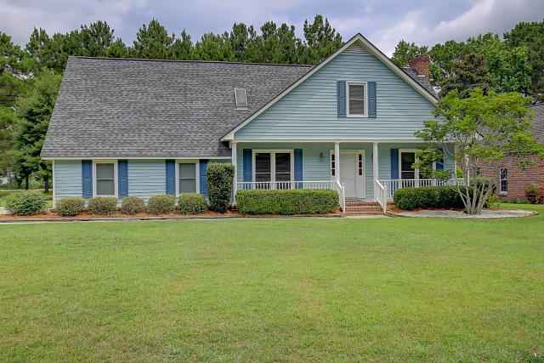
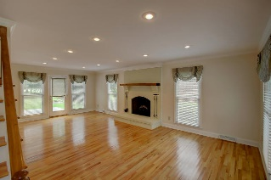
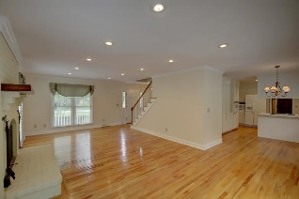
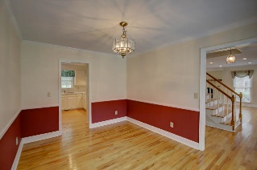
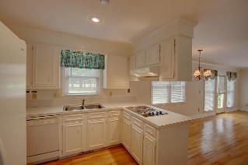
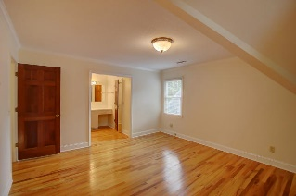
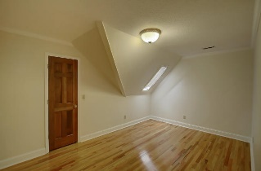
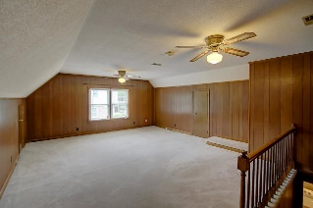
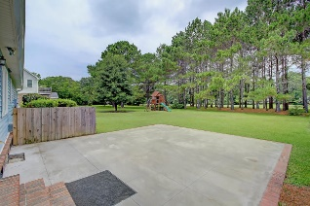
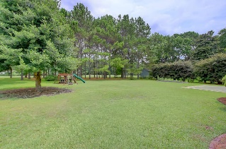
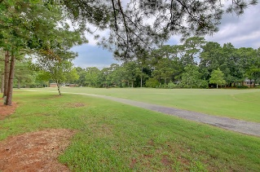


851 Law Lane Snee Farm ~ Mount Pleasant MLS# 16015433 ~ $500,000
Let’s talk incentives and motivation…
The owner has approved a $10,000 Up-fit Allowance with a ratified contract before August 31, 2016
Also, Check this out... He has added a $5,000 selling bonus for the agent that brings a ratified contract by August 31st, 2016...
So let’s Get to Work and Sell this Home...
Beautifully Maintained Home in Snee Farm on the Golf Course. Completely renovated in 2007, New Hardwood Floors up and downstairs. Brand New Hot Water heater, 2010 Roof, HVAC Upstairs unit Brand new Downstairs unit 07, Nice Large Lot, Master Bedroom has an additional room for storage or Baby Room. Great room with fireplace, Formal Dining room, Eat in Kitchen. Loads of storage in the 2 car garage. The crawl space has been enclosed and has 2 sump pumps The crawl space is Dry as Can be. ALL PART OF THE RENOVATION. THE OWNER REALLY TOOK CARE OF THIS HOME.
NICK COLLINS REALTOR, ABR
O (843) 266-5000 | M (843) 224-8771
ncollins@carolinaone.com
http://www.nickacollins.com
Carolina One Real Estate | 2713 Highway 17 North | Mt. Pleasant, SC 29466

