Slide 1
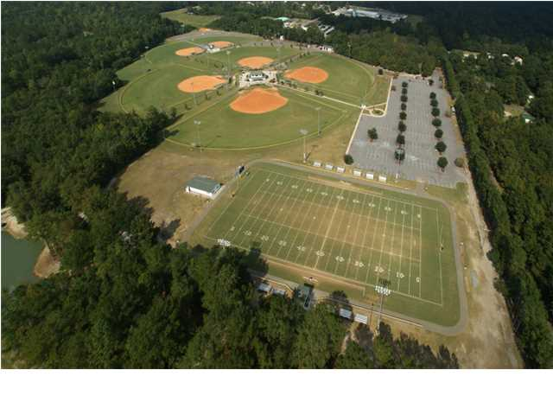
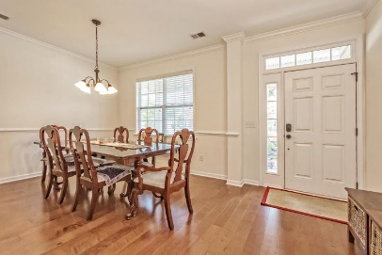
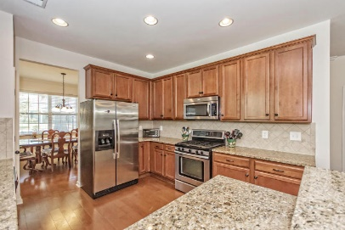
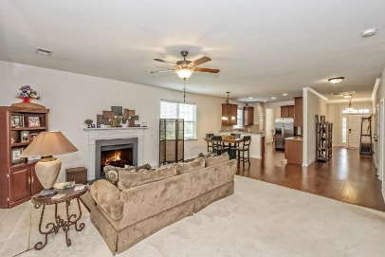
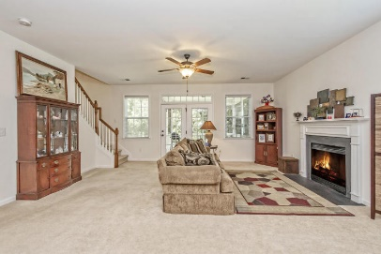
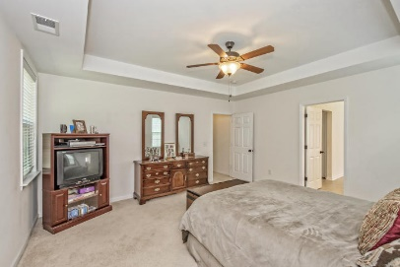
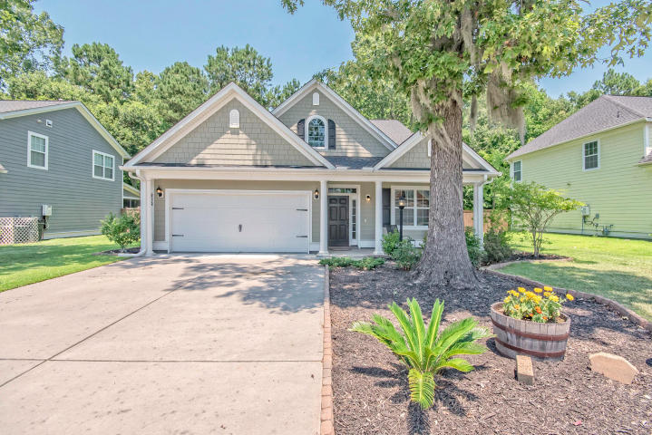
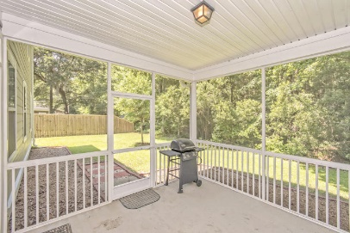
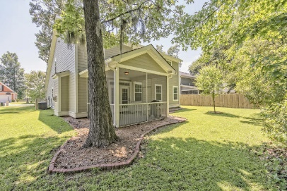


8528 Sentry Circle
Indigo Palms | North Charleston, SC 29420 | MLS# 16016902 | $279,000
Great home…
Bring all offers!
There is so much to love about this Earth Craft/Energy Star built home and neighborhood! The Cassidy Model offers an Open Plan with Master Suite down, Great Room w/Gas FP, Formal Dining Room, Hardwoods in Foyer, DR, Kitchen, Breakfast area and Powder Room. Kitchen has Granite, 42''cabinets and SS appliances including a Gas Range. Screen Porch overlooks Wooded Backyard.
Upstairs is a huge Loft and 3 additional Bedrooms and a Full Bath. Additional Walk-In Storage space can be finished off to add additional square footage. Just needs drywall, flooring and paint. Enjoy the Neighborhood Pool, minutes to Boeing, Bosch, Airport, Military Base, Shopping, Interstate, Downtown Charleston and 20 minutes to area Beaches.
Beth Mandell
M 843-900-1296 | O 843-871-2121
bmandell@century21properties.com
www.bestcarolinahomedeals.com
Century 21 Properties Plus of Summerville | 118 W Richardson Ave | Summerville, SC 29483

