Slide 1
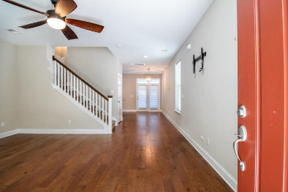
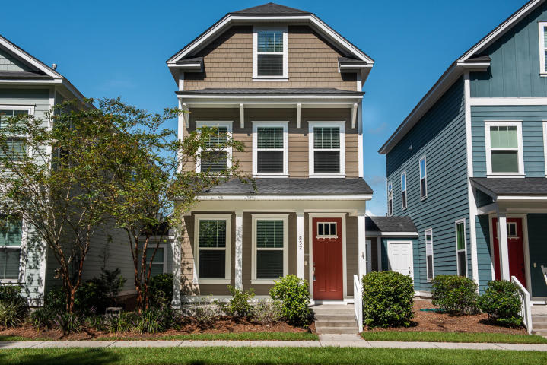
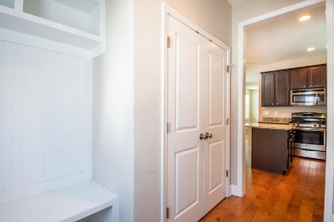
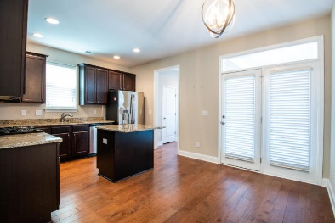
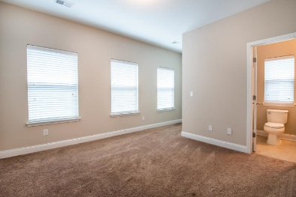
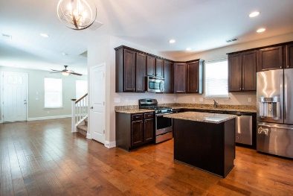
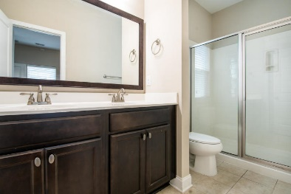
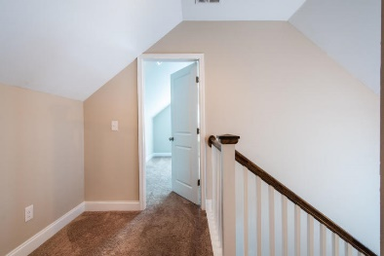
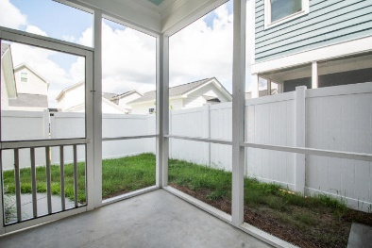
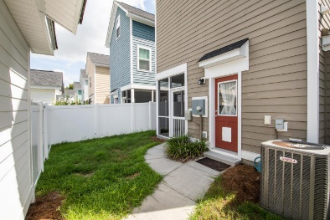
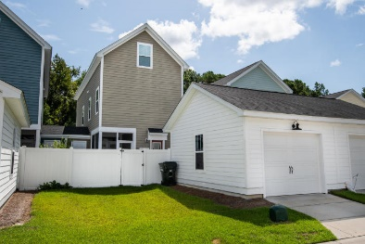


852 Rue Drive
Charleston, SC 29414
MLS# 19022676 :: $289,000
Great Buy in Grand Oaks Plantation
Beautiful 3 story plan with 3 bedrooms and 3 bathrooms upstairs plus a half bath on the first floor. The home has many special features including hard wood floors on the first level, 9 ft ceilings, granite counter-tops in the kitchen and stainless steel appliances, recessed lighting in the kitchen and a kitchen island.
The spacious bedroom on the 3rd floor provides much privacy and could be used as a home office, a guest suite or a recreation area. The home also features a full front porch, a rear screened porch and a 2 car garage plus 2 separate storage rooms.
Carolina One Real Estate
1503 Palm Blvd
Isle of Palms, SC 29451
Bill Donovan
Office - (843) 242-3018
Mobile - (843) 991-0146
donovans@carolinaone.com
Carolina One Real Estate
1503 Palm Blvd
Isle of Palms, SC 29451-2280
www.billdonovan.com

