Slide 1
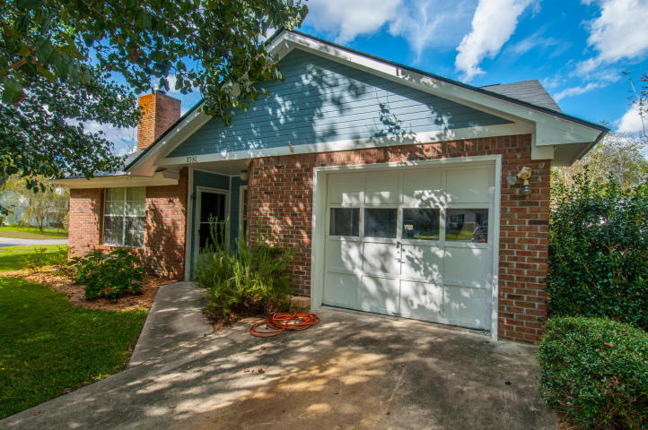
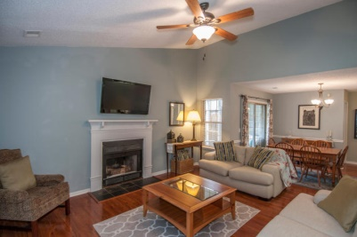
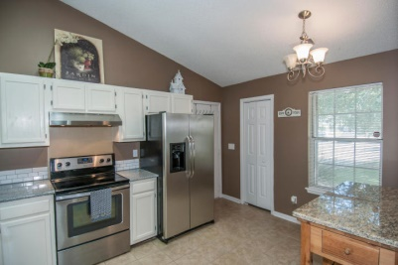
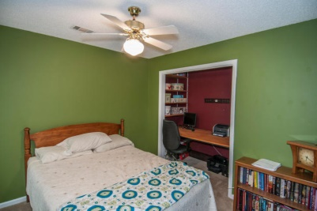
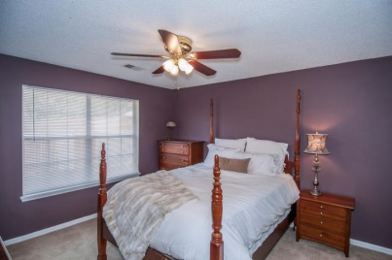
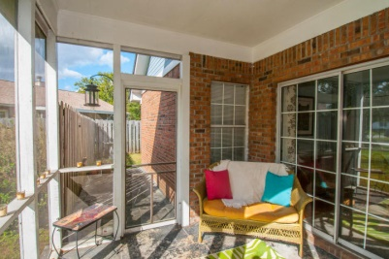
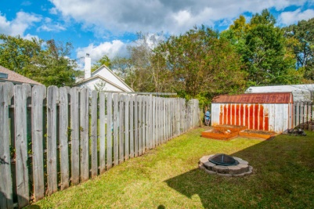


Hidden Gem
8530 Bentwood Drive
Northwoods Estates - North Charleston - MLS# 14027755 - $130,000
This three bedroom, two full bath home is conveniently located in North Charleston, boasting easy access to major highways and the airport.
An easy drive to downtown Charleston and the Battery, enjoy the proximity of the Coliseum, shopping, restaurants, and the lovely riverways of Charleston, South Carolina.
If charm and potential in one of Charleston's most ideal communities is what you're looking for, look no further.
Del Shaffer
843.408.6821
dshaffer@carolinaoneplus.com

