Slide 1

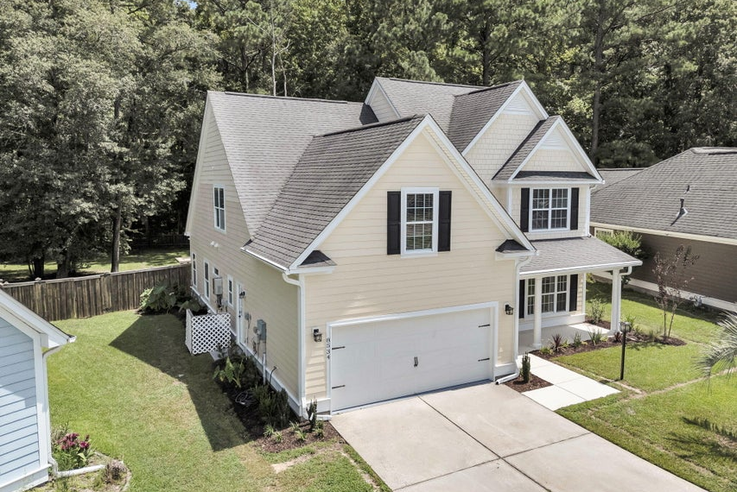
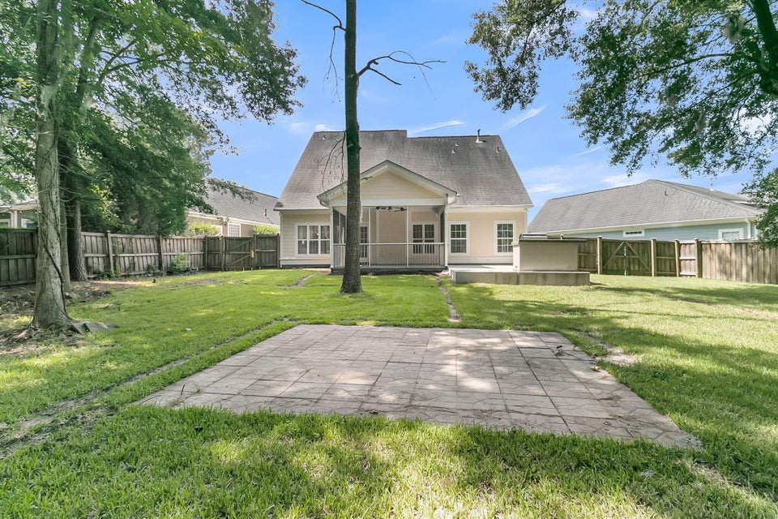
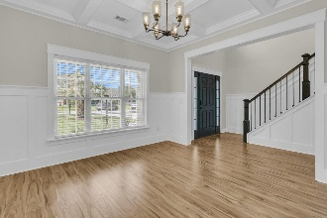
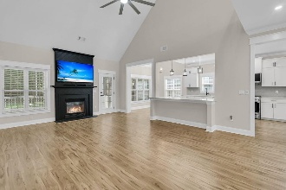
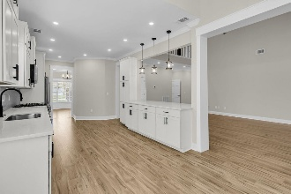
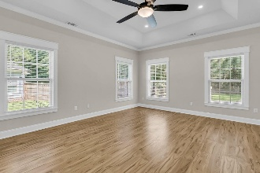
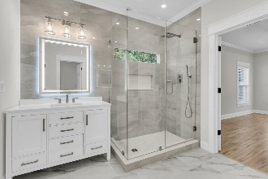

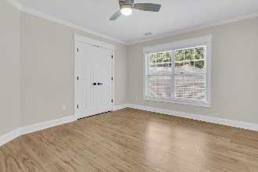
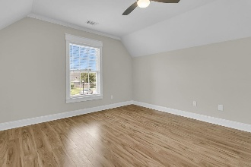
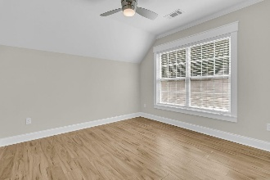
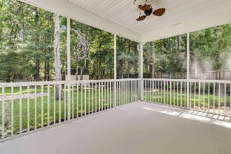
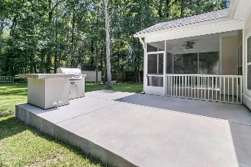
Fully Renovated &
Newly Priced
Debbie Cromer
ABR, RSPS, REALTOR, CRS
(843) 437-6342
debbie@debbiecromer.com
www.debbiecromer.com
8534 Sentry Circle
Indigo Palms | North Charleston, SC 29420 | MLS# 25020253 | $529,999
Get ready to fall in love w/ this completely renovated 5-bedroom, 3.5-bath beauty in the heart of Indigo Palms! Sitting on over a 1/3-acre fenced lot that backs to a peaceful wooded area, this home offers privacy, space, & style all in one. Inside, you'll find a light-filled open floor plan w/ a vaulted ceiling in the living room & a stunning coffered ceiling in the dining room—perfect for everything from casual dinners to festive gatherings. The kitchen is a dream—fully updated w/ sleek new cabinets, countertops, extensive storage, & upgraded stainless steel appliances—ideal for both everyday living & weekend entertaining. Every bathroom has been beautifully redone w/ fresh tile, new tubs & showers, updated vanities, faucets, & fixtures. The reimagined luxury primary suite on the main floor includes a large walk-in closet & a spa-like bath that feels like your own personal retreat. Throughout the home, you'll love the all-new flooring, updated trim, stylish recessed lighting, & ceiling fans in every bedroom & the living room. A convenient first-floor laundry room & attached 2-car garage add ease to your daily routine. Step outside to relax or entertain on your brand-new 15' x 20' concrete patio, or unwind on the screened-in porch overlooking your private backyard oasis. The home also features a new Rannai tankless hot water heater & a brand-new full-yard irrigation system to keep your lawn looking its best year-round. Washer & dryer plus a 65" TV over the fireplace all convey! Located in the highly rated DD2 school district & just minutes from Bosch, Boeing, Joint Base Charleston, shopping, restaurants, & more - this one checks all the boxes. Welcome home!
ZILLOW VIRTUAL TOUR | PROPERTY WEBSITE
Century 21 Properties Plus | 1090 Park West Blvd; Ste 103 | Mount Pleasant, SC 29466

