Slide 1
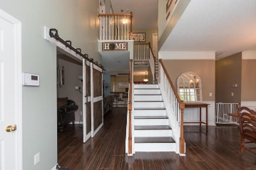
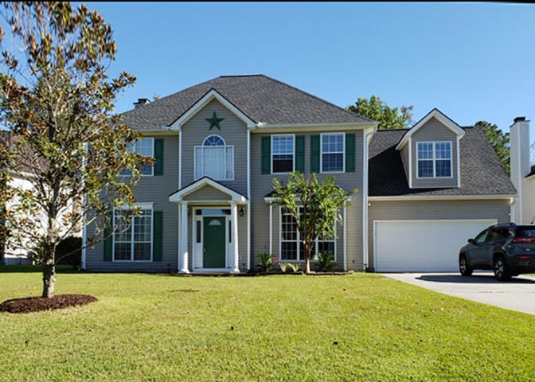
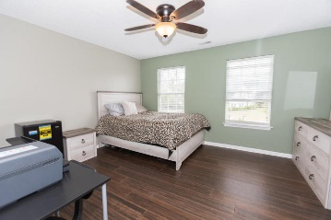
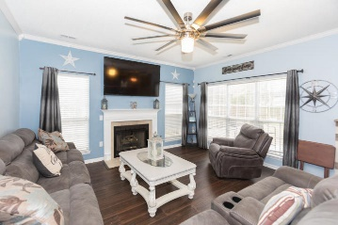
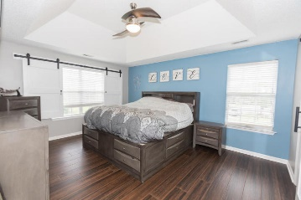
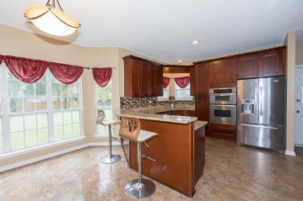
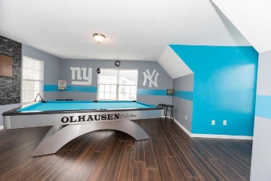


Price Reduced! Must See!!
8539 Kennestone Lane
Whitehall · North Charleston, SC 29420
MLS# 19029514 · Reduced to $299,000
Beautiful 5 bedroom, 2.5 bath home on corner lot in Whitehall. Gorgeous new hardwood floors throughout. 10 ft ceilings downstairs. Large family room with gas fireplace and wet bar. Eat in kitchen has been completely remodeled with new cabinetry, granite counter tops and stainless steel appliances. Dual stair case and nice sized office space. Large master suite with newly remodeled master bath with walk in shower. 4 additional spacious bedrooms and bath upstairs. 5th bedroom is room above garage. Big yard with privacy fence. Brand new roof!! New tankless water heater!! Downstairs HVAC replaced 2016 and upstairs condenser replaced 2019. Convenient to schools, shopping, restaurants, Boeing, AFB and airport. Must see!!
Michael Dew
O 843-769-5100
M 843-870-7000
michaeledew@gmail.com
www.michaeldewrealestate.com
AgentOwned Charleston Group
902 Savannah Hwy
Charleston, SC 29407
Real Estate ● Mortgage
Insurance ● Business Brokerage

