Slide 1
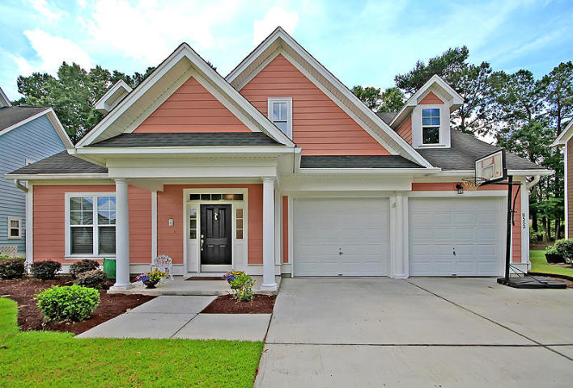
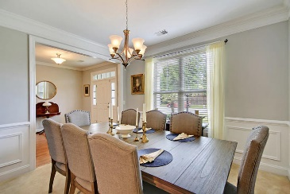
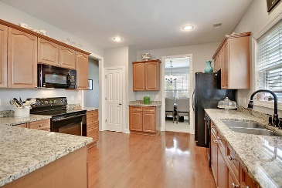
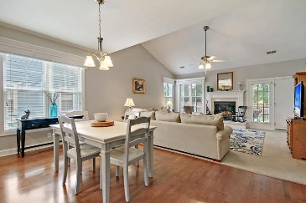
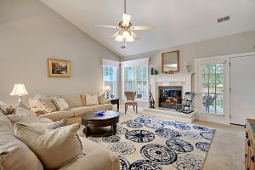
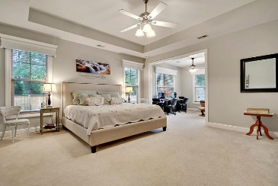
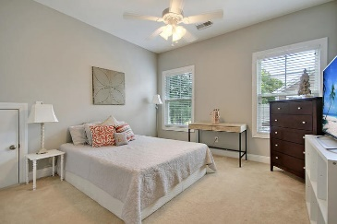
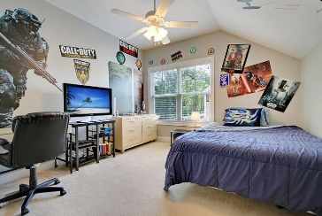
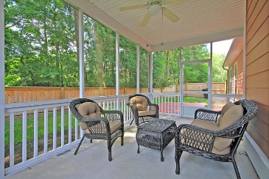

8553 Royal Palms Lane
Indigo Palms ~ N Charleston ~ MLS# 19013422 ~ $285,000
New Low Price in Indigo Palms!
New Listing in Nexton
BEAUTIFUL Charleston Craftsman's Style 3bed/2.5bath home, over 2500 sqft, in Dorchester II schools, private fenced backyard and STUNNING curb appeal! True foyer introduces a formal dining room with wainscoting, crown molding, and an abundance of natural light. Open floor plan features wood floors throughout common living areas. CHEF INSPIRED GOURMET kitchen is upgraded with maple cabinets, recessed lighting, pantry, and granite countertops. The kitchen is open to the family room with soaring ceilings and gas fireplace. Master bedroom suite is located downstairs and features a sitting area which could also be used as a private study or nursery, ensuite SPA-LIKE master bath with TWO HUGE walk-in closets, PLUS a linen closet, tile floors, separate dual vanities, RELAXING SOAKING tub and separate shower. Navy blue wood tread stairs lead you up to the second floor where there are two additional nicely sized bedrooms, one with an oversized walk-in closet. Both bedrooms share a full bath. Also on the second floor is a large walk-in attic storage area. The private fenced backyard is perfect for entertaining family and friends while sitting in the oversized 11x18 screen porch. Indigo Palms is a wonderful neighborhood with a convenient location close to schools, shopping, golf, restaurants, Boeing, Bosch, Volvo, CAFB, interstate access and just 15 mins to downtown. Plenty of amenities including sidewalks, Jr Olympic pool, playing field, and Pavilion. Call today-this home will not last long!
Stan Huff
843-670-2835
stan.huff@agentowned.com
Jill Marcacci
843-297-5590
jill@agentowned.com
www.agentownedrealty.com
AgentOwned Realty Co. Preferred Group, Inc. | 824 Johnnie Dodds Blvd | Mt Pleasant, SC 29464

