Slide 1
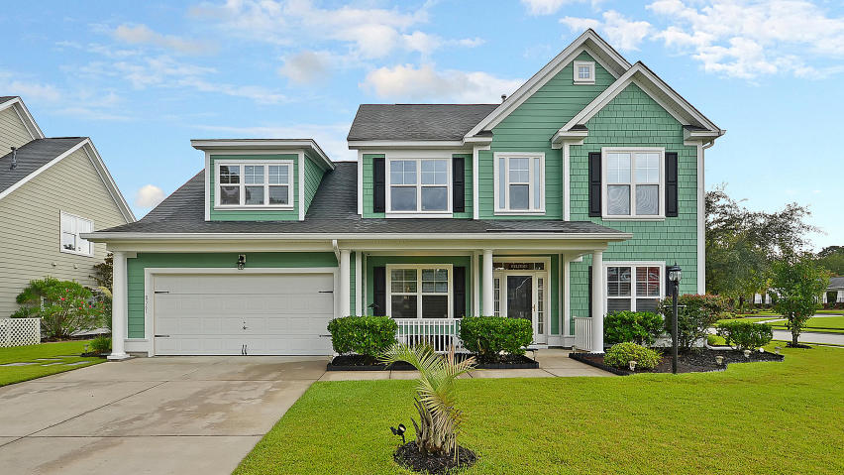
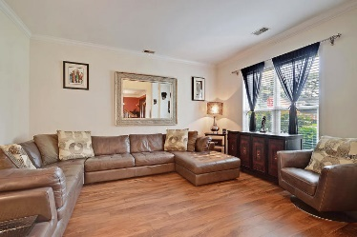
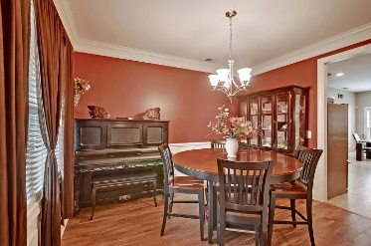
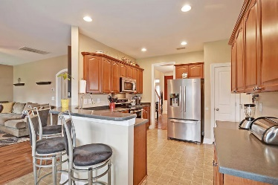
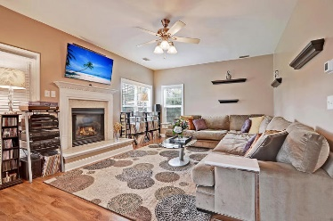
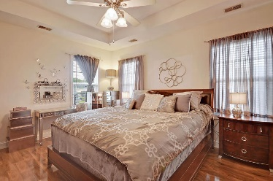
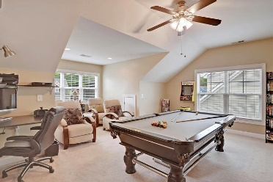
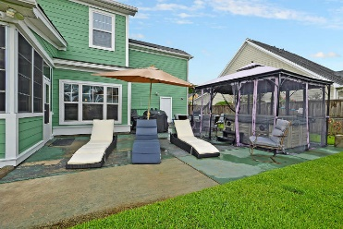
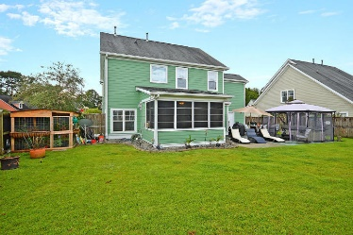

8561 Sentry Circle Indigo Palms · North Charleston, SC 29420 MLS# 20023604 · $315,000
Just Listed ~ Fantastic Home for
Gardening or Entertaining!
Gorgeous Listing
Neighborhood Pool an is across the street. STUNNING 4 bedroom, 2.5 bath home with GORGEOUS CURB APPEAL w/professional landscaping, and covered front porch ideal for rocking chairs, HUGE fenced backyard with large patio including hot tub and an awesome green house to plant vegetables, herbs, and flowers year round-this home really is a GARDENER'S HAVEN AND ENTERTAIN'S DREAM! Upon entering the home you are greeted with a grand foyer, handsome floors, crown molding, and an abundance of natural light. To the right is a large living room/flex room and to the left is a nicely sized formal dining room. Continuing in is the chef-inspired kitchen with stainless steel appliances, breakfast bar with seating for 4, 42" cabinets, tons of counter space, TWO PANTRIES, and eat-in area w/loads of windows. family room w/room for a large section couch and has a beautiful gas fireplace w/mantle. The second floor has the primary bedroom suite wth trey ceilings, spa-like bath with relaxing soaking tub, separate shower, dual sink vanity, and BIG walk-in closet w/added custom shelving! Also upstairs is a massive bonus room (4th bedroom) that has room for a billiards table and theater seating! In addition, there are two additional nicely sized bedrooms that share a full bath. Heading out back there is a 4 season room that that could have multiple uses and leads to the immense fenced backyard with large patio perfect for grilling and entertaining family and friends and has a hot tub just right for unwinding after a hard day, spacious yard, and garden area with greenhouse. Indigo Palms is a wonderfully landscaped community with a play park, and community pool that is right across the street! The neighborhood is close to local shopping and grocery stores and is a short drive to downtown Charleston with 5-star restaurants, world class shopping and iconic history as well as a short drive to the beaches, the airport, Boeing and Daniel Island. Come take a look because you will not find another home that offers as much as this one: a gardener's delight and entertainer's dream!
Take a video tour: https://vimeo.com/451979447
Stan Huff
843-670-2835 stan.huff@agentowned.com
Jill Marcacci
843-297-5590 jill@agentowned.com
www.agentownedrealty.com
AgentOwned Realty Co. Preferred Group, Inc. | 824 Johnnie Dodds Blvd | Mt Pleasant, SC 29464

