Slide 1
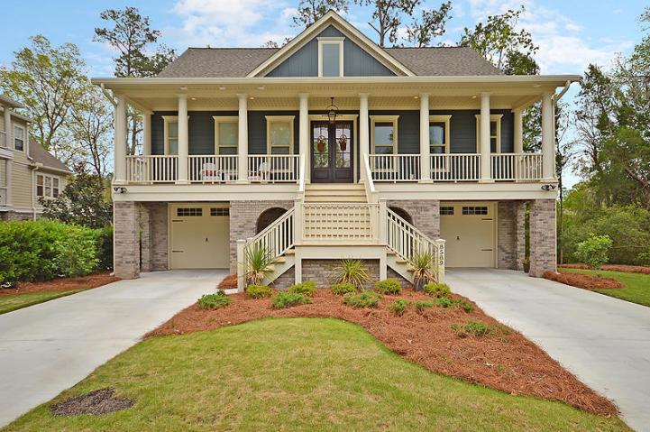
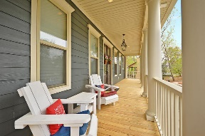
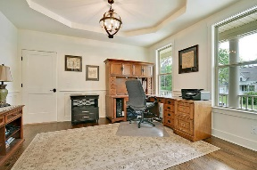
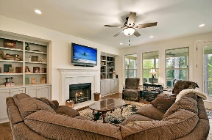
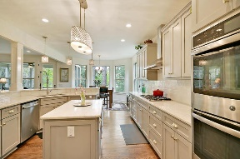
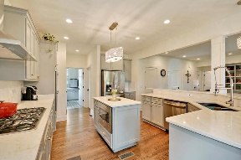
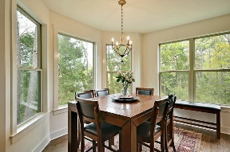
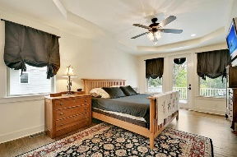
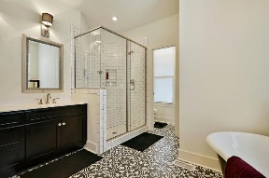
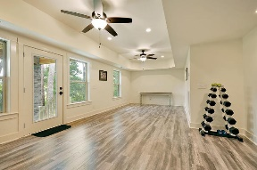
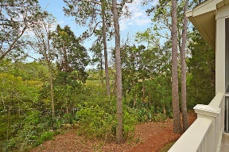
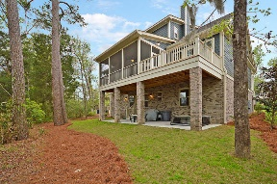
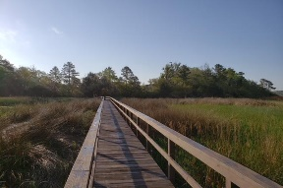


Ashley River Views With Mother In Law Suite
8589 Refuge Point Circle
The Refuge at Whitehall
North Charleston, SC 29420
MLS# 18009459
$599,000
5 Bedrooms | 4½ Baths | 3,896 sf
Get ready to be impressed! Nothing was left out in this gorgeous marsh front property home. You will immediately fall in love at first sight! Curb appeal galore, and located next to the community play park as well as the community dock access. Talk about convenience. The full front porch is very welcoming with a gorgeous gas lantern and plenty of space for chairs. Upon entering the home you'll immediately be wowed! The dining room is a great size with shaker wainscoting. Down the hall is a large family room/great room with built in cabinetry and a wood burning fireplace. Open to the family room is the dream kitchen. This stunning kitchen is perfect for entertaining with a breakfast bar and large eat in area. The marble countertops, double wall ovens, gas cooktop, shaker cabinets and island are a chef's delight! This kitchen is something out of a magazine! Off the kitchen is the laundry room with gorgeous tile work, tons of cabinet and counter space and a separate sink. On the main floor, you'll also find the master bedroom which has access to the back deck. The master bathroom has an oversized shower with a touch screen control for water temperature and a stunning cast iron claw foot tub. There are two walk in closets and exquisite tile work. Upstairs on the third floor there are three great sized bedrooms. One bedroom has its own full bath and the other two bedrooms share a jack and jill bath. There are very spacious closets plus dual walk in attic space for additional storage. Back down to the ground floor you'll find awesome flex space that can be a mother in law suite, game room, man cave, you name it! There is a bedroom along with a full bath, a wet bar with cabinetry that can easily be turned in to a kitchenette and access to a covered patio out back. This home has it all! Natural gas grill hookup on back patio, in ground sprinkler system, 3 separate HVAC systems, one for each floor, ethernet in each bedroom and tankless hot water heater. Conveniently located close to Boeing, Bosch, AFB, Airport and Palmetto Commerce Park. In the Dorchester District 2 schools as well! Come see this house today!
Larry & Kathy Mazalatis
Larry Cell 843-693-0529
Kathy Cell 843-693-0159
Office 843-871-9133
AGENTOWNED PREMIERE GROUP | 1800 TROLLEY RD | SUMMERVILLE, SC 29485

