Slide 1
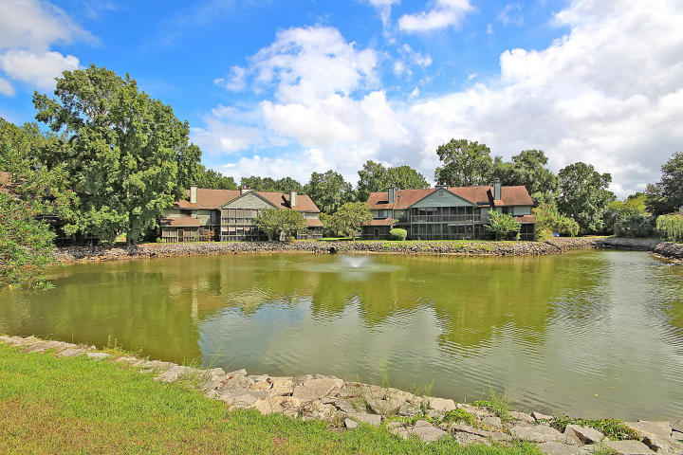
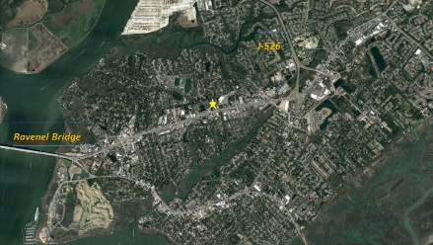
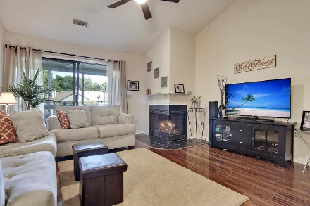
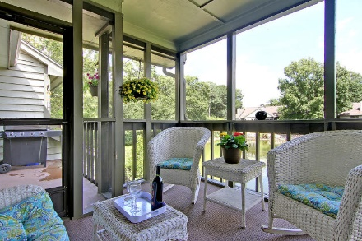
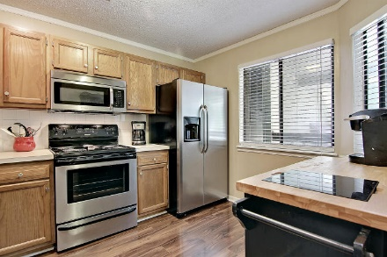
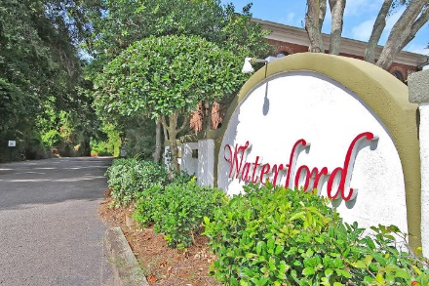
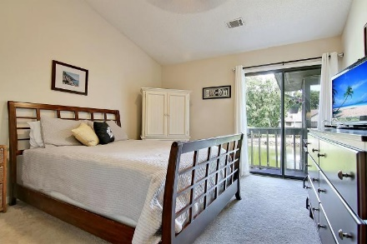
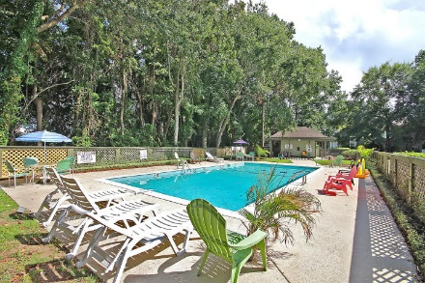
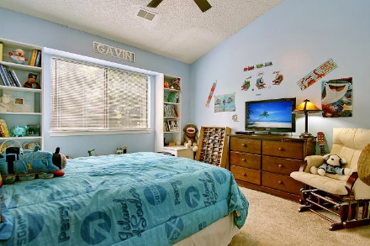
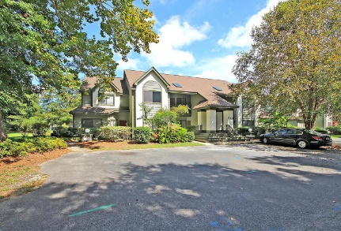
Close to it all…
$500 Agent Bonus At Closing
With Acceptable Offer!
859 Sandlake Drive E
Waterford ~ Mount Pleasant ~ MLS# 16023626 ~ $209,500
The Waterford community in Mt Pleasant is one with which you’ll immediately fall in love for its convenient location to everything & natural beauty found throughout.
This 2nd floor condo offers 2BR, 2BA, high ceilings & gorgeous views of the pond and water feature from the screened-in porch & deck. The open floor plan features gleaming, laminate hardwood floors, a wood burning fireplace in the living room & the kitchen which has SS appliances & a breakfast bar. Both bedrooms have vaulted ceilings & the master has an en-suite bath, two closets & a sliding door to the deck.
The community has a nature walking trail & a sparkling swimming pool. You’ll enjoy maintenance-free living, a very walk-able neighborhood, & close proximity to shopping, dining, beaches and downtown! VA approved condo.
Terry Bell-Aby terry@mattoneillteam.com (508) 627-2988

