Slide 1
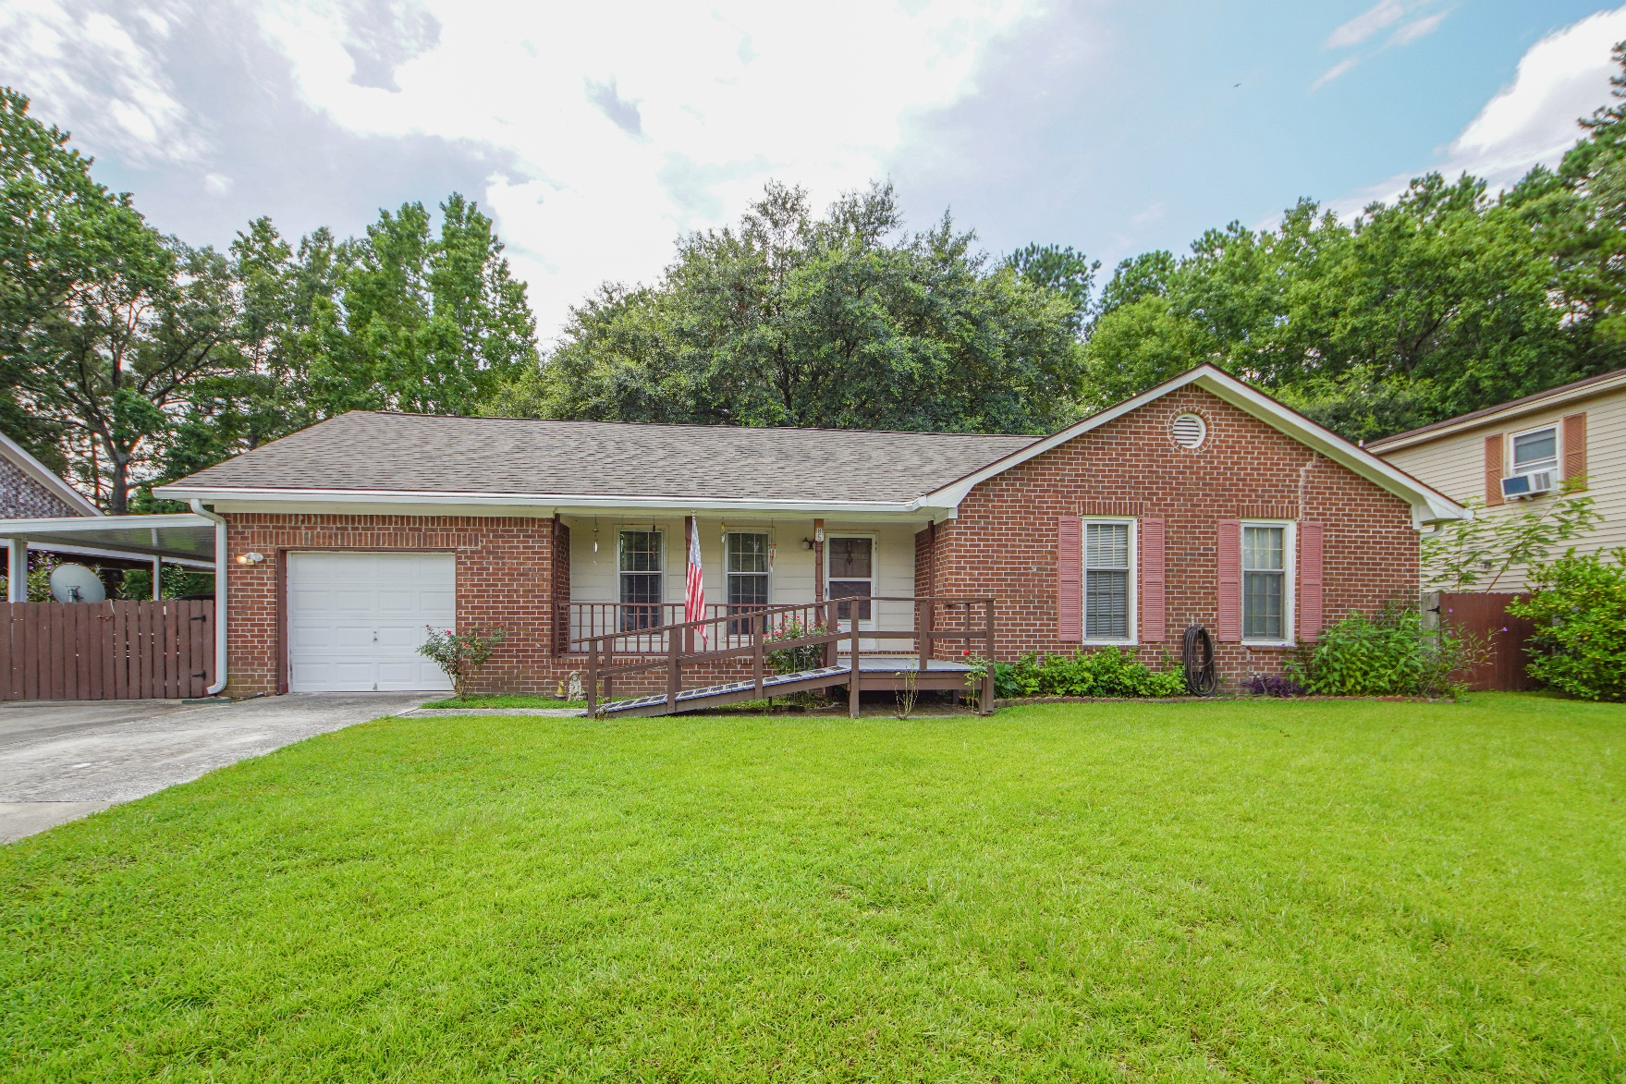
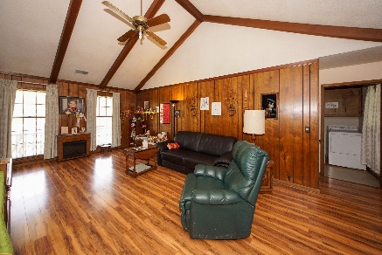
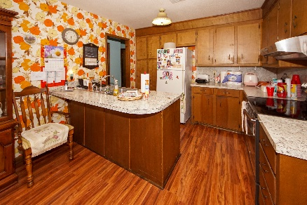
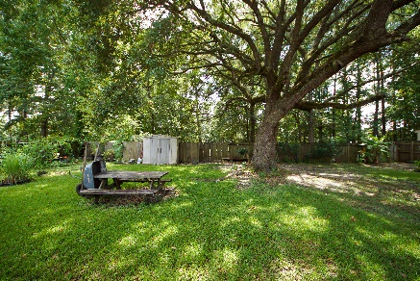


85 Lighthouse Drive
Goose Creek, SC 29445
MLS# 19021673 :: $185,000
3 Bed / 2 Bath
New Price in Harbour Lake
Price Drop!
Well maintained 3 bedrooms 2 bath home in Harbour Lake. Family room has a fire place and the kitchen is spacious with island. Bonus room over the garage is currently used for storage but could be finished for extra living space.
Back yard is over sized and the children's play park is located behind the fence. Roof was installed in 2012, HVAC installed 2009 and leaf guard gutter system was installed in 2016.
Vintage is our theme but this home has was well cared for and maintained by the seller. List of items purchased and the year they were purchased with documents.
Connie White, Broker
843-532-3356
connie@chrepros.com · conniewhiterealestate.com
Charleston Homes · 597 Old Mt. Holly Road · Suite 301 · Goose Creek, SC 29445

