Slide 1
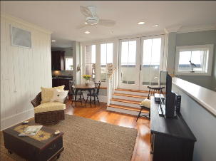
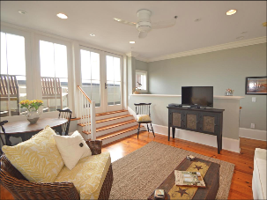
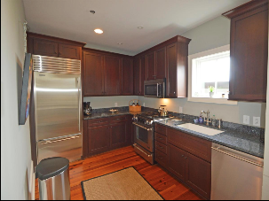
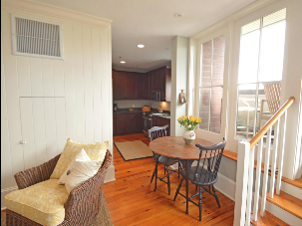
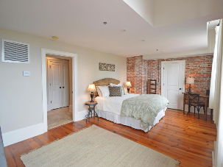


Penthouse Pocket Listing Downtown
Penthouse #21 in 85 Cumberland Street
1 bed | 1.5 baths | 861 sqft | $599,000
Stunning condo with private balcony boasting views of St. Philip's Steeple and Downtown Charleston.
Please email me at bwalsh@carolinaone.com with any interest
Thank you,
Brian
Brian Walsh
(843) 754-2089 | bwalsh@carolinaone.com
www.carolinaonerealestate.com/brianwalsh
Carolina One Real Estate | 49 Broad St | Charleston, SC 29401

