Slide 1
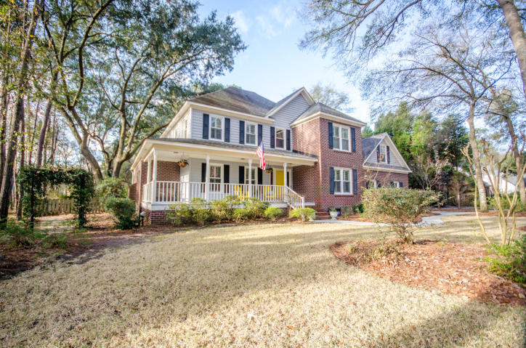
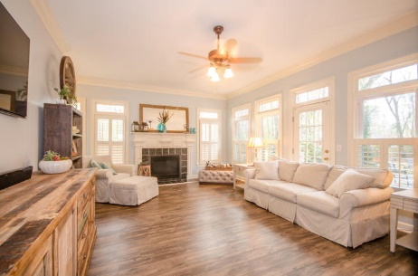
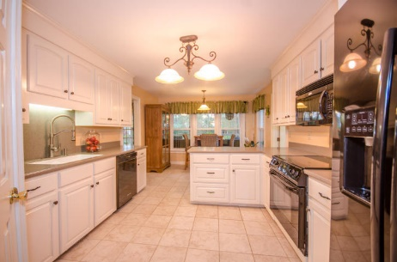
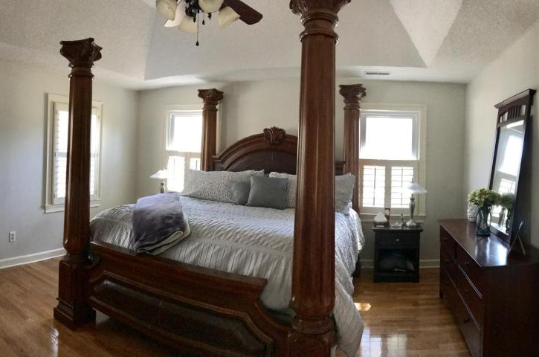
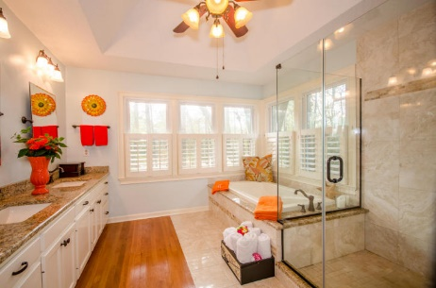
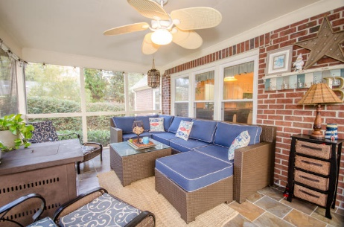
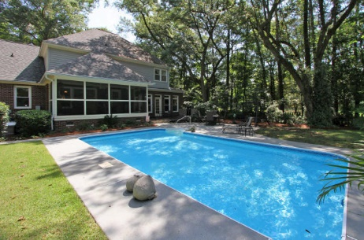


PRICE ADJUSTED!
$50 Gas Card Drawing
8603 W Fairway Woods Drive
Coosaw Creek Country Club ~ Charleston, SC 29420
MLS# 17001083 ~ $420,000
Beautiful home for entertaining and gracious living! Set on a wooded, private lot, walk up onto the huge front porch and into the foyer. To the left is the office; to the right is the dining room. Follow that into the eat-in kitchen. Head down into the large family room with a fireplace, or head out onto the screened porch. The patio with built-in grill is down two step and leads you to a beautiful in-ground salt water pool, great for those private summertime swims. Of course there's a separate laundry room off of the kitchen. Upstairs there's a sizeable master with a luxuriously appointed bath. Three bedrooms, huge bonus room to use for a media room or bedroom. This is a wonderful neighborhood with a mandatory private golf, pool, dinner club. AHS home warranty provided.
Susan Woodworth Kraber
Mobile - (843) 779-9655
susankraber1@gmail.com
ERA Wilder Realty, 125-F Wappoo Creek Dr, Charleston, SC 29412

