Slide 1
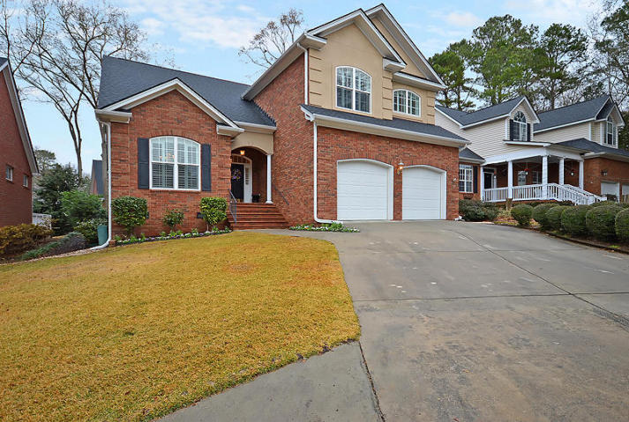
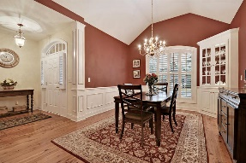
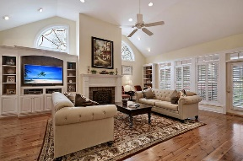
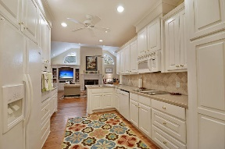
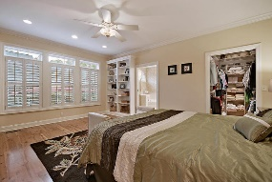
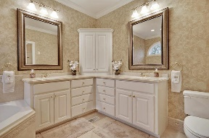
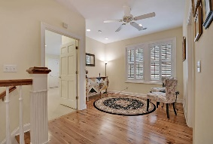
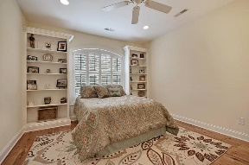
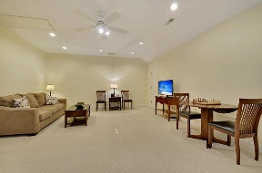
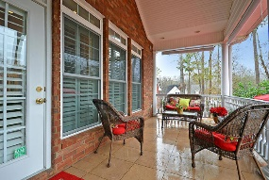
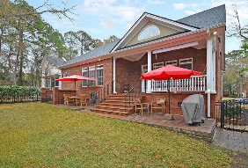
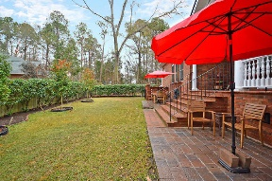



Gated Golf Community Beauty!
8605 Fox Hollow Rd
Coosaw Creek Country Club
North Charleston, SC 29420
MLS# 18000918
$369,900
4 Bedrooms | 2½ Baths | 2,920 sf
This is a wow house! Located in the gated community of Coosaw Creek Country Club, this house has been very well maintained and was built by an excellent custom builder as his own home so it's loaded with extras! Walk in and notice the gorgeous Australian cypress flooring! To your left, the dining area offers a chair rail with wainscoting below, cathedral ceiling and a built in china cabinet with glass doors. The family room has a gas fireplace, built in entertainment center and bookcases. Plantation shutters are on most windows! The kitchen has plenty of cabinet space and a pantry with built in adjustable shelves. Laundry room and half bath both with pocket doors. The downstairs master bedroom also has wood floors with a walk in closet, sitting area with book case, and a great master bath!
Dual vanity, whirlpool tub as well as shower stall. Upstairs you'll find two bedrooms both offering wood floors, walk in closets and built in bookcases. The upstairs full bath has a dual vanity, skylight and cast iron separate tub. Bedroom #4 can be used as a bedroom or bonus room. It has two walk in closets as well as attic walk in storage. This home was built by a builder as his own personal home and has all the bells and whistles including impact windows. Built above SPEC!! It is a must see in Coosaw Creek! The neighborhood has 24 hour 7 day a week gated security, unlimited golf for all household members, and the location, wow...close to it all! Boeing, Bosch, AFB, Mercedes are all a short drive away. Come live the good life in a golf course community that has tons of activities and events, great food in the restaurant, great community pool with an award winning swim team, and the most beautiful golf course you'll ever play on!
Larry & Kathy Mazalatis
Larry Cell 843-693-0529
Kathy Cell 843-693-0159
Office 843-871-9133
AGENTOWNED PREMIERE GROUP | 1800 TROLLEY RD | SUMMERVILLE, SC 29485

