Slide 1
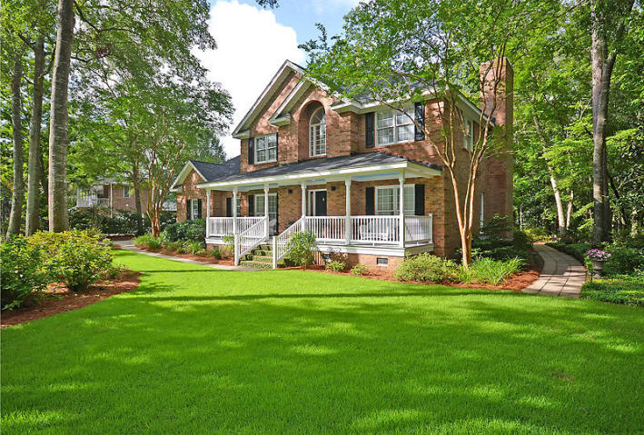
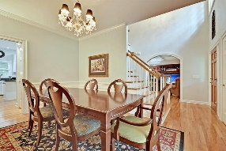
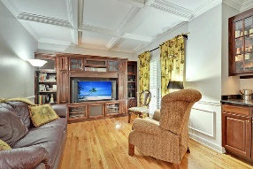
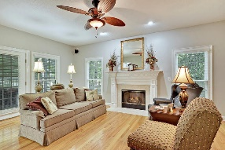
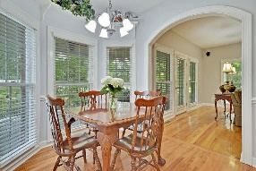
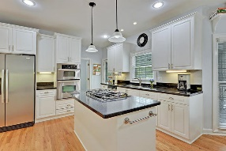
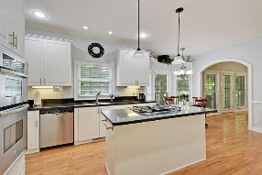
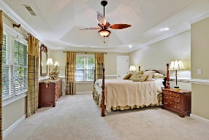
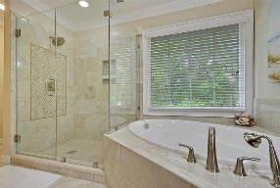
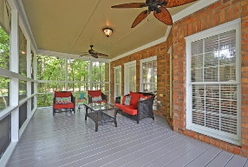
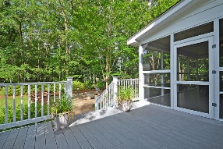
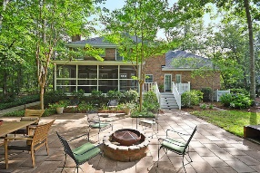



Gated Community Beauty!!!
8607 Arthur Hills Cir
Coosaw Creek Country Club
North Charleston, SC 29420
MLS# 17018030
$379,000
4 Bedrooms | 2½ Baths | 3,000 sf
Get ready to be impressed with this beautiful home that has been well taken care of! You'll immediately be wowed by the curb appeal, the well manicured lawn, gorgeous landscaping and great front porch! Upon entering, you'll quickly notice the beautiful wood floors! To your right, is a great office/formal living room with a coffered ceiling and bar. To your left, a large dining room, perfect for entertaining. The back of the home is the kitchen open to the family room. The kitchen has an island with a gas cook top, wall oven, built in microwave and eat in area. Both the family room and kitchen overlook the gorgeous outdoor living area. There's a huge screened in porch, a deck for your grill, then a stunning patio are with a fire pit. This all surrounded by a private wooded buffer! You're own little paradise! Back in the home, head upstairs and find the large master bedroom with a completely renovated master bath! You'll fall in love with the dual vanities, custom cabinetry, separate tub, huge shower and walk in closet. Down the hall, two more large bedrooms, one with built ins. At the end of the hall, you'll find a full bathroom and a fourth bedroom or bonus room. Off this room is tons of attic/storage space as well as a small office. This small office space can easily be turned in to another full bath. Don't miss out on this home! It is move in ready!!
The neighborhood has 24 hour 7 day a week gated security, unlimited golf for all household members, and the location, wow...close to it all! Boeing, Bosch, AFB, Mercedes are all a short drive away. Come live the good life in a golf course community that has tons of activities and events, great food in the restaurant, great community pool with an award winning swim team, and the most beautiful golf course you'll ever play on!
Larry & Kathy Mazalatis
Larry Cell 843-693-0529
Kathy Cell 843-693-0159
Office 843-871-9133
AGENTOWNED PREMIERE GROUP | 1800 TROLLEY RD | SUMMERVILLE, SC 29485

