Slide 1
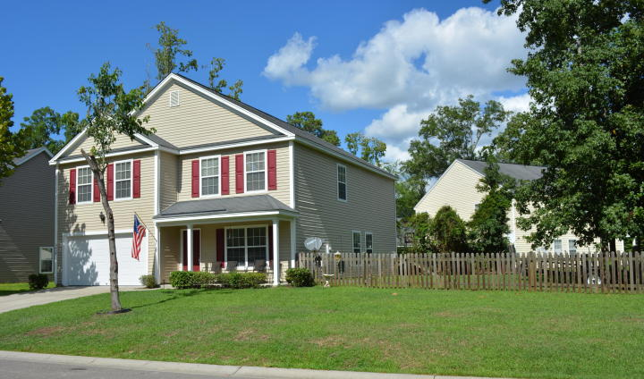
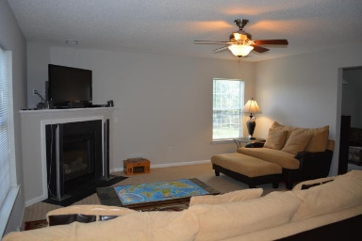
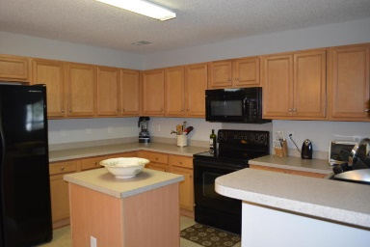
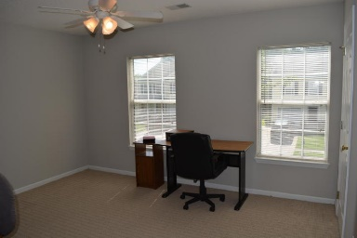
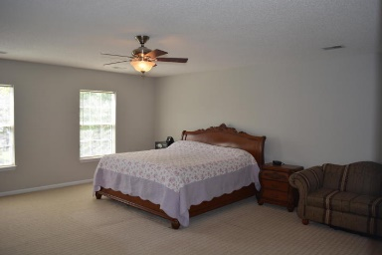
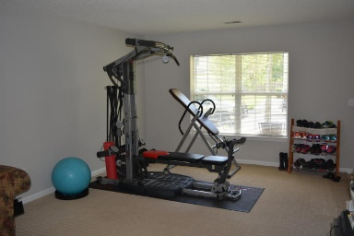
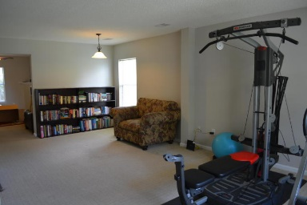
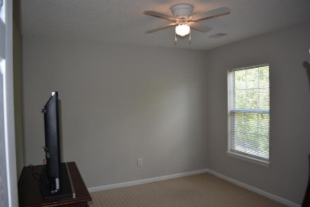


Price Reduced!
8608 Chloe Lane
Hollow Oaks ~ North Charleston
MLS# 16020135 ~ $212,900
Beazer's Washington floor plan boast LARGE rooms with over 2,600 sqft. Two story home with 4 bedrooms, 2.5 bath and 2 car garage. Downstairs has open kitchen and living room with breakfast area, separate dining and flex space. Upstairs find a 18' x 19'8'' master suite with ceiling fan, walk in closet, dual vanities and separate tub and shower. Large loft area is perfect space for play room and wired for surround sound. 3 additional rooms upstairs all with ceiling fans and walk in closets.
Custom built shed in back matches home. You must see to appreciate the great use of space this home offers. Situated on a large corner lot with .24 acres, fenced. 2 HVAC units have just been updated a few months ago. Home has just been painted throughout the inside and ready for new owners!
Jennifer Frampton Pait
843-568-9509
jenniferfp@carolinaone.com

