Slide 1
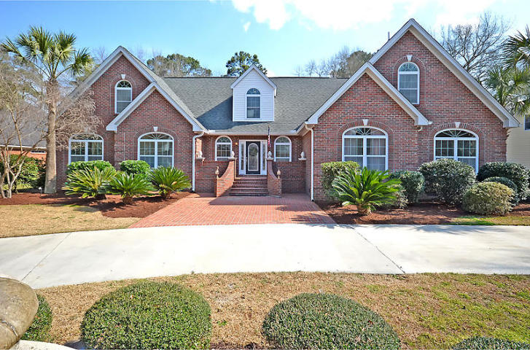
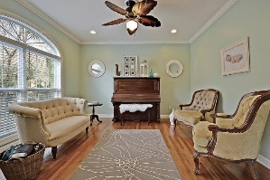
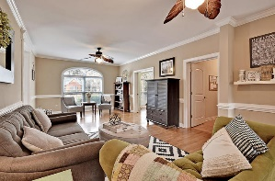
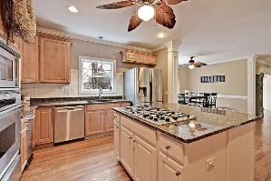
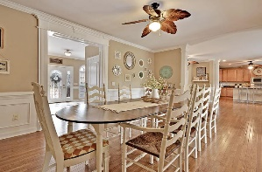
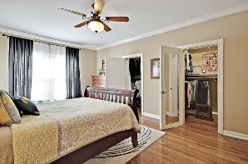
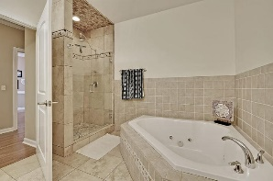
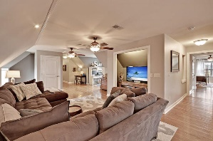
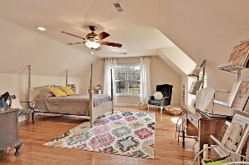
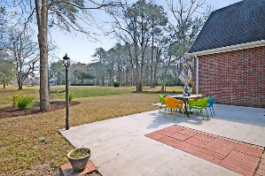
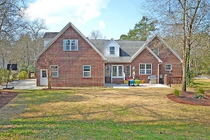
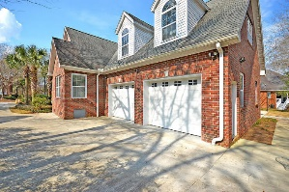



Coosaw Creek Beauty
8610 W Fairway Woods Dr
Coosaw Creek Country Club
North Charleston, SC 29420
MLS# 16006254
$525,000
6 Bedrooms | 5½ Baths | 5,755 sf
In IMMACULATE condition, this home offers beautiful golf course views down the 16th fairway from behind the tee box. Enjoy the excellent view without your home being struck by golf balls! This huge 5,755 SF. custom, brick home offers 6 bedrooms, 5.5 bathrooms, two family / living rooms (one upstairs and one downstairs) as well as an office, sunroom, dining room and much more!
The 1st floor features beautiful hardwood floors and tile foyer, 3 bedrooms (including a downstairs master suite), 2.5 bathrooms, family room, executive office, dining room, sunroom and an awesome kitchen with granite counters, custom cabinetry, HUGE pantry, stainless appliances and an eat-in- kitchen area. The 2nd floor offers 3 bedrooms, 3 bathrooms, LARGE family room or bonus room as well as its own upstairs laundry room. The home also features a back patio, lawn irrigation and professional landscaping, plenty of storage, circular driveway, 400 amp electrical service, Rinnai tankless hot water system and low utility bills.
Coosaw Creek offers an excellent clubhouse with restaurant and bar, neighborhood pool, tennis courts as well as an excellent golf course. Planned events and meals in the very active clubhouse are common and country club members enjoy the numerous monthly golf events offered within this private gated community!
Larry & Kathy Mazalatis
Larry Cell 843-693-0529
Kathy Cell 843-693-0159
Office 843-871-9133
AGENTOWNED PREMIERE GROUP | 1800 TROLLEY RD | SUMMERVILLE, SC 29485

